Slide 1

Alabama Commission on Higher Education
Commission Meeting
March 10, 2023

Slide 2


CALL TO ORDER, PRAYER, AND PLEDGE OF ALLEGIANCE

Slide 3

II. ROLL CALL and
QUORUM DETERMINATION

Slide 4

III. APPROVAL OF AGENDA
Commission Meeting Agenda
of March 10, 2023

Slide 5

IV. CONSIDERATION OF MINUTES
Commission Meeting Agenda
of December 9, 2022

Slide 6

V. CHAIRMAN’S REPORT

Slide 7

VI. EXECUTIVE DIRECTOR’S REPORT

Slide 8

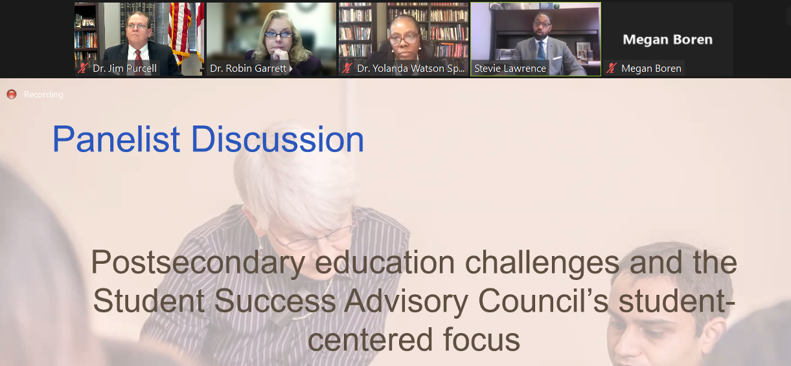
Alabama representation on the Student Success Advisory Council:
Jim Purcell, Executive Director, AL Commission on Higher Education
Cynthia Anthony, President, Lawson State Community College
Taffye Benson-Clayton, Associate Provost and Vice President for Inclusion and Diversity, Auburn University,

Slide 9
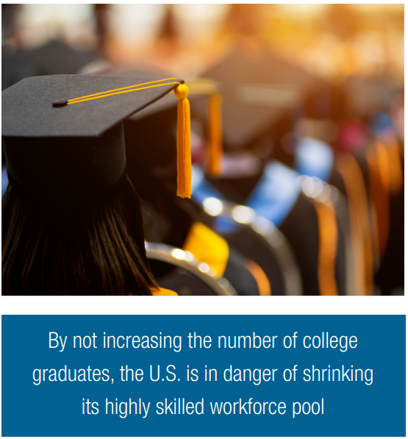
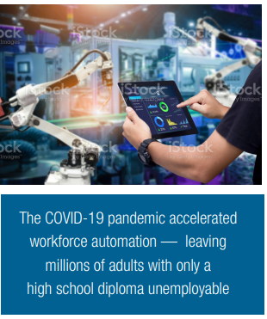
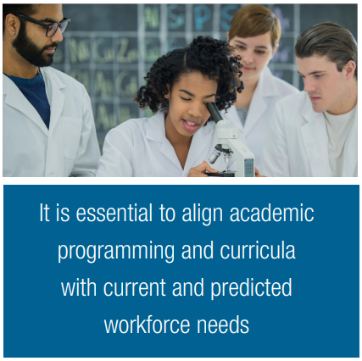



Slide 10
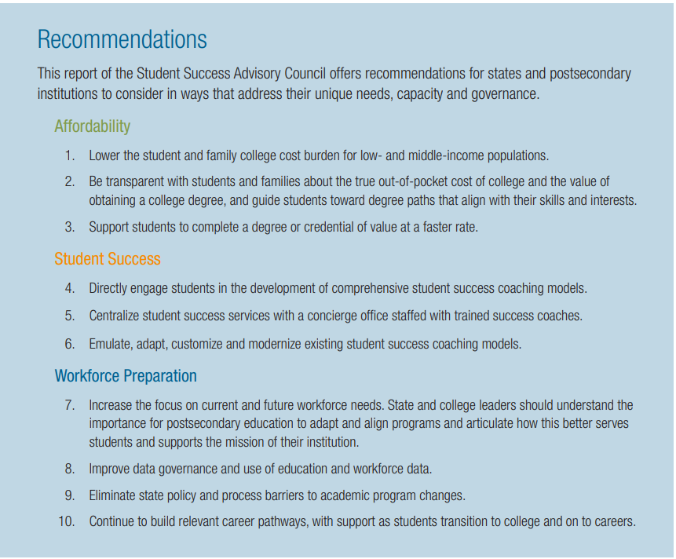

Slide 11

Realizing Education and Workforce Challenges Facing Alabama and Its Workforce and Regions
Dr. Patrick Kelly
Assistant Director of Workforce Alignment Alabama Commission on Higher Education
Dr. Jim Purcell
Executive Director
Alabama Commission on Higher Education

Slide 12
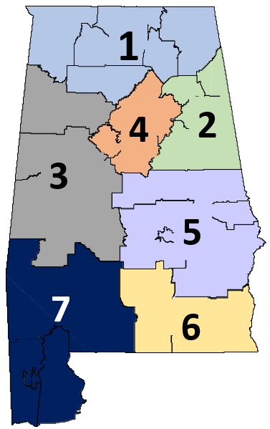
Alabama Workforce Regions
Alabama
Region 1
U.S. Quartiles
Less Need
U.S. Median
Most Need
Overall Education and Workforce Need
4
5
1
1
2
7
6
3
Education Need
4
1
7
3
6
2
5
High School Completion Only
4
1
5
7
3
6
2
Associate Degree Completion
6
4
1
2
7
7
3
5
Completion of a Bachelor's Degree or Higher
4
1
5
7
3
6
2
College Attainment of Young vs Older Adults
2
3
7
4
1
6
5
7
Enrollment of Young Adults without a College Degree
4
1
7
6
5
3
2
Workforce Need
5
1
2
7
6
4
3
7
Labor Force Participation
4
1
5
6
7
2
3
Unemployment
1
7
4
2
5
6
3
Employment in Volatile Industries
5
7
1
6
4
2
3
Median Annual Wage Earnings for Full-Time Workers
5
2
1
6
7
4
3
Personal Income
5
2
1
6
7
3
4
Working-Age Adults with SSI or Welfare Income
5
2
6
1
7
4
3

Slide 13

Alabama Workforce Regions
1
4
2
3
5
7
6

Slide 14
Public Use Microdata Areas (PUMAs)
North Alabama Workforce Region
Public Use Microdata Areas
Counties
Huntsville (North) &
Madison (East) Cities
Limestone & Madison (Outer)
Counties – Huntsville City
Lauderdale
Limestone
Colbert
Limestone
Madison
Jackson
DeKalb &
Jackson Counties
Colbert
Lawrence
Huntsville City
(Central & South)
Franklin
Morgan
DeKalb
Lauderdale, Colbert,
Franklin, &
Marion (Northeast)
Counties
Marshall
DeKalb
Cullman
Cullman
Cherokee
Marion
Winston
Etowah
Cherokee
Morgan & Lawrence Counties
– Decatur City
Marshall & Madison
(Outer) Counties – Huntsville City
(Far West &
Southwest)
Blount
Etowah
Lamar
Walker
St. Clair
Calhoun
Fayette
Jefferson
Cleburne
Cleburne
Pickens
Tuscaloosa
Shelby
Talladega
Randolph
Clay
Cullman & Winston Counties
Clay
Bibb
Coosa
Chambers
Greene
Greene
Chilton
Tallapoosa
Hale
Perry
Tallapoosa
Sumter
Autauga
Elmore
Lee
Marengo
Dallas
Macon
Russell
Choctaw
Marengo
Montgomery
Choctaw
Lowndes
Bullock
Wilcox
Wilcox
Butler
Barbour
Clarke
Butler
Crenshaw
Pike
Clarke
Monroe
Monroe
Henry
Washington
Conecuh
Coffee
Dale
Conecuh
Covington
Escambia
Houston
Geneva
Houston
Baldwin
Mobile
Baldwin

Slide 15
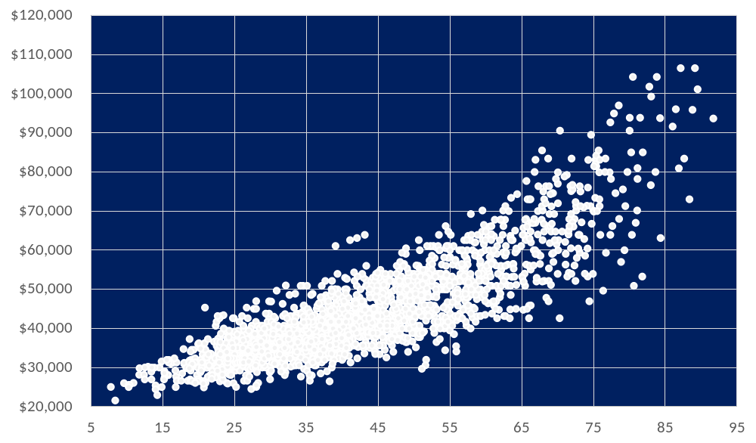
United States Public Use Microdata Areas
Annual Wage Earnings Relative to the Percentage with a College Degree
DeKalb & Jackson Counties
Cullman & Winston Counties
Lauderdale, Colbert, Franklin, & Marion (Northeast) Counties
Morgan & Lawrence Counties – Decatur City
Marshall & Madison (Outer) Counties – Huntsville City (Far West & Southwest)
Limestone & Madison (Outer) Counties – Huntsville City
Huntsville City (Central & South)
Huntsville (North) & Madison (East) Cities
United States
Median Annual Wage Earnings for Full-Time Workers
6
3
3
4
7
1
2
Percent of Adults Ages 25 to 64 with College Degrees
U.S. Census Bureau, 2019 American Community Survey 5-year PUMS (Public Use Microdata Sample).
Steven Ruggles, Sarah Flood, Sophia Foster, Ronald Goeken, Jose Pacas, Megan Schouweiler and Matthew Sobek. IPUMS USA: Version 11.0 [dataset]. Minneapolis, MN: IPUMS, 2021. https://doi.org/10.18128/D010.V11.0

Slide 16
United States Public Use Microdata Areas
Annual Wage Earnings Relative to the Percentage with a College Degree
DeKalb & Jackson Counties
Cullman & Winston Counties
Lauderdale, Colbert, Franklin, & Marion (Northeast) Counties
Morgan & Lawrence Counties – Decatur City
Marshall & Madison (Outer) Counties – Huntsville City (Far West & Southwest)
Limestone & Madison (Outer) Counties – Huntsville City
Huntsville City (Central & South)
Huntsville (North) & Madison (East) Cities
United States
Alabama Public Use Areas
North Alabama Workforce Region
Median Annual Wage Earnings for Full-Time Workers
6
8
3
3
4
5
7
1
2
Percent of Adults Ages 25 to 64 with College Degrees
U.S. Census Bureau, 2019 American Community Survey 5-year PUMS (Public Use Microdata Sample).
Steven Ruggles, Sarah Flood, Sophia Foster, Ronald Goeken, Jose Pacas, Megan Schouweiler and Matthew Sobek. IPUMS USA: Version 11.0 [dataset]. Minneapolis, MN: IPUMS, 2021. https://doi.org/10.18128/D010.V11.0

Slide 17

Measures of Education and Workforce Need
North Alabama Workforce Region
Percentage with a High School Diploma Only
Percentage with an Associate Degree
Percentage with a Bachelor’s Degree or Higher
Difference in College Attainment between Young and Older Adults

Slide 18
Measures of Education and Workforce Need
North Alabama Workforce Region
Percentage of Adults Ages 18 to 29 without College Degrees not Enrolled
Percentage Not Participating in Labor Force
Unemployment Rate (2019)
Percent Employment in Volatile Industries

Slide 19
Measures of Education and Workforce Need
North Alabama Workforce Region
Median Wage Earnings for Full-Time Workers (30+ Hours)
Median Personal Income
Percentage of Adults Ages 25 to 64 Relying on Public Assistance

Slide 20
Measures of Key Population Characteristics
North Alabama Workforce Region
Percentage of Adults Ages 25 to 64 in Poverty
Percentage Underrepresented Minorities
Annual % Change in Population Under 64 from 2014 to 2019

Slide 21
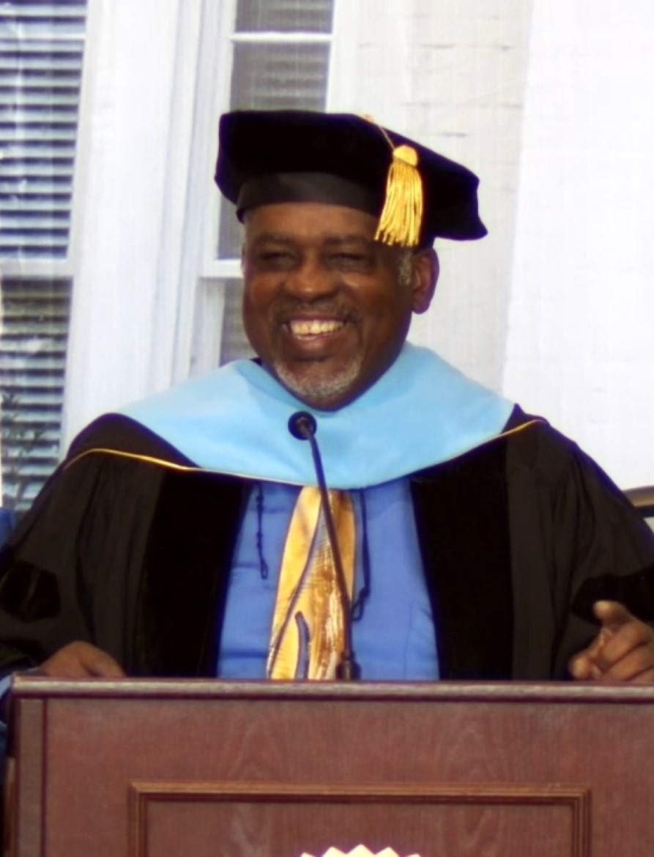


Outreach Coordinator, Michael Walker Jones moving on to be the Executive Director of the Alabama HBCU Consortium.

Slide 22


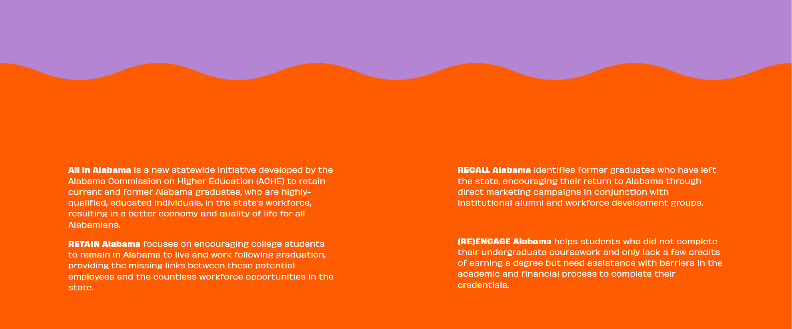

All in Alabama
Retain Alabama - encourage existing students to consider a future in Alabama
Recall Alabama - encourage expatriates (graduates that left) to return to Alabama
(Re)Engage Alabama – encourage adults, especially those with some college, to return to college to complete their degree. Develop scholarships for returning adults majoring in high demand high-wage programs.
First communications sent out to graduates living out of state
Follow up survey –report on the web
6 million in ACHE budget request

Slide 23

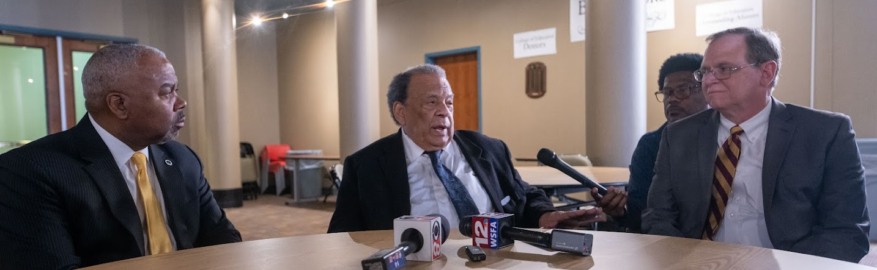
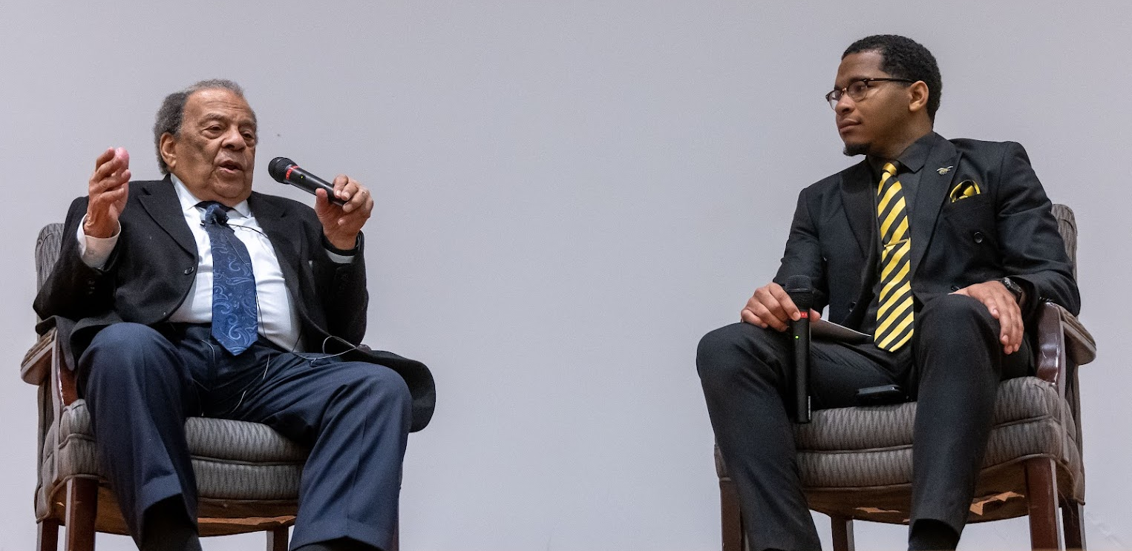
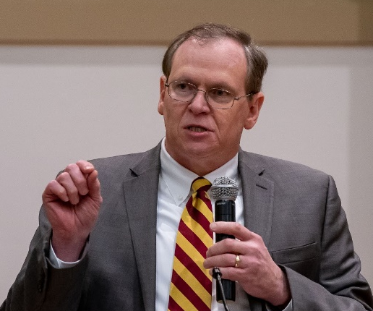

Slide 24
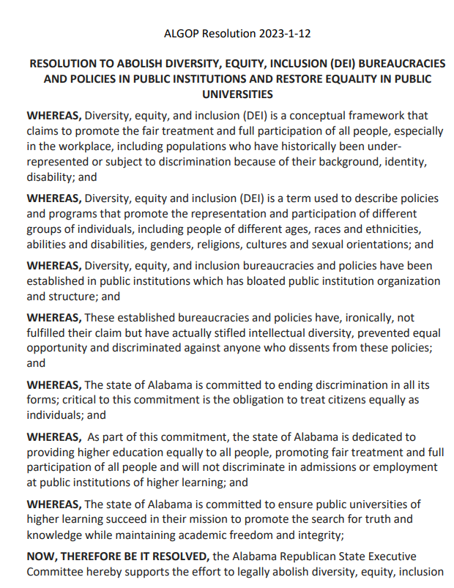
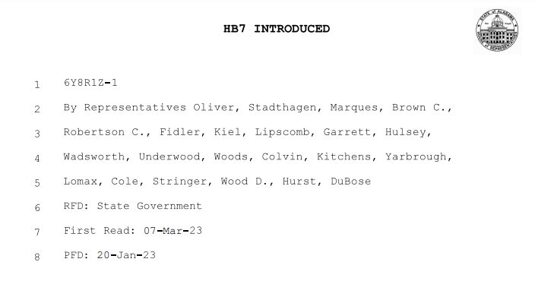
Alabama Legislature considering Diversity, Equity, and Inclusion (DEI) at public colleges and universities

Slide 25
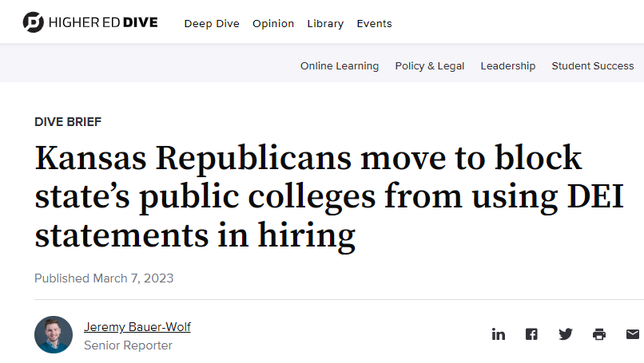
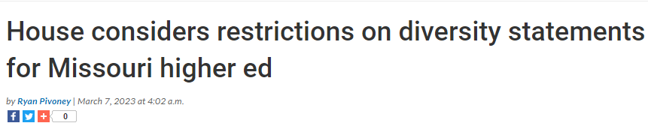

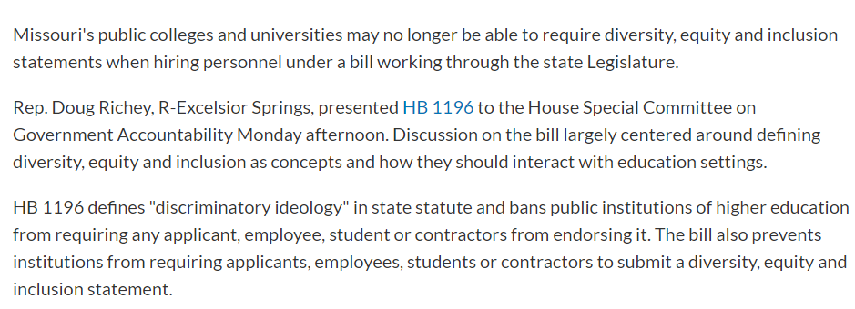
Spectrum of DEI actions under consideration across a number of states
KS and MO bills would restrict university hiring committees from requesting DEI statements

Slide 26



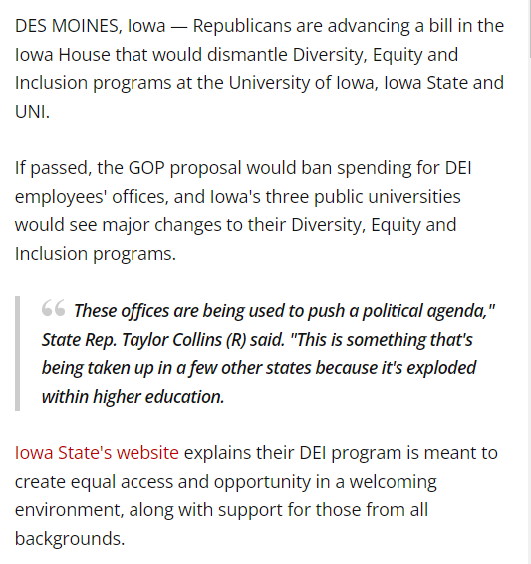
Spectrum of DEI actions under consideration across a number of states
TX and IA bills would restrict use of state funding to support DEI personnel and activities

Slide 27
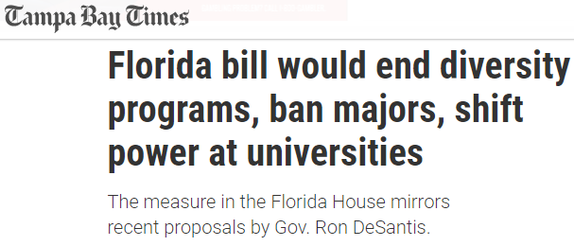


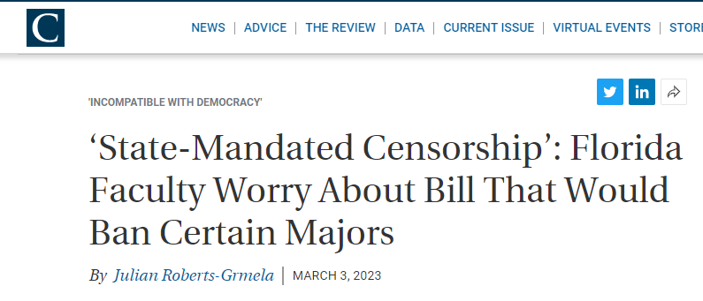
Spectrum of DEI actions under consideration across a number of states

Slide 28
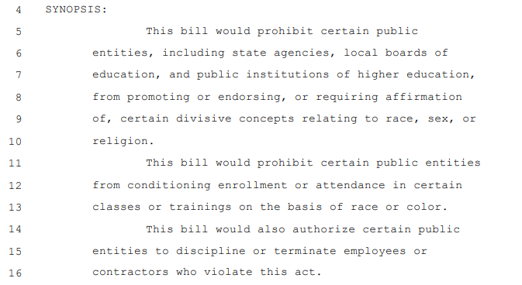

Slide 29
Section 4 notes that institutions are NOT prevented from:
Teaching or discussing divisive concepts, so long as there is no endorsement or expectation of assent
Collecting data required for federal reporting
Teaching topics in a historically accurate context
Promoting free speech rights or academic freedom for students and employees

Slide 30
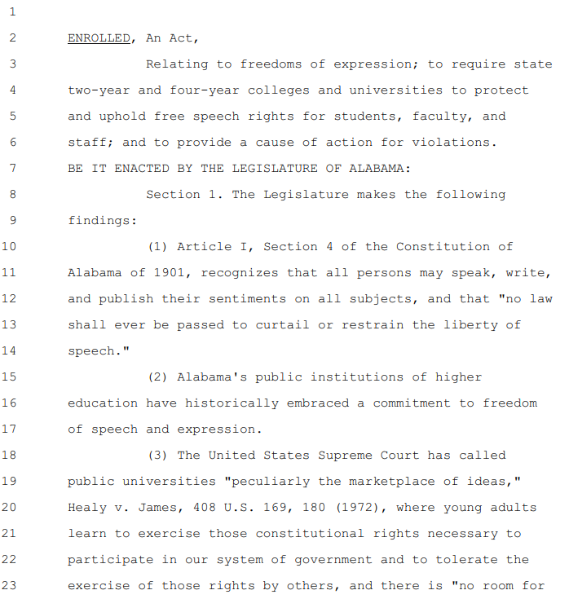
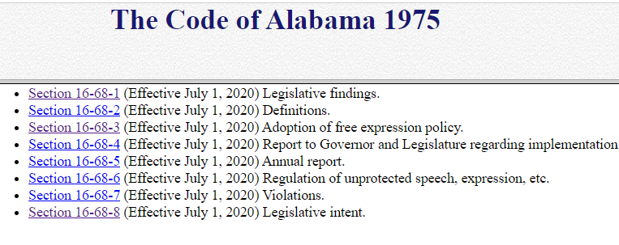
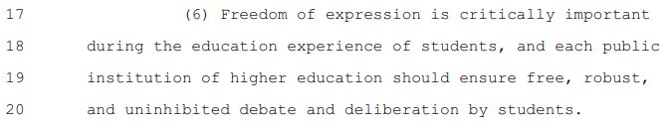
Importance of ensuring freedom of expression
(Act 2019-396, §1.)

Slide 31
Diversity, Equity, Inclusion
There is no better curriculum for preparing for the real world than a curriculum that requires students to think critically about real-world issues, including topics such as diversity, equity, and inclusion.
Colleges should create a safe environment where persons are encouraged to explore new ideas, develop socially, and are recognized by their talents above all else.
Topics discussed in the public square should become a part of the dialog occurring on college campuses, inspiring students to reflect on differing perspectives.
Our society must consistently evaluate how we engage with one another, or we may easily find ourselves advancing a nonproductive sequence of decisions embodying unconscious bias, injustice, and exclusion.
We should continuously seek to live out the promise in the Constitution’s preamble to build a “more perfect union.”

Slide 32

VII. DISCUSSION ITEMS

Slide 33

2022 Employment Outcomes Report
Staff Presenter: Dr. Jim Hood

Slide 34
2022 Employment Outcomes Report: Purpose
Examines the value of public higher education in Alabama by analyzing employment outcomes for graduates.
Results show how public higher education is contributing to the state’s workforce and economy.
Report addresses the following questions:
  How does level of education impact salary?
  How does field of study (academic discipline) impact retention and salary?
  What percent of Alabama residents and non-residents remain in Alabama following graduation?
Notes:
In my mind this is one of the most important reports developed by the Commission. It is not based on estimates or assumptions but links thousands of actual graduation records with actual employment records over a number of years to show how public higher education is contributing to the state’s workforce and economy.
This report measures average salary and retention at both 1-year and 5-year intervals -- by level of education, academic discipline, and residency.

Slide 35
2022 Employment Outcomes Report
Percentage of Alabama Employment (Retention) by Degree Level - After 5 Years
Notes:
This slide shows trends for the percentages of Alabama employment by degree level – for five years after graduation – so these numbers reflect the percentages of graduates who stay in Alabama for five years after graduation.
You’ll notice we retain about 65 percent of graduates with undergraduate certificates, and about 71 percent of graduates with an associate degree.
Those percentages decline at the bachelor’s level and above.

Slide 36
2022 Employment Outcomes Report
Percentage of Alabama Employment (Retention) by Degree Level - After 5 Years
Community Colleges
Less than 2% non-resident
Notes:
This slide shows trends for the percentages of Alabama employment by degree level – for five years after graduation – so these numbers reflect the percentages of graduates who stay in Alabama for five years after graduation.
You’ll notice we retain about 65 percent of graduates with undergraduate certificates, and about 71 percent of graduates with an associate degree.
Those percentages decline at the bachelor’s level and above.

Slide 37
2022 Employment Outcomes Report
Percentage of Alabama Employment (Retention) by Degree Level - After 5 Years
Universities
In 2012: 14.8% non-resident
In 2015: 18.6% non-resident
Notes:
This slide shows trends for the percentages of Alabama employment by degree level – for five years after graduation – so these numbers reflect the percentages of graduates who stay in Alabama for five years after graduation.
You’ll notice we retain about 65 percent of graduates with undergraduate certificates, and about 71 percent of graduates with an associate degree.
Those percentages decline at the bachelor’s level and above.

Slide 38
2022 Employment Outcomes Report
Percentage of Alabama Employment (Retention) by Residence & Degree Level
2015 Graduates - Five Years After Graduation

Slide 39
2022 Employment Outcomes Report
Average Salary by Degree Level
for Alabama Residents - Five Years After Graduation
Notes:
This slide shows trends for the average salaries by degree level for Alabama residents – for five years after graduation – you can see the direct relationship between level of education and income.

Slide 40
2022 Employment Outcomes Report
Average Salary by Degree Level
for Alabama Residents - Five Years After Graduation
Associate 23% less than Bachelor’s
Notes:
These new few slides highlight a few comparisons

Slide 41
2022 Employment Outcomes Report
Average Salary by Degree Level
for Alabama Residents - Five Years After Graduation
Associate 23% less than Bachelor’s
Master’s 34% more than Bachelor’s

Slide 42
2022 Employment Outcomes Report
Average Salary by Degree Level
for Alabama Residents - Five Years After Graduation
Associate 23% less than Bachelor’s
Master’s 34% more than Bachelor’s
Doctoral Professional 120% more than Bachelor’s

Slide 43
2022 Employment Outcomes Report
Bubble Charts
Average Annual Income
2021 Median Household Income
$54,943
Bubble Sizes Reflect Number of Graduates
(Larger Bubbles = More Graduates)
Average Retention Rate for Alabama Students
(After Five Years)

Slide 44
2022 Employment Outcomes Report
Associate – All 2015 Graduates (After 5 Years)
ACADEMIC DISCIPLINE (TOP 10) |  | SALARY | 5-YEAR RETENTION
MECHANIC TECHNOLOGIES | MECH | $60,491 | 74.7%
CONSTRUCTION TRADES | CONS | $56,858 | 79.4%
ENGINEERING TECHNOLOGIES | ENGT | $54,146 | 68.6%
PRECISION PRODUCTION | PREC | $48,224 | 70.0%
HEALTH PROFESSIONS | HLTH | $47,288 | 81.2%
MULTI/ INTERDISCIPLIN STUDIES | MULT | $44,686 | 68.5%
COMPUTER AND INFO SCIENCES | CIS | $42,403 | 67.8%
PROTECTIVE SERV AND SECURITY | PROT | $42,340 | 67.3%
LIBERAL ARTS AND SCIENCES | LIBL | $38,459 | 71.4%
LEGAL PROFESSIONS | LEGL | $32,751 | 73.5%
Lower Average Salaries
Higher 5-Year Retention Rates
2021 Median Household Income
$54,943

Slide 45
2022 Employment Outcomes Report
Bachelor’s – All 2015 Graduates (After 5 Years)

Slide 46
2022 Employment Outcomes Report
Bachelor’s – All 2015 Graduates (After 5 Years)
HIGHEST EARNING DISCIPLINES
ENGINEERING | ENGR | $81,037
COMPUTER AND INFO SCIENCES | CIS | $69,693
ENGINEERING TECHNOLOGIES | ENGT | $66,756
MATHEMATICS AND STATISTICS | MATH | $58,825
BUSINESS, MGT, AND MARKETING | BUS | $58,224
HEALTH PROFESSIONS | HLTH | $57,641

Slide 47
2022 Employment Outcomes Report
Bachelor’s – All 2015 Graduates (After 5 Years)
LOWEST EARNING DISCIPLINES
COMMUNICATION AND JOURNALISM | COMM | $40,867
FAMILY AND CONSUMER SCIENCES | FMLY | $39,907
PUBLIC ADMINISTRATION | PUBL | $38,106
PSYCHOLOGY | PYCH | $37,561
FOREIGN LANGUAGES | FORL | $36,404
ENGLISH LANGUAGE | ENGL | $35,974
VISUAL AND PERFORMING ARTS | VISL | $34,931

Slide 48
2022 Employment Outcomes Report
Bachelor’s – All 2015 Graduates (After 5 Years)
LOWEST 5-YEAR RETENTION RATES
ENGINEERING | ENGR | 52.9%
SOCIAL SCIENCES | SOCL | 52.9%
VISUAL AND PERFORMING ARTS | VISL | 51.5%
BIOLOGICAL SCIENCES | BIOL | 51.4%
PHILOSOPHY AND RELIGION | PHIL | 51.0%
FOREIGN LANGUAGES | FORL | 46.5%
PHYSICAL SCIENCES | PHYS | 46.3%

Slide 49
2022 Employment Outcomes Report
Bachelor’s – All 2015 Graduates (After 5 Years)
HIGHEST 5-YEAR RETENTION RATES
PARKS, RECREATION, LEISURE | PARK | 77.0%
EDUCATION | EDUC | 72.8%
HEALTH PROFESSIONS | HLTH | 72.1%
PUBLIC ADMINISTRATION | PUBL | 66.7%
PROTECTIVE SERVICES AND SECURITY | PROT | 64.1%
HISTORY | HIST | 63.8%

Slide 50
2022 Employment Outcomes Report
Bachelor’s and Associate – All 2015 Graduates (After 5 Years)

Slide 51
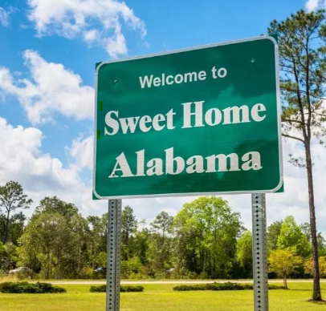
2022 Employment Outcomes Report: Findings
With regard to RETENTION….
Alabama residents (natives) are 3x more likely to remain in state following graduation.
Lower academic levels (certificates & associate degrees) are more likely to remain in state but typically earn less than higher degree levels.

Slide 52

2022 Employment Outcomes Report: Findings
With regard to SALARY….
Higher academic levels consistently earn higher salaries.
Health and STEM-related disciplines consistently earn higher salaries.
  For 2015 graduates (after five years), 5 of the top 6 highest-paid disciplines were either in a health or STEM-related program.

Slide 53

VIII. Decision ITEMS

Slide 54

A. Academic Programs
Staff Presenters: Dr. Robin McGill and
Mrs. Kristan White

Slide 55














FOUR-YEAR INSTITUTIONS

Slide 56

Alabama A&M University
1. Doctor of Philosophy in Social Work (CIP 44.0701)
The bachelor’s and master’s in Social Work programs at AAMU have been fully accredited since their inception and produce significant numbers of graduates annually.
Currently, only one public institution in Alabama offers doctoral-level Social Work programs (the University of Alabama).
According to the Bureau of Labor and Statistics, employment for social workers is expected to grow by 13% from 2019 to 2029. With more individuals entering the field, there continues to be significant demand for those who are credentialed to educate future graduate level social workers and assume leadership roles within the profession.
This proposal includes two letters of support from the
National Association of Social Workers (NASW)--Alabama
Chapter and the Council on Social Work Education (CSWE).
This Photo by Unknown Author is licensed under CC BY-ND

Slide 57
Motion, Decision Item A-1:
That the Commission approve Alabama A&M University’s proposal to offer a Doctor of Philosophy in Social Work.

Slide 58


Auburn University at Montgomery
2. Doctor of Education in Instructional Systems and Learning
Sciences (CIP 13.0607)
The proposed program is designed to strengthen Alabama’s pipeline of professionals trained in learning sciences to become directors of early learning centers and instructional technology leaders in schools and organizations.
This program will build on AUM’s existing coursework for existing MEd and EdS programs in both Instructional Technology and Early Childhood Education. AUM’s programs in both areas continue to exceed viability standards for their respective levels.
The proposed program offers a strategic benefit through its
unique focus on the learning sciences in relation to two
specific disciplines: early childhood education and instructional
technology and systems.

Slide 59
Motion, Decision Item A-2:
That the Commission approve Auburn University at Montgomery’s proposal to offer a Doctor of Education in Instructional Systems and Learning Sciences.

Slide 60


Jacksonville State University
3a. Bachelor of Public Health in Public Health (CIP 51.2201)
The proposed BPH program will prepare graduates for employment in the growing public health sector, particularly as community health workers and community and social service managers, which appear on the most recent In-Demand Occupations List.
The proposed program is designed to meet the program requirements set by the Council on Education for Public Health (CEPH) and will prepare graduates for the Certified Health Education Specialist (CHES) exam offered by the National Commission for Health Education Credentialing.
The proposal includes 5 letters of support attesting
to the need for the program, including two from
local government entities.
This Photo by Unknown Author is licensed under CC BY-ND

Slide 61
Motion, Decision Item A-3a:
That the Commission approve Jacksonville State University’s proposal to offer a Bachelor of Public Health in Public Health.

Slide 62

Jacksonville State University
3b. Master of Public Health in Public Health (CIP 51.2201)
The proposed Master of Public Health (MPH) will prepare graduates for employment in the growing public health sector, particularly as community health workers and community and social service managers, which appear on the most recent In-Demand Occupations List.
The proposed program is designed to meet the program requirements set by the Council on Education for Public Health (CEPH), and as a result, graduates will be eligible for professional certification through the National Board of Public Health Examiners.
The proposal includes 5 letters of support attesting
to the need for the program, including two from
local government entities.
This Photo by Unknown Author is licensed under CC BY-ND

Slide 63
Motion, Decision Item A-3b:
That the Commission approve Jacksonville State University’s proposal to offer a Master of Public Health in Public Health.

Slide 64


University of Alabama at Birmingham
4a. Bachelor of Science in Disability Studies and Rehabilitation
Science (CIP 51.2314)
The proposed program will increase the number of people trained to support the health and wellbeing of individuals with disabilities, metrics on which Alabama has ranked low. Graduates will be prepared to pursue professional degrees in physical or occupational therapy or research degrees in rehabilitation sciences.
This proposed program builds on the clinical practices and research strengths of the UAB Department of Physical Therapy and therefore will require minimal new resources to deliver.
The proposal includes 3 letters of support from community
partners attesting to the need for the proposed program.

Slide 65
Motion, Decision Item A-4a:
That the Commission approve the University of Alabama at Birmingham’s proposal to offer a Bachelor of Science in Disability Studies and Rehabilitation Science.

Slide 66

University of Alabama at Birmingham
4b. Education Specialist in School Psychology (CIP 42.2805)
This program will extend coursework from UAB’s existing MAEd in School Psychometry to the Education Specialist level and will be one of two programs leading to Class AA certification in School Psychology.
The program will directly address the documented critical workforce shortage for school psychologists seen nationally, regionally, and in Alabama.
The program proposal includes four letters of support from
the following: National Association of School Psychologists
(NASP), Alabama Association of School Psychologists (AASP),
Birmingham City Schools, and Sylacauga City Schools.

Slide 67
Motion, Decision Item A-4b:
That the Commission approve the University of Alabama at Birmingham’s proposal to offer an Education Specialist in School Psychology.

Slide 68


University of Alabama in Huntsville
5. Bachelor of Science in Business Administration in Analytics
(CIP 52.1301)
The proposed BSBA in Analytics will build on existing expertise within UAH’s College of Business and will not require any additional resources to implement.
The US Bureau of Labor Statistics has found that Data Scientists
and Mathematical Science Occupations are among the top 10
fastest growing occupations, with a significant number of openings
in UAH’s service area.
The proposal includes 5 letters of support from industry
and economic development partners attesting to the
need for the program.

Slide 69
Motion, Decision Item A-5:
That the Commission approve the University of Alabama in Huntsville’s proposal to offer a Bachelor of Science in Business Administration in Analytics.

Slide 70


University of South Alabama
6a. Bachelor of Science in Organizational Leadership (CIP 52.0213)
The proposed Organizational Leadership degree is designed to provide flexibility for working professionals who need a four-year degree to advance their careers.
The proposed degree offers a disciplinary focus that is more structured than USA’s existing BA/BS in Interdisciplinary Studies, which is appealing to employers who offer tuition reimbursement.
Only one other institution (University of Alabama in Huntsville)
offers a comparable degree within Alabama.

Slide 71
Motion, Decision Item A-6a:
That the Commission approve the University of South Alabama’s proposal to offer a Bachelor of Science in Organizational Leadership.

Slide 72

University of South Alabama
6b. Master of Science in Cyber Security (CIP 11.1003)
The USA School of Computing has been designated a National Center of Academic Excellence in Cyber Defense (CAE-CD) since 2011 but currently does not offer a full degree program in cyber security.
This program will be an additional pathway into USA’s PhD in Computing and serves the needs of the University’s National Science Foundation Scholarship for Service program by providing a research-intensive cyber security program.
The proposed program addresses workforce needs within
USA’s service area for workers with skills and competencies
relating vulnerabilities and countermeasures for cyber-attacks
and cyber-terrorism.

Slide 73
Motion, Decision Item A-6b:
That the Commission approve the University of South Alabama’s proposal to offer a Master of Science in Cyber Security.

Slide 74

University of South Alabama
6c. Master of Science in Computer and Information Sciences
(CIP 11.0101) - Substantive Modification
University of South Alabama (USA) is proposing to modify its existing MS in Computer and Information Sciences (CIP 11.0101) to create two separate programs: a Master of Science in Computer Science (11.0701) and a Master of Science in Information Systems (11.0401).
For many years, USA has offered a graduate degree in Computer and Information Sciences with specializations in Computer Science and Information Systems. As currently constructed, the two specializations only share one required course, CIS 518 Research Methodologies, and as a result are already operating as distinct programs. USA intends to close the master’s offering at CIP 11.0101 if the substantive modification is approved.

Slide 75
Motion, Decision Item A-6c:
That the Commission approve the University of South Alabama’s proposal to make a Substantive Modification to the Master of Science in Computer and Information Sciences.

Slide 76

University of South Alabama
6d. Doctor of Philosophy in Exercise Science and Performance
Nutrition (CIP 26.0908)
The proposed program would complement the existing MS in Exercise Science and Kinesiology (CIP 26.0908), with minimal additional coursework to be developed.
The Department of Health, Kinesiology and Sport houses state-of-the-art research laboratories equipped with a wide-array of equipment for a broad range of projects in the exercise and performance nutrition fields. The addition of doctoral students will increase research productivity and potentially attract sponsored research funding.
Exercise Science is a large (top 5 in enrollment at USA)
and rapidly growing major both in-state and nationally.
The addition of doctoral students would provide undergraduate
students with more viewpoints from diverse backgrounds.

Slide 77
Motion, Decision Item A-6d:
That the Commission approve the University of South Alabama’s proposal to offer a Doctor of Philosophy in Exercise Science and Performance Nutrition.

Slide 78

























ALABAMA COMMUNITY COLLEGE SYSTEM

Slide 79


Ingram State Technical College
7. Certificate in Industrial Maintenance Technology (CIP 47.0303)
This proposal combines the content of three existing stackable short-term certificates with 12 hours of mathematics, computer basics and communications (speech and English) into a more comprehensive program of study that better reflects the range of skills needed for success in industrial maintenance.
The program is designed to prepare graduates for employment as Industrial Machinery Mechanics, Millwrights, and Maintenance and Repair Workers, which appear on the Statewide In-Demand Jobs List.
This program reflects efforts by ING to change public perception of the skill level which incarcerated students can attain. Students who are successful in this program will serve as examples to other justice-involved individuals that they can successfully pursue careers in high-wage/ high-demand occupations with opportunities for advancement.

Slide 80
Motion, Decision Item A-7:
That the Commission approve Ingram State Technical College’s proposal to offer a Certificate in Industrial Maintenance Technology.

Slide 81

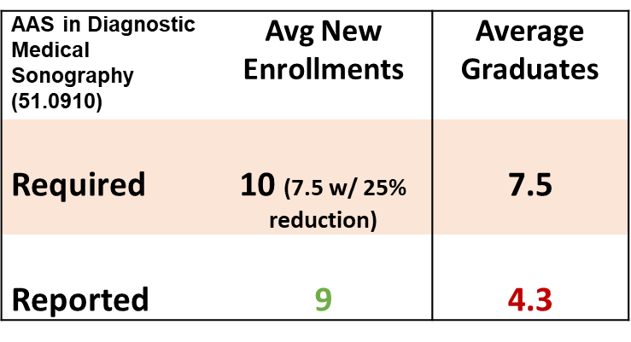
Request to Amend Post-Implementation Conditions
8a. Lawson State Community College, AAS in Diagnostic Medical Sonography (CIP 51.0910)
The program did not meet the graduate condition.
LAW has requested an extension of the post-implementation period for two years (AY 2022-23 and AY 2023-24) to produce enough graduates to meet the viability standard for associate programs. ACHE staff is recommending approval of the request based on the following rationale:
  The program has demonstrated stable enrollment numbers throughout its first four years of implementation.
  LAW has indicated that there are enough students
  in the program on track to graduate within the next
  two academic years to meet the viability requirement
  for graduates.
  COVID interruptions delayed students from
  reaching graduation on time.

Slide 82
Motion, Decision Item A-8a:
That the Commission approve Lawson State Community College’s request to amend post-implementation conditions for the Associate of Applied Science in Diagnostic Medical Sonography.

Slide 83

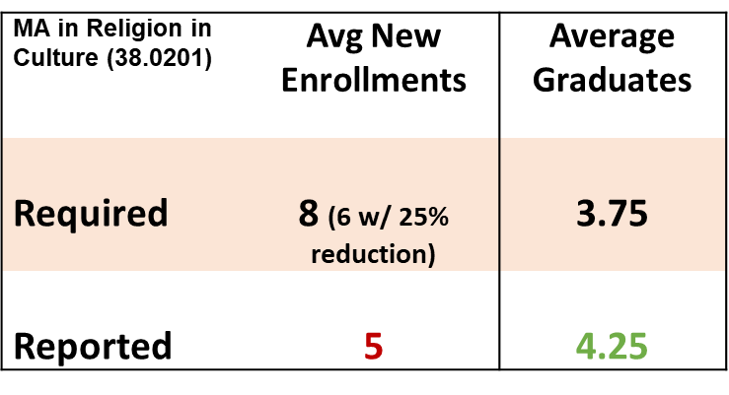
Request to Amend Post-Implementation Conditions
8a. University of Alabama, MA in Religion in Culture (CIP 38.0201)
The program did not meet the enrollment condition.
UA has requested that the original post-implementation condition for new enrollments be modified to reflect the actual enrollment achieved over the first five years and that the MA in Religion in Culture be deemed a viable program going forward. ACHE staff is recommending approval of the request based on the following rationale:
  The program has demonstrated its viability by exceeding the required minimum number of graduates per year each year since it began to produce graduates.
  Average new enrollments have exceeded the
  required minimum number of graduates,
  indicating that there is a sustainable pipeline
  of students.

Slide 84
Motion, Decision Item A-8b:
That the Commission approve the University of Alabama’s request to amend post-implementation conditions for the Master of Arts in Religion in Culture.

Slide 85
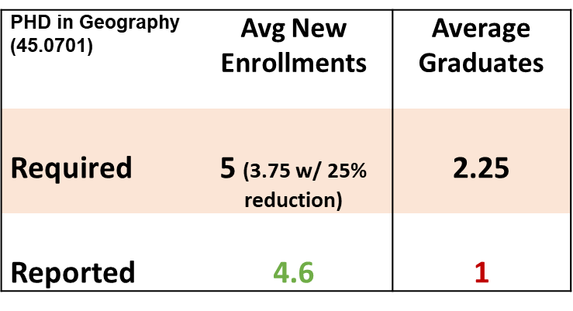
Request to Amend Post-Implementation Conditions
8c. University of Alabama, PHD in Geography (CIP 45.0701)
The program did not meet the graduate condition.
UA has requested an extension of the post-implementation period for two years (AY 2022-23 and AY 2023-24) to produce enough graduates to meet the viability standard for doctorate programs. ACHE staff is recommending approval of the request based on the following rationale:
  The program has demonstrated strong enrollment numbers throughout its first five years of implementation, exceeding the number of students needed to build a sustainable program pipeline.
  UA has indicated that there are enough students
  in the program on track to graduate within the
  next two academic years to meet the viability
  requirement for graduates.
  COVID interruptions delayed students
  from reaching graduation on time.

Slide 86
Motion, Decision Item A-8c:
That the Commission approve the University of Alabama’s request to amend post-implementation conditions for the Doctor of Philosophy in Geography.

Slide 87

B. INFORMATION ITEMS
Implementation of Non-Degree Programs at Senior Institutions
Implementation of New Short Certificate Programs (Less than 30 Semester Hours)
Changes to the Academic Program Inventory
Updates to Units of Instruction, Research, Public Service, and Administration
Extensions/ Alterations to Existing Programs of Instruction
Implementation of Distance Education Programs
Summary of Post-Implementation Reports

Slide 88
7a. Summary of Post-Implementation Reports
Programs that met post-implementation conditions
• Bevill State Community College, Associate of Applied Science and Certificate in Salon and Spa Management (CIP 12.0412)
• Drake State Community and Technical College, Associate of Applied Science in Nursing (CIP 51.3801)
• Shelton State Community College, Associate of Applied Science in Child Development (CIP 19.0708)
• Wallace State Community College - Dothan, Associate of Applied Science in Criminal Justice (CIP 43.0107)
• Auburn University, Bachelor of Science in Computer Science (11.0701)

Slide 89
Programs that met post-implementation conditions, continued
• Auburn University, Bachelor of Science in Professional Flight (CIP 49.0102)
• Auburn University, Bachelor of Science in Aviation Management (CIP 49.0104)
• Auburn University at Montgomery, Bachelor of Science in Computer Science (CIP 11.0701)
• Auburn University at Montgomery, Master of Healthcare Administration in Healthcare Administration (CIP 51.0701)
• University of Alabama in Huntsville, Bachelor of Fine Arts in Art (CIP 50.0701)

Slide 90
7b. Summary of Post-Implementation Reports
b. Programs that did not meet post-implementation conditions
Lawson State Community College, Associate of Applied Science in Diagnostic Medical Sonography (CIP 51.0910) – Extension Requested
University of Alabama, Master of Arts in Religion in Culture (CIP 38.0201) – Modification Requested
University of Alabama, Doctor of Philosophy in Geography (CIP 45.0701) – Extension Requested

Slide 91
Motion, Decision Item B:
That the Commission accept the information items as presented.

Slide 92
C. ADJOURNMENT

