Slide 1

Alabama Commission on Higher Education
Commission Meeting
September 8, 2023

Slide 2


I. CALL TO ORDER, PRAYER, AND PLEDGE OF ALLEGIANCE

Slide 3

II. ROLL CALL and
QUORUM DETERMINATION

Slide 4

III. Welcome Remarks
Jacksonville State University
President Dr. Don Killingsworth

Slide 5

IV. APPROVAL OF AGENDA
Commission Meeting Agenda
of September 8, 2023

Slide 6

V. CONSIDERATION OF MINUTES
Commission Meeting Minutes of June 9, 2023

Slide 7

VI. CHAIRMAN’S REPORT

Slide 8

VII. Election of Officers
Nominating Committee Report

Slide 9

VIII. EXECUTIVE DIRECTOR’S REPORT

Slide 10




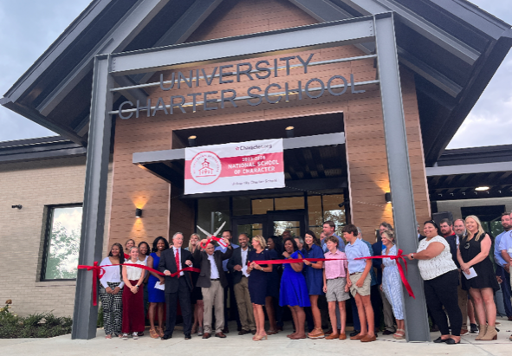
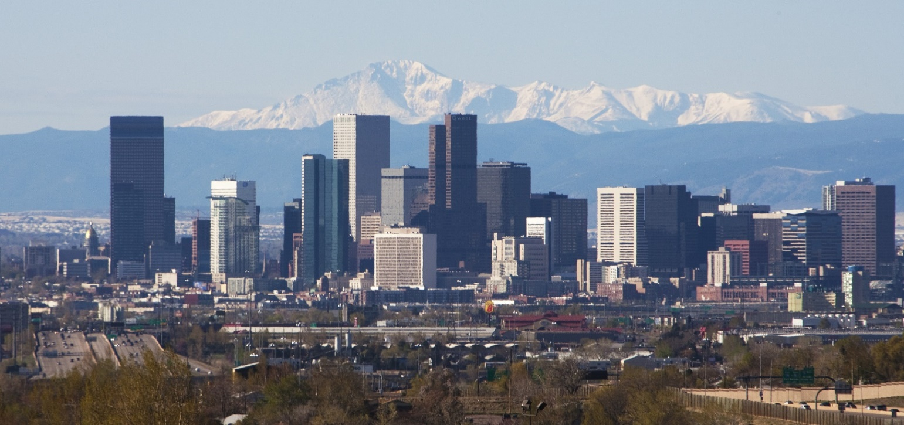
Summer Travel
Minneapolis
Portland
Presentations: Robin McGill, Patrick Kelly,
Stephanie Dolan, Jim Purcell
Livingston
Denver

Slide 11

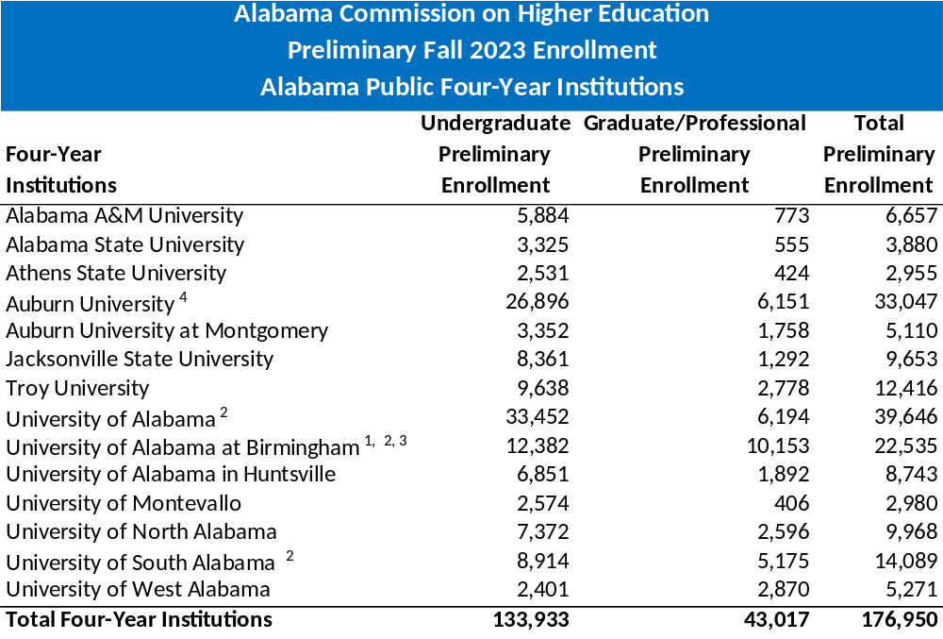
Preliminary Enrollment Trends for Fall 2023
Source: Alabama Commission on Higher Education, Preliminary Opening Fall Enrollment Report, Fall 2023
Notes: 1) Does not include postdocs, 2) Includes medical residents and/or medical interns, 3) Includes dental and optometry residents, and 4) Excludes Vet Med and Pharmacy residents and interns

Slide 12
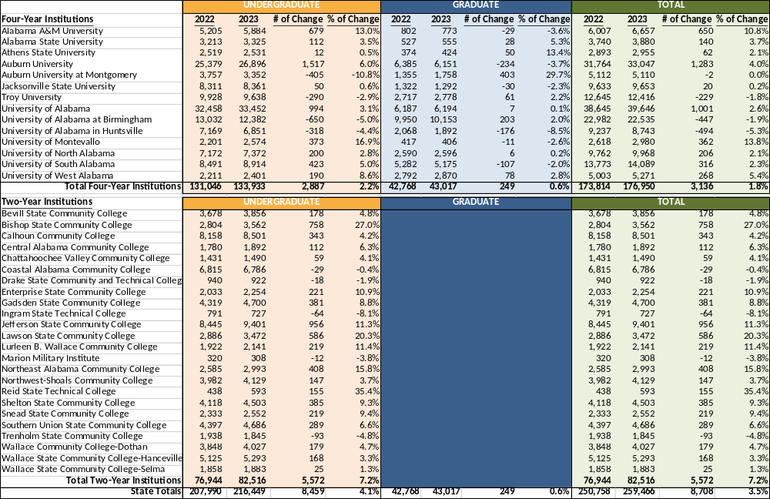
ACHE Preliminary Fall Enrollment by Level of Alabama Public Institutions
Fall 2022 to Fall 2023 Comparison
Source: ACHE Preliminary Opening Fall Enrollment Reports
University Sector up 1.8%
Community College Sector up 7.2%

Slide 13

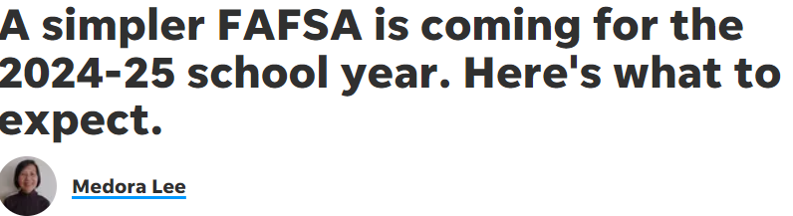

Changes in FAFSA Rules
FAFSA will be reduced to just 36 questions from 108.
It will be easier to import income data from tax records.
Changing its formulas to determine who will qualify for aid and how much $$.
The new formula emphasizes wealth instead of cash flow.
Lower-income families will be eligible for more aid.
Incarcerated students and students who have been convicted of drug-related offenses will be eligible again for financial aid.

Slide 14
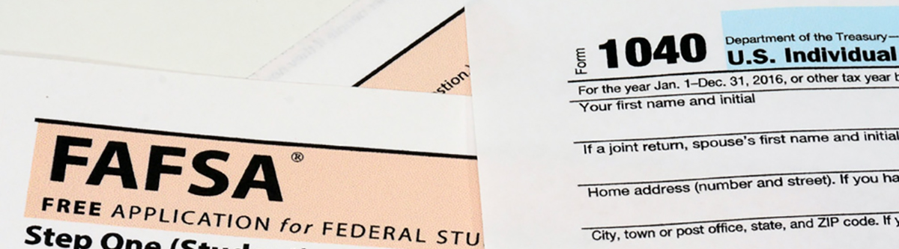
Change is Hard
New forms will be available in December, at least three months later than usual.
Unintended/ Intended consequences – Less financial aid for some:
  Net worth of family farms and businesses will now be required as part of the application
  The number of students a family has enrolled in college will no longer be a factor into the FAFSA calculation
If parents are divorced or separated, the parent who provided the most financial support in the last calendar year will now complete the FAFSA.

Slide 15
Change is Hard
Both students and parents must create a Student Aid Account before completing the form. Allow at least three days because in the new process, the Social Security Administration will require verification of FSA IDs before tax information can be accessed.
Students and parents must log in to the FAFSA separately to complete each of their respective sections.

Slide 16

Summer Bridge Program
$1,500,000 from the Governor’s Emergency Education Relief Fund (GEER) II for establishing a Summer Bridge programs at the universities and colleges.
Focused on helping students transition to college with emphasis on students that may have fallen behind academically because of COVID. Projects primarily focused on remedial math and English classes, but also other topics, such as time management, study skills, and financial aid, were often also provided.
In 2022, 11 Universities and 6 community college participated, and in 2023, 4 universities and 3 community colleges participated, totaling an excess of 480 students being served over the last two years.
The amount of each grant per institution ranged from $28,000 to over $94,000.

Slide 17
Summer Bridge Program
Jacksonville State Program was exemplary, and Dr. Janet L. Bavonese,
Assistant Vice Provost for Advising, and Courtney Peppers, JSU’s Summer Bridge Director, will provide an overview of their program.

Slide 18
Jax State Summer Bridge
Dr. Janet L. Bavonese, Assistant Vice Provost for Advising
Courtney Peppers, BCBA, Director, Learning Services & Analytics

Slide 19
Bridge to Success
Traditionally held in summer for conditionally admitted students
Comprehensive program of orientation and academic support
Five-week session
College classes, workshops, academic advisement and career development
Success coaching
Residential
6 Credit Hours

Slide 20
Summer Bridge and ACHE 2022
2022 STREAM to Success
Integrated academic advising and career readiness
Highlighted STREAM (Science, Technology, Reading, Engineering, Art, and Mathematics) in majors
91% of students returned in the fall
Activities
Cookies and Careers
Let’s Taco ‘Bout Careers
Resume and Cover Letter Lunch n’ Learn
Emerging Leaders Institute
Networking Luncheon and AL Employer Panel

Slide 21
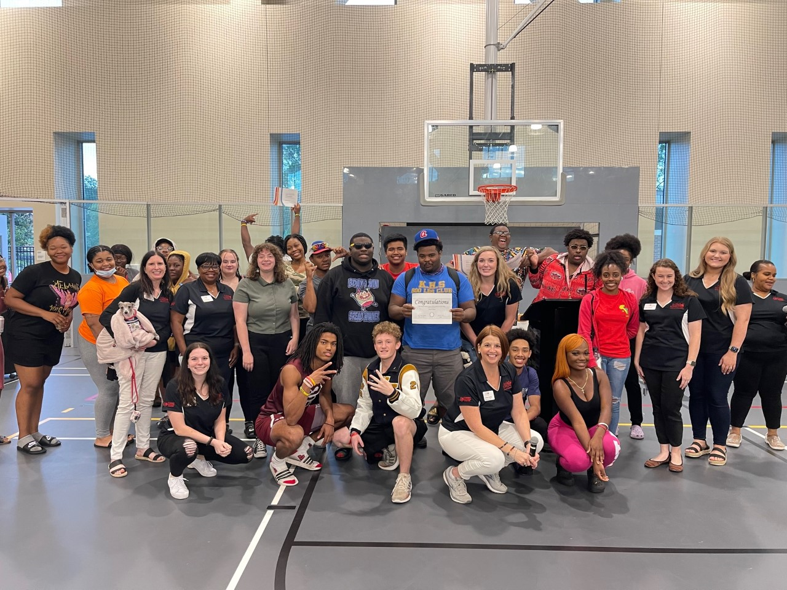
Bridge 2022 Participants

Slide 22
Summer Bridge and ACHE 2023
College to Career Readiness
Embedded NACE (National Association of Colleges and Employers) Career Readiness Standards
Strengthened career emphasis throughout
Career Readiness Micro-credential Award
92% of students returned to fall
Leadership Lab
Pre- and Post Self-Assessment of NACE Career Readiness Standards
Emerging Leaders Institute
Networking, Resume & Professionalism Workshops
Networking Brunch and AL Employer Panel

Slide 23
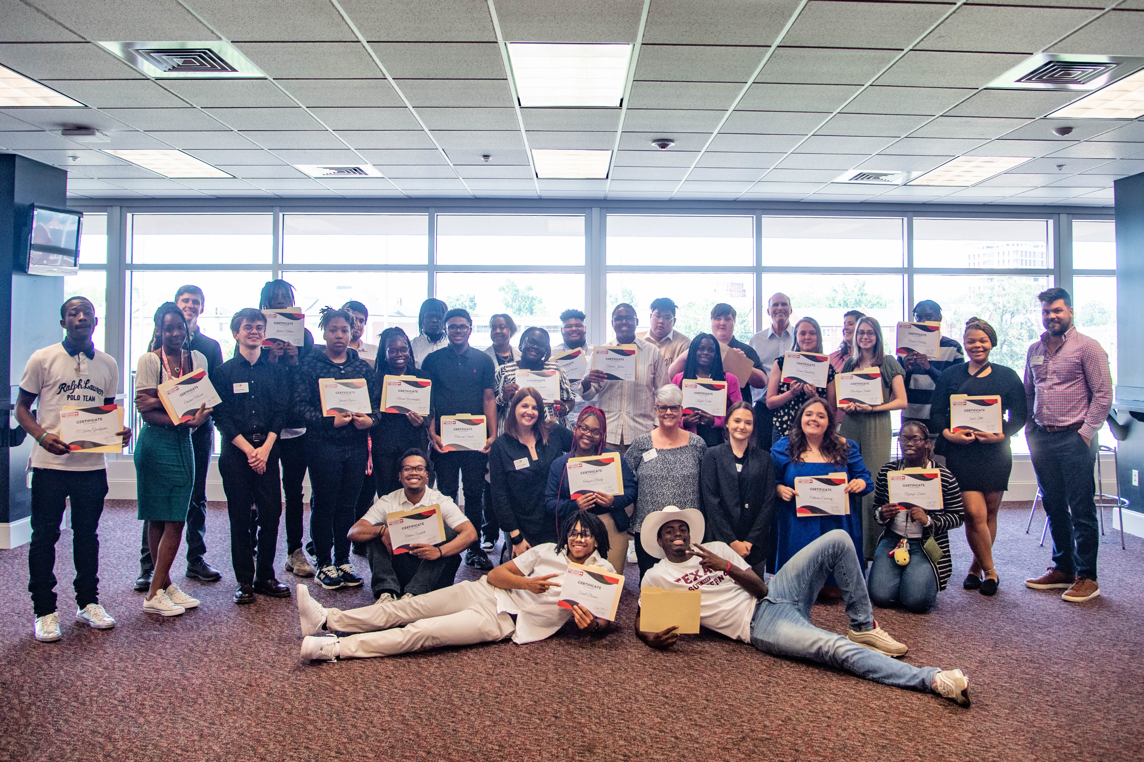
Bridge 2023 Participants

Slide 24
Benefits of ACHE Bridge Funds
Category | Direct Benefit to Students
Financial | Scholarships
Well-Being | Supported activities encourage early intervention
Sense of Belonging | Increased engagement with campus community
Academics | Real-world connections for academics and career pathways

Slide 25

Summer 23 Networking Brunch

Slide 26
Bridge Future Directions
Summer Bridge option plus Early Arrival for Fall Bridge.
Expand the program to include a fall bridge in 2024.
Sustain career emphasis throughout freshman and sophomore years to support into upper division major.
Strengthen appreciative, person-centered advisement strategies
Utilize OER EdReady Math and English.
Success Coaching tied to course outcomes.

Slide 27

IX. DISCUSSION ITEMS

Slide 28
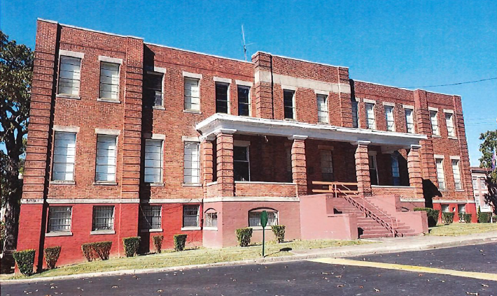
HBCU Deferred Maintenance Grant Program
Williams Hall at Miles College built in 1907
Notes:
Thank you Madam Chair…
Good morning Commissioners…it’s my pleasure to be with you this morning to discuss the next three agenda items…
The first of these three items deals with the HBCU Deferred Maintenance Grant Program.

Slide 29
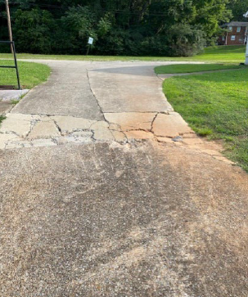
HBCU Deferred Maintenance Grant: Overview
Lawmakers passed two acts in 2023
($5 million each) that provided a total of $10 million in funding
ACHE charged with administering the grant
Projects limited to deferred maintenance defined as general upkeep and maintenance of facilities
Priority placed on projects related to ADA, health, and safety compliance
Dollar-for-dollar match between institutional and state funds
Driveway repair project at Oakwood University
Notes:
Lawmakers passed two Acts in 2023 related to deferred maintenance funding for the HBCU institutions.
Projects were limited to deferred maintenance with a priority placed on ADA, health, and safety compliance.

Slide 30
HBCU Deferred Maintenance Grant: Overview
To facilitate institutional planning, funds from the two grant program Acts were combined into one $10 million pool of funds.
50% of the funds would be available immediately in accordance with SB87. The remaining 50% of funds would be distributed quarterly in accordance with SB88.
ACT | Appropriation Type | Amount | % of Total Funds | Distribution Timeline
2023-378 (SB87) | Supplemental (Funds available immediately) | $5,000,000 | 50% | September 2023
2023-379 (SB88) | Regular ETF (Funds available quarterly in 2023-24) | $5,000,000 | 50% | 1st Qtr – 12/01/23 2nd Qtr – 03/01/24 3rd Qtr – 06/01/24 4th Qtr – 09/01/24
Notes:
In my mind this is one of the most important reports developed by the Commission. It is not based on estimates or assumptions but links thousands of actual graduation records with actual employment records over a number of years to show how public higher education is contributing to the state’s workforce and economy.
This report measures average salary and retention at both 1-year and 5-year intervals -- by level of education, academic discipline, and residency.

Slide 31
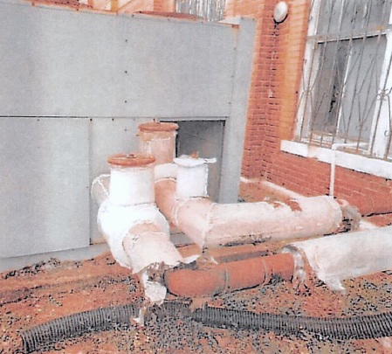
HBCU Deferred Maintenance Grant: Overview
$2 million limit/cap per institution to facilitate a more equitable distribution of funds
ACHE convened Zoom meeting on July 18 to discuss grant program
Institutions submitted projects in priority order on July 28
13 of 14 institutions submitted applications
Institutions submitted 30 projects requesting over $18 million (funds addressed 55%)
ACHE reviewed projects and finalized distribution of funds on August 11
HVAC repair project for
Dinkins Hall at Selma University
Notes:
In my mind this is one of the most important reports developed by the Commission. It is not based on estimates or assumptions but links thousands of actual graduation records with actual employment records over a number of years to show how public higher education is contributing to the state’s workforce and economy.
This report measures average salary and retention at both 1-year and 5-year intervals -- by level of education, academic discipline, and residency.

Slide 32
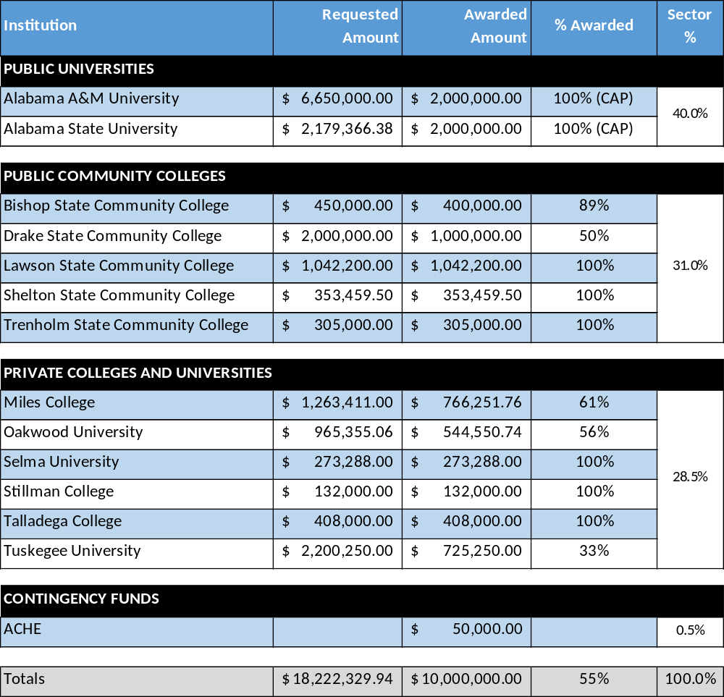
HBCU Deferred Maintenance Grant: Distribution of Funds
Public Universities
  A&M and ASU received $2 million cap
  40% of total available funds
Public Community Colleges
  4* of 5 received 100% of requested funds
  31% of total available funds
Private Colleges & Universities
  3* of 6 received 100% of requested funds
  Several received separate deferred maintenance appropriations
  28.5% of total available funds
Notes:
In my mind this is one of the most important reports developed by the Commission. It is not based on estimates or assumptions but links thousands of actual graduation records with actual employment records over a number of years to show how public higher education is contributing to the state’s workforce and economy.
This report measures average salary and retention at both 1-year and 5-year intervals -- by level of education, academic discipline, and residency.

Slide 33
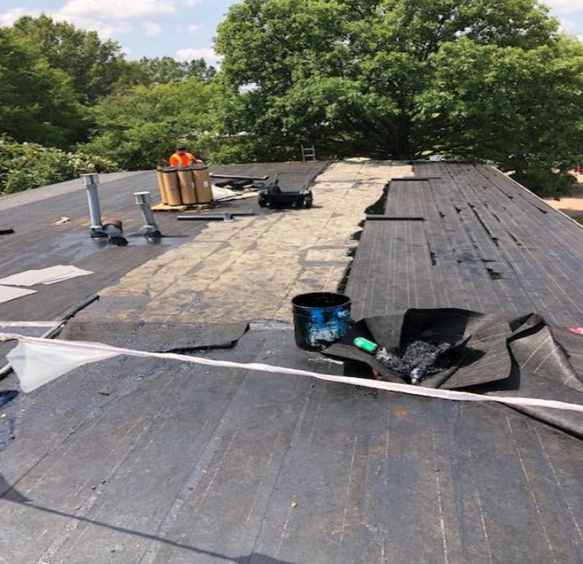
HBCU Deferred Maintenance Grant: Current Timeline
August 18 – Institutions were notified of their selected projects
August 25 – Verification of Matching Funds forms were due for selected projects
September 1 – ACHE begins distributing supplemental funds (first 50% of funds)
November 1 – ACHE begins quarterly payments from regular appropriation (remaining 50% of funds)
Roof renovation for
Adult Education Building at
Lawson State Community College
Notes:
In my mind this is one of the most important reports developed by the Commission. It is not based on estimates or assumptions but links thousands of actual graduation records with actual employment records over a number of years to show how public higher education is contributing to the state’s workforce and economy.
This report measures average salary and retention at both 1-year and 5-year intervals -- by level of education, academic discipline, and residency.

Slide 34

Students’ Right-to-Know Website

Slide 35

Students’ Right-to-Know Website: Overview
Lawmakers passed Act in 2023-556 (SB176) that created the Students’ Right to Know Act of 2023
ACHE required to collect necessary data and create an interactive data tool for students and parents
– to facilitate informed decision-making related to education and professions
Notes:
In my mind this is one of the most important reports developed by the Commission. It is not based on estimates or assumptions but links thousands of actual graduation records with actual employment records over a number of years to show how public higher education is contributing to the state’s workforce and economy.
This report measures average salary and retention at both 1-year and 5-year intervals -- by level of education, academic discipline, and residency.

Slide 36

Students’ Right-to-Know Website: Under Construction
Requirements include Commission and Department of Commerce sharing data and information as necessary to comply with the requirements outlined in the Act
ACHE is responding to the Act
-- by enhancing its Institutional Profiles and
-- by developing an interactive Student Horizon Database for students and parents
Notes:
In my mind this is one of the most important reports developed by the Commission. It is not based on estimates or assumptions but links thousands of actual graduation records with actual employment records over a number of years to show how public higher education is contributing to the state’s workforce and economy.
This report measures average salary and retention at both 1-year and 5-year intervals -- by level of education, academic discipline, and residency.

Slide 37
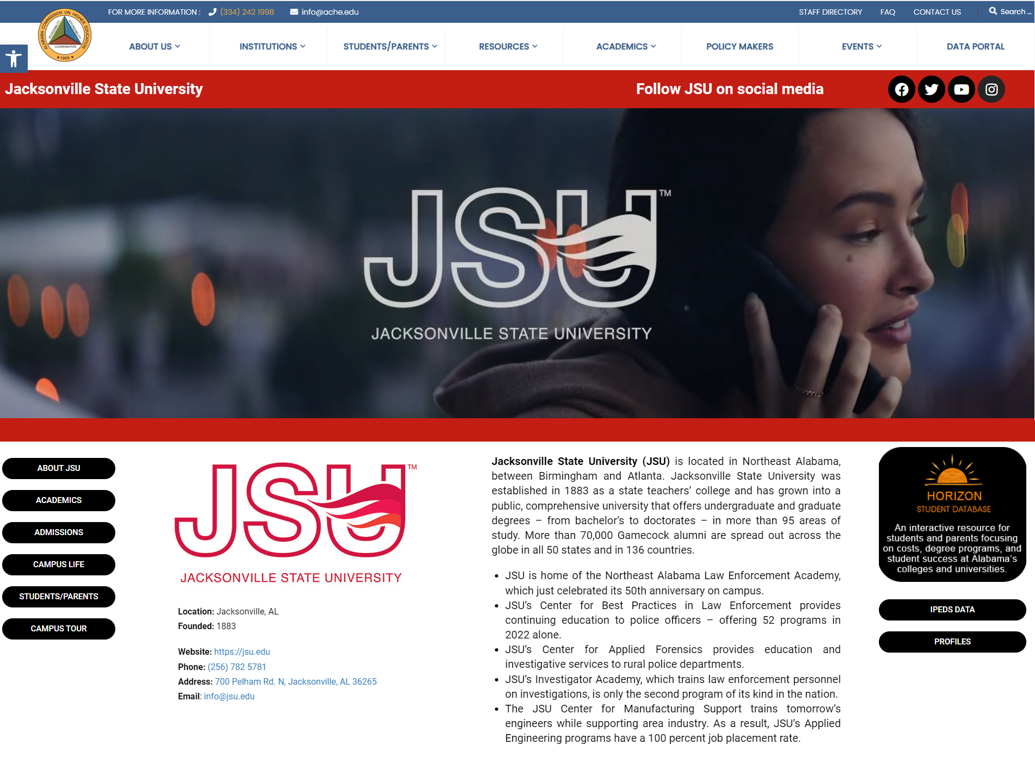
Institutional Profile Example
Social Media Icons
Full Page Institutional Video
Links to Institutional Pages
Unique Institutional “Brag” Facts
Federal and State Data
Horizon Student Database
Notes:
In my mind this is one of the most important reports developed by the Commission. It is not based on estimates or assumptions but links thousands of actual graduation records with actual employment records over a number of years to show how public higher education is contributing to the state’s workforce and economy.
This report measures average salary and retention at both 1-year and 5-year intervals -- by level of education, academic discipline, and residency.

Slide 38

Student Database
Student Database
Provides Interactive and Comparative Metrics for Students and Parents
Metrics will include the following categories:
Next Steps:
Wrap-up drafts of institutional profiles and Horizon database
Convene meetings with institutional stakeholders for feedback
Student Costs | Degrees & Degree Programs
Financial Aid and Debt | Student Enrollment
Retention & Graduation Outcomes | Workforce & Income
Notes:
In my mind this is one of the most important reports developed by the Commission. It is not based on estimates or assumptions but links thousands of actual graduation records with actual employment records over a number of years to show how public higher education is contributing to the state’s workforce and economy.
This report measures average salary and retention at both 1-year and 5-year intervals -- by level of education, academic discipline, and residency.

Slide 39

Outcomes-Based Funding

Slide 40

Outcomes-Based Funding*: Overview
Lawmakers passed Act in 2023-378 (SB87) that provided $15 million in outcomes-based funding for public universities
Funds included as part of the supplemental appropriation
Legislative language prescribes allocating the funds based on the February 2021 report from the Alabama Workgroup on Outcomes-Based Funding
*Legislation references
“Outcomes-Based Funding”
commonly known as
“Performance-Based funding”.

Slide 41

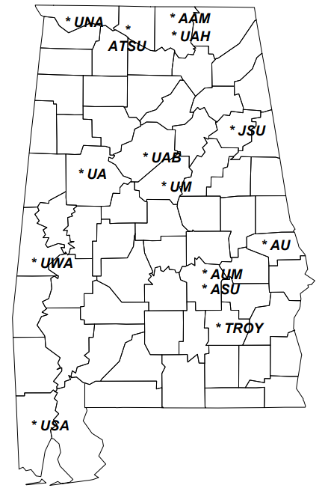
Outcomes-Based Funding: Overview
In 2020, the legislature encouraged university leaders to develop a performance funding model. ACCS had developed a performance funding specific to their institutions in the prior year.
University leaders identified metrics that primarily focused on student progression, degree completion, and research expenditures.
ACHE and HCM Strategists served as a resource for the university leaders.
Implementation was paused due to Covid.
In 2023, the supplemental budget allocated $15 million for the implementation of an outcome-based funding formula for the universities.
Conversations have begun to finalize implementation of outcomes-based funding for the universities.

Slide 42

UPDATE
Timeline Status of the
Alabama National Guard Education Assistance Program (ANGEAP)
Administrative Procedures Code Changes
Staff Presenter: Mrs. Artcola Pettway

Slide 43

Timeline of ANGEAP Approval
Preliminarily approval of the proposed amendments was granted by the Commission during a Special Commission meeting held on Monday, August 14, 2023, to stay within the LSA timeline for Fall 2023 awards to be granted.
The proposed changes were filed with the Legislative Services Agency on August 17, 2023, and published in the Alabama Administrative Monthly on August 31, 2023. Interested parties have until October 5, 2023, to make comments.
A second Special Commission meeting is scheduled to be held Wednesday, October 11, 2023. Proposed Amendments will be brought to the Commission to grant final approval to the proposed changes.
Should the Commission grant final approval to the proposed amendments, the certified changes will be filed with the Alabama Procedures Office and will go into effect a minimum of 45 days after the publication of the certification notice.

Slide 44



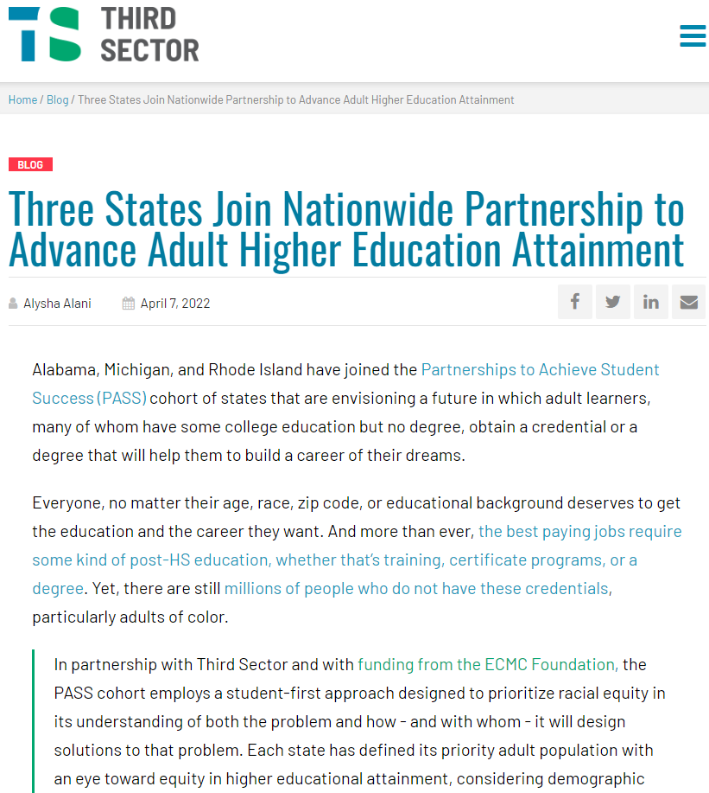






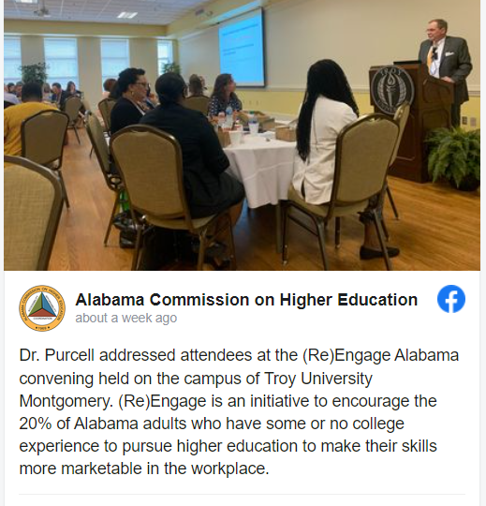








(Re)Engage Alabama Community of Practice

Slide 45

X. Decision ITEMS

Slide 46
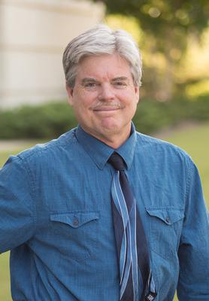


A. Forever Wild Appointment of Board Member
Dr. James B. McClintock
Staff Presenter: Mrs. Margaret Gunter

Slide 47
Forever Wild Appointment of Board Member
Dr. James B. McClintock
Central District appointment: October 1, 2023 – September 30, 2029
Endowed University Professor of Polar and Marine Biology at UAB
His research has been funded continuously over the past 25 years by the National Science Foundation and focuses on aspects of marine invertebrate nutrition, reproduction, and Antarctic marine chemical ecology
Research has expanded to include studies of the impacts of rapid climate change and ocean acidification on Antarctic marine algae and invertebrates
Has published over 290 scientific publications
His research has been featured in a variety of media outlets including National Geographic, Smithsonian, Wall Street Journal, The Weather Channel, and NPR’s “On Point”

Slide 48
Motion, Decision Item A:
That the Commission approve the Forever Wild Appointment of Board Member, Dr. James B. McClintock.

Slide 49

B. Approval of 2024 Meeting Schedule
Proposed Meeting Schedule for 2024
March 8, 2024
June 14, 2024
September 13, 2024
December 13, 2024

Slide 50
Motion, Decision Item B:
That the Commission approve the Commission’s 2024 Meeting Schedule.

Slide 51

C. Fiscal Year 2023-2024 Operations Plan
Veronica Harris
Director of Agency Fiscal Services and Accounting

Slide 52
Alabama Commission on Higher Education
FY 2023-24 Budgetary Facts
The purpose of the Operations Plan is to ensure that the objectives of the Legislature’s FY 2023-24 appropriations are satisfied. Each agency is required to submit a plan for each budget unit showing expenditures for each quarter of the fiscal year. This plan was due to the Executive Budget Office (EBO) on July 31, 2023, and submitted; however, any changes can be made by a revision after October 1, 2023.
The Commission has 36 programs under 6 appropriation units.
There is one new program in the FY 2023-24 budget, which is Alabama HBCU Cares.
The FY 2023-24 budget represents a 5.86% increase over the previous fiscal year’s budget.

Slide 53

Program Variants
The following programs received increases/decreases in the FY 2023-24 ETF budget:
ACHE Operations and Maintenance | $91,347
Retain Alabama | $100,000
Alabama Student Assistance Program | $1,000,000
Alabama Student Grant Program | $1,000,000
Articulations | $206,279
Experimental Program Stimulate Research | $59,968
Network of Alabama Academic Libraries | $4,875
Alabama Agricultural Land Grant Alliance | $100,000
Resource Conservation & Development | $700,000
Soil and Water Conservation Committee | $150,000
Alabama Forestry Foundation | ($650,000)
AKEEP | $50,000
National Computer Forensics | $100,000
Alabama Humanities Foundation | $100,000
USS Alabama Battleship | $600,000

Slide 54
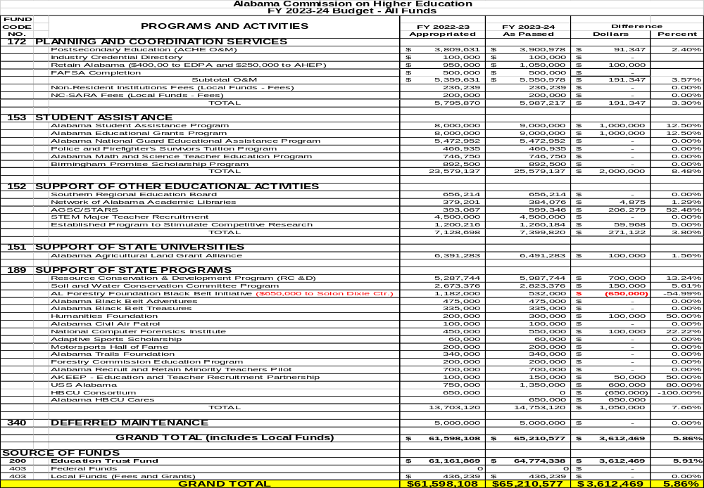

Slide 56
Planning and Coordinating Services
Retain Alabama/EDPA FAFSA Completion
Student Assistance
Alabama Student Assistance Program Alabama Educational Grants Program Alabama National Guard Educational Assistance Program Police and Firefighters’ Survivors Tuition Program Alabama Math and Science Teacher Education Program Birmingham Promise Scholarship Program
Support of Other Educational Activities
AGSC/STARS Southern Regional Education Board STEM Major Teacher Recruitment
Support of State Universities
Alabama Agricultural Land Grant Alliance
Deferred Maintenance
State Programs (17 Programs)

Slide 58
FY 2022-23 SUPPLEMENTAL FUNDS per Act 2023-378
$46,660,831

Slide 59
Motion, Decision Item C:
That the Commission approve the Fiscal Year 2023-2024 Operations Plan.

Slide 60
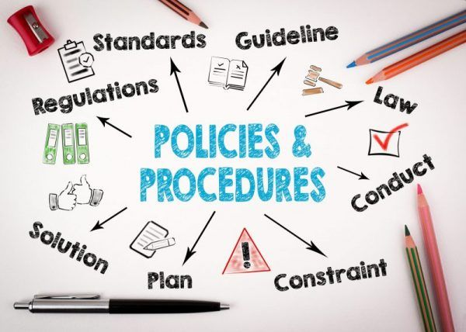
D. Preliminary Approval of Administrative Procedures for the New Chapter 300-4-13:
(Re)Engage Alabama Grant Program
Staff Presenter: Mrs. Artcola Pettway

Slide 61


Preliminary Approval of Administrative Procedures for the New Chapter 300-4-13:
(Re)Engage Alabama Grant Program
During the 2023 Legislative Session, Alabama Act 2023-539 was passed.
Establish the (Re)Engage Alabama Grant Program
  Increase the number of AL adults with college degrees;
  Encourage adults with some college credits to return to college;
  Provide grant award payment assistance to eligible adults;
  Establish eligibility standards and procedures;
  Provide ACHE with resources for administration

Slide 62

300-4-13-.01 Purpose of Grant Program
300-4-13-.02 Organization
300-4-13-.03 Definition of Terms
300-4-13-.04 Audits
300-4-13-.05 Rule Making Authority
300-4-13-.06 Awarding Procedures
300-4-13-.07 Disbursement of Funds
300-4-13-.08 Refund and Repayment Requirements
300-4-13-.09 Review Procedures
300-4-13-.10 Maintenance of Records

Slide 63
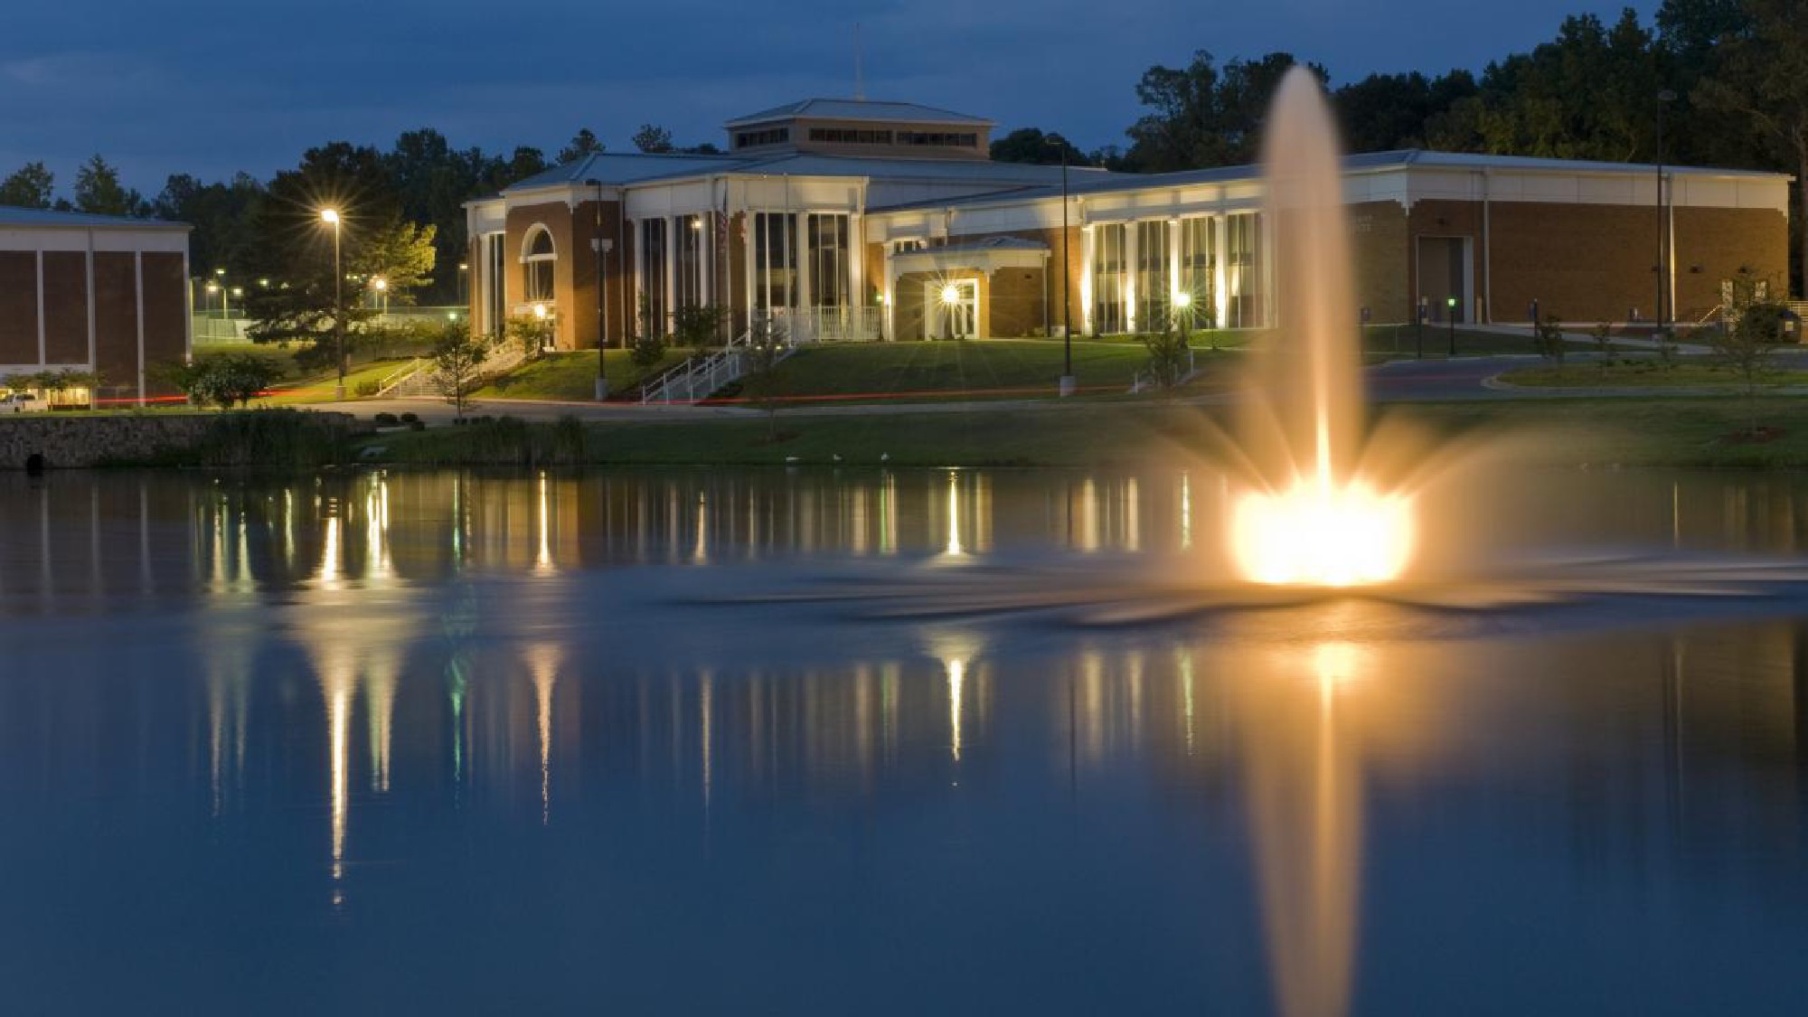
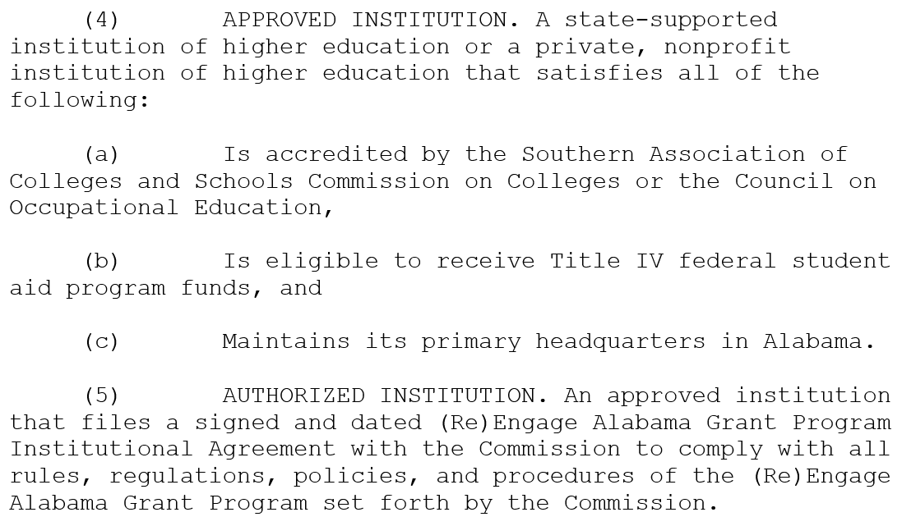
“Approved” Colleges and Universities per Act 2023-539
Chapter 300-4-13-.03.(4)

Slide 64
“Approved” Colleges and Universities
Alabama A&M University
Alabama State University
Athens State University
Auburn University
Auburn University at Montgomery
Jacksonville State University
Troy University
University of Alabama
UA in Birmingham
UA in Huntsville
University of Montevallo
University of North Alabama
University of South Alabama
University of West Alabama
Amridge University
Birmingham-Southern College
Faulkner University
Huntingdon College
Miles College
Oakwood University
Samford University
South University-Montgomery
Spring Hill College
Stillman College
Talladega College
Tuskegee University
United States Sports Academy
University of Mobile
Bevill State Community College
Bishop State Community College
Coastal Alabama Community College
Calhoun Community College
Central Alabama Community College
Chattahoochee Valley Community College
Drake State Community College
Enterprise State Community College
Gadsden State Community College
Jefferson State Community College
Lawson State Community College
LB Wallace Community College
Northeast Alabama Community College
Northwest-Shoals Community College
Reid State Community College
Shelton State Community College
Snead State Community College
Southern Union State Community College
Trenholm State Community College
Ingram State Community College
Marion Military Institute
Wallace State Community College-Dothan
Wallace State Community College-Hanceville
Wallace State Community College-Selma

Slide 65
“Authorized Institution” per Act 2023-539
Chapter 300-4-13-.03.(5)

Slide 66


Eligible Student per Act 2023-539
Chapter 300-4-13-.06.3(i)-3(x)
Is 25 years of age or older at time of current enrollment
Is a citizen or a lawful permanent resident of the United States
Is an Alabama Resident
  Proof includes a current valid Alabama driver license (front and back), a current valid Alabama vehicle registration, or a current valid Alabama voter registration card
Is a graduate of a secondary school or the recognized equivalent of a high school graduate
Has been out of college for two years (24 consecutive months) prior to their current enrollment
Has not earned their first associate or baccalaureate degree
  Only can pursue their first degree but having earned a certificate is acceptable for this program

Slide 67
Eligible Student per Act 2023-539
Chapter 300-4-13-.06.3(i)-3(x)
Has earned 36 credits toward an associate degree or 72 hours toward a baccalaureate degree of the approved program
Has been accepted, admitted, or enrolled in a program leading to a degree identified in alignment with a job on the ACCCP list of high demand programs and enrolled in six hours or more per semester
Has good academic standing as defined by the institution
Not enrolled in a course of study leading to an undergraduate degree in theology, divinity, or field of preparation for a religious vocation.
*Eligible Student: FAFSA must be completed, but individuals do not have to qualify for Pell grant and do not have to take out a Federal loan to receive (Re)Engage. Individuals should accept a Pell Grant if they qualify.

Slide 68

Award Amounts per Act 2023-539
Chapter 300-4-13-.06.3(e)
Full-time Students (at least 12 hours; maximum amount)
  $1,500 per semester for students pursuing an associate
  $3,000 per semester for students pursuing a bachelor’s
Part-time Students
  Prorated for 6-11 hours ($125 per credit hour for associate; $250 per credit hour for bachelor’s)
  Prorated for quarter terms: 3 semester credit hours is equivalent to 4.5 quarter credit hours
*A student grant recipient who elects to transfer from the original awarding institution to another educational institution will automatically become ineligible for the grant as this program award is not transferable from one educational institution to another.
*300-4-13-.03(20)

Slide 69


Steps to Determine the Allocation for Campuses
Chapter 300-4-13-.05
Careers requiring an associate or bachelor’s degree were identified within the upper quartile based on high demand and high wage (HDHW).
Program CIPs were aligned with the ACCCP high demand job list.
Program CIPs offered at the institutions were identified.
Annual average graduate counts of the CIPs were collected to determine the scholarship slots available to each institution.
A detailed webinar on the overall process was held for campuses on August 2, 2023, which can be viewed at https://www.ache.edu/?page_id=16109.

Slide 70
Determine HDHW Workforce Shortages to Target
Upper quartile of jobs requiring associate or baccalaureate degrees
Occupation Title in ACCCP List | Degree | Employed 2020 | Average Annual Openings | Openings Weights Rank 1-4 | Median Annual Salary | Salary Weights Rank 1-4 | Openings + Salary (1-8)
Medical & Health Services Managers | A/B | 6,950 | 830 | 4 | $82,608 | 4 | 8
Industrial Engineers | B | 6,320 | 605 | 4 | $87,837 | 4 | 8
Construction Managers | A/B | 6,580 | 585 | 4 | $87,915 | 4 | 8
Management Analysts | B | 5,500 | 615 | 4 | $90,377 | 4 | 8
Software Developers & Software Quality Assurance Analysts & Testers | B | 17,220 | 1,710 | 4 | $98,524 | 4 | 8
Registered Nurses | A/B | 51,280 | 3,185 | 4 | $58,631 | 3 | 7
Human Resources Specialists | B | 6,800 | 725 | 4 | $59,119 | 3 | 7
Accountants & Auditors | A/B | 20,900 | 2,025 | 4 | $64,035 | 3 | 7
Civil Engineers | B | 4,820 | 410 | 3 | $85,954 | 4 | 7
Logisticians | A/B | 4,390 | 545 | 3 | $87,230 | 4 | 7
Computer Systems Analysts | B | 5,170 | 390 | 3 | $88,552 | 4 | 7
Mechanical Engineers | B | 3,940 | 300 | 3 | $89,136 | 4 | 7
Electrical Engineers | B | 4,500 | 355 | 3 | $100,026 | 4 | 7
Financial Managers | B | 5,810 | 555 | 3 | $116,927 | 4 | 7
Computer & Information Systems Managers | A/B | 4,190 | 365 | 3 | $123,215 | 4 | 7

Slide 71
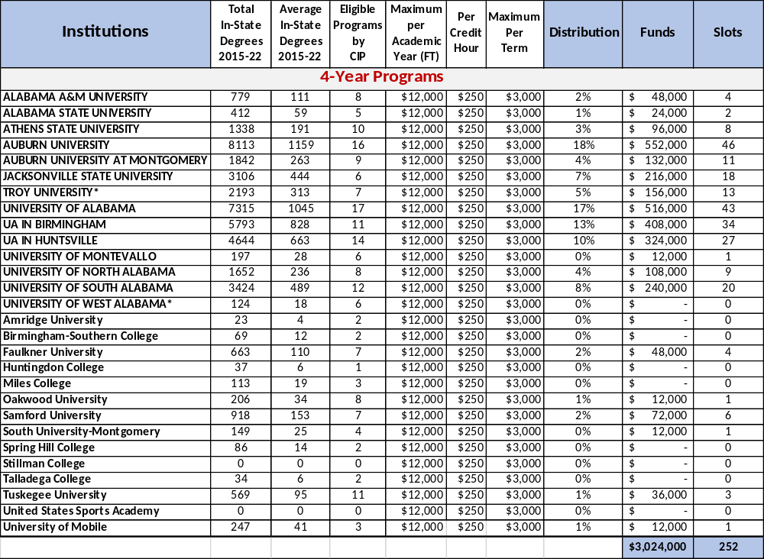
(Re)Engage Slots Based on Graduate Average: 4-Yr Programs
Projected 252 Slots for
4-Year Programs

Slide 72
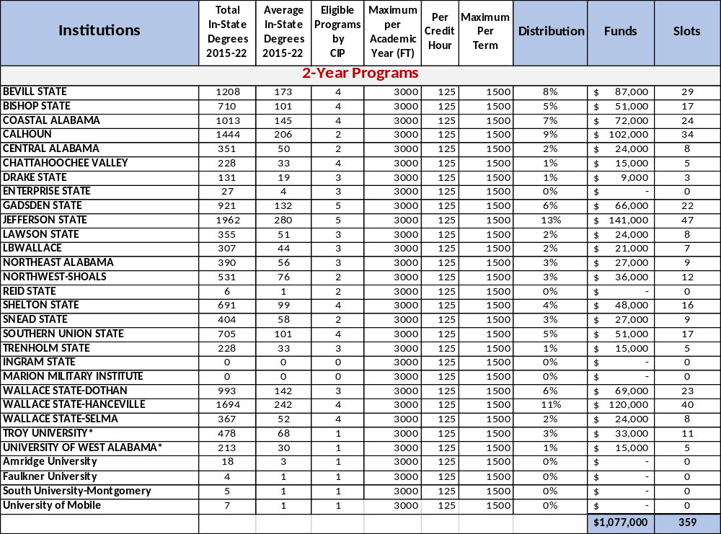
(Re)Engage Slots Based on Graduate Average: 2-Yr Programs
Projected 359 Slots for
2-Year Programs

Slide 73
The Approval Process for the Administrative Procedures of the
New Chapter 300-4-13 : (Re)Engage Alabama Grant Program
Once the proposed Administrative Procedures are preliminarily approved by the Commission (today), the proposed procedures will be filed with the Legislative Services Agency.
It will be published in the Alabama Administrative Monthly for 45 days for interested parties to comment.
At the December Commission meeting, the proposed Administrative Procedures will be brought back to the Commission to grant final approval of the proposed Administrative Procedures.
The certified Administrative Procedures will be filed with the Alabama Procedures Office and will go into effect a minimum of 45 days after the certification notice is published.

Slide 74
Motion, Decision Item D:
That the Commission grant their preliminary approval for the proposed Administrative Procedures for the New Chapter 300-4-13: (Re)Engage Alabama Grant Program.

Slide 75
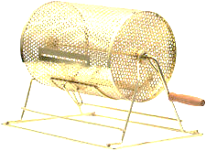
E. Public Drawing to Determine the Order of Payment of Alabama Student Grant Program (ASGP) Funds for the 2023-2024 Academic Year
Staff Presenter: Mrs. Takena Jones
Alabama Student Grant Program (ASGP) provides grants for eligible in-state students attending one of the following private institutions:
  Amridge University
  Birmingham Southern College
  Faulkner University
  Huntingdon College
  Miles College
  Oakwood University
Since all funds cannot be disbursed immediately, drawing is needed to determine disbursement order by institution.
Samford University
Spring Hill College
South University - Montgomery
Stillman College
U.S. Sports Academy
University of Mobile

Slide 76













Slide 77
Motion, Decision Item E:
That the Commission approve the Public Drawing to Determine the Order of Payment of Alabama Student Grant Program (ASGP) Funds for the 2023-2024 Academic Year.

Slide 78

F. Final Approval of Amendments to the Administrative Procedures for Academic Program Review
Staff Presenter: Dr. Robin McGill

Slide 79
Overview of Amendments: Chapter 300-2-1-.03
300-2-1-.03 Evaluation and Review of New Instructional Program Proposals of Public Postsecondary Institutions Last Amended: 1999
Synopsis of Section: This section sets forth the procedures for reviewing proposals for new academic degree programs and applies only to public institutions in Alabama. Separate review processes are given for each degree level, including review by institutional stakeholder groups. Processes for reviewing baccalaureate and graduate proposals include a two-month waiting period between receipt of the Notification of Intent to Submit a Proposal (NISP) and the proposal.
Summary of Changes:
Outdated terminology has been updated.
Definitions of degree levels are added to improve clarity.
Required notification of intent has been eliminated so that proposals can be processed more efficiently.
Review processes by institutional stakeholders allow for more flexibility.
New subsection added on review of programs above instructional role, adapting existing guidelines into policy.

Slide 80
Motion, Decision Item F-1:
That the Commission approve Overview of Amendments: Chapter 300-2-1-.03.

Slide 81
Overview of Amendments: Chapter 300-2-1-.04
300-2-1-.04 Operational Policy on the Approval, Disapproval, Deferral, and Withdrawal of New Programs of Instruction and Requirements for Post-Implementation Monitoring
Last Amended: 2018
Synopsis of Section: This section discusses actions the Commission may take on new program proposals, as well as some post-implementation considerations.
Summary of Recommended Changes:
New subsection has been added on post-implementation conditions reflecting current practice.
New subsection has been added on post-implementation review reflecting current practice.

Slide 82
Motion, Decision Item F-2:
That the Commission approve Overview of Amendments: Chapter 300-2-1-.04.

Slide 83
Overview of New Rule: Chapter 300-2-1-.11
300-2-1-.11 Evaluation of Changes to Instructional Role and Academic Units
Synopsis of New Rule: This section fills a policy need around instructional role change, which has only been addressed in a guidelines document. This section is also be an appropriate place to address changes to units of instruction (i.e., departments and divisions) within an institution’s existing instructional role. The rule defines instructional role and lay out a process for expanding the role to a higher degree level.
Summary of Stakeholder Discussions:
Several institutions have approached ACHE for guidance on expanding their instructional role, but no official policy exists outside a set of guidelines.
Stakeholders were largely comfortable codifying existing guidelines, along with some changes.
Definitions for different instructional role levels have been discussed with academic leadership and Alabama Council of Graduate Deans.

Slide 84
Motion, Decision Item F-3:
That the Commission approve Overview of New Rule: Chapter 300-2-1-.11.

Slide 85

G. Preliminary Approval of Repeal and New Rule 300-2-1.02 within Administrative Procedures for
Academic Program Review
Staff Presenter: Dr. Robin McGill

Slide 86
Proposed Updates to Chapter 300-2-1-.02
300-2-1-.02 Review and Approval or Disapproval of Proposed Postsecondary Course Offerings in Alabama By Non-Alabama Institutions Seeking State Authorization
Last Amended: 2018
Synopsis of Section: This section applies only to non-Alabama institutions seeking to offer postsecondary coursework to Alabama residents and does not apply to colleges or universities based in Alabama. It sets forth ACHE’s procedures for evaluating program offerings in tandem with the private school licensure process conducted by the Alabama Community College System (ACCS).
Summary of Recommended Changes:
Needs to be reorganized to improve clarity.
Needs additional terms defined to improve clarity.

Slide 87
Motion, Decision Item G:
That the Commission approve the Preliminary Approval of Repeal and New Rule 300-2-1.02 within Administrative Procedures for
Academic Program Review.

Slide 88

H. Preliminary Approval of Amendments to the Administrative Procedures for Academic Program Review 300-2-1.10
Staff Presenter: Dr. Robin McGill

Slide 89
Proposed Updates to Chapter 300-2-1-.10
300-2-1-.10 Distance Education
Adopted: 2007, Last Amended: 2018
Synopsis of Section: The section defines distance education and sets forth the requirements for public institutions to offer distance education programs.
Summary of Recommended Changes:
The section should be expanded to include a statement of purpose, commission responsibility, and scope.
Language should be clarified.

Slide 90
Motion, Decision Item H
That the Commission approve the Preliminary Approval of Amendments to the Administrative Procedures for Academic Program Review 300-2-1.10.

Slide 91

I. Academic Programs
Staff Presenters: Dr. Robin McGill
and Mrs. Kristan White

Slide 92








FOUR-YEAR INSTITUTIONS

Slide 93


Athens State University
1. Bachelor of Science in Marketing and Analytics (CIP 52.1401)
The proposed program builds upon an existing minor in Marketing within the College of Business and therefore will require minimal new resources to deliver.
The proposed BS will prepare graduates for employment as Market Research Analysts and Marketing Specialists, which are included on the Alabama Statewide In-Demand Occupations and the Region 1 In-Demand Occupations Lists.

Slide 94
Motion, Decision Item I-1:
That the Commission approve Athens State University’s proposal to offer a Bachelor of Science in Marketing and Analytics.

Slide 95


Auburn University
2a. Bachelor of Science in Drug and Biopharmaceutical Sciences
(CIP 51.2010)
The proposed program extends AU’s offerings within the College of Pharmacy down to the undergraduate level and offers an undergraduate field of study in Drug and Biopharmaceutical Science not currently offered by other institutions in the State of Alabama.
The Alabama biosciences sector, including biopharmaceutical manufacturers, currently generates about $7.3 billion in economic activity annually, while supporting 780 companies and nearly 48,000 direct and indirect jobs across the state.
This Photo by Unknown Author is licensed under CC BY-ND

Slide 96
Motion, Decision Item I-2a:
That the Commission approve Auburn University’s proposal to offer a Bachelor of Science in Drug and Biopharmaceutical Sciences.

Slide 97

Auburn University
2b. Master of Science in Business Administration - Finance
(CIP 52.0201) – Substantive Modification
Auburn University is proposing to modify the CIP code and title for the MS in Business Administration—Finance from CIP 52.0201, which is shared with the MS in Business Administration (all options), to CIP 52.0801 (MS in Finance), which better describes the content of the degree. Consistent with Commission policy, the proposed substantive modification pertains to a program that has already been in existence and does not require any additional funding to deliver in its modified form.
This Photo by Unknown Author is licensed under CC BY-ND

Slide 98
Motion, Decision Item I-2b:
That the Commission approve Auburn University’s proposal to make a Substantive Modification to the Master of Science in Business Administration – Finance.

Slide 99


Auburn University at Montgomery
3. Master of Science in Biochemistry and Molecular Biology
(CIP 26.0210)
AUM’s investments in this program are part of a larger strategic growth plan for the College of Sciences focused on significantly increasing its research output and increasing the amount of external funding.
The proposed program is designed to support Alabama’s biosciences sector, which currently generates about $7.3 billion in economic activity annually, while supporting 780 companies and nearly 48,000 direct and indirect jobs across the state.
This Photo by Unknown Author is licensed under CC BY-ND

Slide 100
Motion, Decision Item I-3:
That the Commission approve Auburn University at Montgomery’s proposal to offer a Master of Science in Biochemistry and Molecular Biology.

Slide 101


Troy University
4a. Change of Instructional Role to Doctoral Granting
In 2019, Troy University’s Board of Trustees approved a revision to the University’s mission statement to specifically include doctoral programs among its graduate offerings, with the goal of pursuing a role change to doctoral granting.
Beginning in 2009, Troy University has successfully implemented three doctoral-level programs: DNP in Nursing (CIP 51.3818), PhD in Sport Management (CIP 31.0504), and PhD in Global Leadership (CIP 52.0213).
Troy University seeks to expand its doctoral production and sponsored research activities with the goal of reaching the Carnegie classification of “R2: Doctoral University—High Research Activity,” a recognition that will benefit the University community, along with the region and the state, especially in developing partnerships with business and industry.
This Photo by Unknown Author is licensed under CC BY-ND

Slide 102
Motion, Decision Item I-4a:
That the Commission approve Troy University’s instructional role change to a doctoral granting institution.

Slide 103

Troy University
4b. Master of Business Administration in Business Design
(CIP 52.0701)
The MBA in Business Design adapts the traditional broad MBA curriculum to focus on entrepreneurial aspects of launching and growing a firm, which aligns with statewide efforts to promote innovation and attract start-up companies to Alabama.
The proposed program will build on existing expertise within the College of Business and will not require any additional resources to implement.
The proposed program will leverage the facilities and resources
of the Troy University IDEA Bank, including potential business
start-up funding from alumni donors.
This Photo by Unknown Author is licensed under CC BY-ND

Slide 104
Motion, Decision Item I-4b:
That the Commission approve Troy University’s proposal to offer a Master of Business Administration in Business Design.

Slide 105



University of Alabama
5. Master of Science in Nursing in Master’s Entry to the Profession
of Nursing (CIP 51.3801)
The proposed MSN program is designed to prepare those with a bachelor's degree in any area outside of Nursing to become entry-level professional nurses (generalists) and will prepare them for licensure at a faster rate than the traditional pre-licensure programs. UA indicates that it has a significant pool of bachelor’s graduates who started in pre-nursing and may be interested in this program.
The proposed program will take advantage of significant existing faculty expertise at the UA Capstone College of Nursing and would require no new funds to implement.

Slide 106
Motion, Decision Item I-5:
That the Commission approve the University of Alabama’s proposal to offer a Master of Science in Nursing in Master’s Entry to the Profession of Nursing.

Slide 107

University of Alabama at Birmingham
6. Master of Science in Healthcare Innovation (CIP 51.0722)
UAB’s Heersink School of Medicine recently received a significant gift to launch a Healthcare Innovation Institute focused explicitly on capacity development to support the healthcare innovation and entrepreneurship ecosystem of Birmingham and Alabama. The gift will enable the institute to recruit world-class specialized faculty to lead the academic healthcare innovation program.
Given the unique healthcare and biomedical ecosystem in the Birmingham region and UAB’s presence in that ecosystem, the program will advance economic development and commercial activity in the City of Birmingham and the State of Alabama.

Slide 108
Motion, Decision Item I-6:
That the Commission approve the University of Alabama at Birmingham’s proposal to offer a Master of Science in Healthcare Innovation.

Slide 109


University of Montevallo
7. Doctor of Education in Educational Leadership (CIP 13.0401)
The proposed program would become the first practice-focused doctorate offered by UM and fits within the University’s remit to offer “professional programs supported by a broad base of arts and sciences.”
The proposed EdD will extend UM’s offerings in Educational Leadership to the doctoral level. UM’s existing MEd in Educational Leadership (CIP 13.0401) and related EdS offerings (Teacher Leadership CIP 13.0101 and Instructional Leadership CIP 13.0401) have demonstrated strong enrollment and completion numbers.

Slide 110
Motion, Decision Item I-7:
That the Commission approve the University of Montevallo’s proposal to offer a Doctor of Education in Educational Leadership.

Slide 111


University of North Alabama
8a. Bachelor of Science in Instructional Technology and Design
(CIP 13.0501)
This program will fulfill a strong demand for entry-level positions in instructional design, corporate training, and digital design. North Alabama, Huntsville in particular, attracts a variety of IT talent, making it one of the best places to live for technology professionals.
The proposed program will extend UNA’s offerings in Instructional Design and Technology down to the undergraduate level. Its existing online Master of Science in Instructional Technology and Design (CIP 13.0501) has experienced a high level of growth since its launch in Fall 2021.

Slide 112
Motion, Decision Item I-8a:
That the Commission approve the University of North Alabama’s proposal to offer a Bachelor of Science in Instructional Technology and Design.

Slide 113


University of North Alabama
8b. Bachelor of Engineering in Engineering (CIP 14.0101)
The proposed BEng is designed to meet requirements for specialized accreditation through the Accreditation Board for Engineering and Technology, and if approved, it will be one of two interdisciplinary Engineering programs offered at the undergraduate level in Alabama.
The proposed BEng will be supported, in part, by faculty and resources that are associated with UNA’s current BS in Engineering Technology program (CIP 15.0000), which will significantly reduce start-up costs.

Slide 114
Motion, Decision Item I-8b:
That the Commission approve the University of North Alabama’s proposal to offer a Bachelor of Engineering in Engineering.

Slide 115

University of North Alabama
8c. Bachelor of Business Administration in Human Resource
Management (CIP 52.1001)
The proposed BBA Human Resource Management will prepare graduates for employment as HR Managers, HR Specialists, and Training and Development Specialists, occupations that are included on the 2023 Statewide In-Demand List.
The proposed program builds upon an existing concentration in Human Resource Management within the BBA in Professional Management (CIP 52.0201) and therefore will require minimal new resources to deliver.

Slide 116
Motion, Decision Item I-8c:
That the Commission approve the University of North Alabama’s proposal to offer a Bachelor of Business Administration in Human Resource Management.

Slide 117


University of North Alabama
8d. Master of Science in Occupational Safety and Health
Management (CIP 51.2206)
The proposed program is designed to prepare graduates for employment as Occupational Health and Safety Specialists (SOC 19-5011) and Health and Safety Engineers, Except Mining Safety Engineers and Inspectors (SOC 17-2111), both of which appear on the Region 1 Statewide In-Demand Occupations List.
The proposed program will extend UNA’s existing offerings in Occupational Health Science into the master’s level, and shared resources will reduce the start-up costs for the program.

Slide 118
Motion, Decision Item I-8d:
That the Commission approve the University of North Alabama’s proposal to offer a Master of Science in Occupational Safety and Health Management.

Slide 119


University of North Alabama
8e. Doctor of Social Work in Social Work (CIP 44.0701)
UNA currently offers successful Bachelor of Social Work (BSW) and Master of Social Work (MSW) programs, both of which are fully accredited by the Council on Social Work Education (CSWE) and produce 40-50 graduates per year on average. The proposed program will extend UNA’s offerings to the practice-doctorate level.
Currently, there is only one public institution in Alabama that offers a DSW program (the University of Alabama) and demand for doctoral-level social work practitioners remains high throughout the state.

Slide 120
Motion, Decision Item I-8e:
That the Commission approve the University of North Alabama’s proposal to offer a Doctor of Social Work in Social Work.

Slide 121

























ALABAMA COMMUNITY COLLEGE SYSTEM

Slide 122


Snead State Community College
9a. Associate of Applied Science and Certificate in HVAC/R Technology
(CIP 15.0501)
The proposed program will help meet the current demand for HVAC/R mechanics and installers, an occupation included on the Statewide and Region 1 In-Demand positions lists.
The new program will provide career pathways and apprenticeship opportunities for students entering the HVAC/R field, including high school dual enrollment students and underemployed and unemployed workers.

Slide 123
Motion, Decision Item I-9a:
That the Commission approve Snead State Community College’s proposal to offer an Associate of Applied Science and Certificate in HVAC/R Technology.

Slide 124


Snead State Community College
9b. Associate of Applied Science and Certificate in Machine Tool
Technology (CIP 48.0501)
The proposed AAS and CER in Machine Tool Technology are designed to prepare graduates for employment in occupations on the Statewide In-Demand Occupations List, such as machine setters and operators.
The new program will provide career pathways and apprenticeship opportunities for students entering the machine tool field, including high school dual enrollment students and underemployed and unemployed workers.

Slide 125
Motion, Decision Item I-9b:
That the Commission approve Snead State Community College’s proposal to offer an Associate of Applied Science and Certificate in Machine Tool Technology.

Slide 126



Wallace Community College - Selma
10. Associate of Applied Science and Certificate in Modern
Manufacturing (CIP 15.0613)
The proposed program will replace the current AAS and CER in Industrial Maintenance Technology, and as such will require minimal new investment to deliver.
The program will prepare students for employment in careers that are all included on the Alabama In-Demand Occupations list.

Slide 127
Motion, Decision Item I-10:
That the Commission approve Wallace Community College - Selma’s proposal to offer an Associate of Applied Science and Certificate in Modern Manufacturing.

Slide 128

J. INFORMATION ITEMS
Distribution of 2023-2024 Alabama Student Assistance Program (ASAP) Funds
Troy University, Annual Report of Program Offerings at Dothan and Montgomery Campuses
Implementation of Non-Degree Programs at Senior Institutions
Implementation of New Short Certificate Programs (Less than 30 Semester Hours)
Changes to the Academic Program Inventory
Updates to Academic Units
Extensions/Alterations to Existing Programs of Instruction
Implementation of Distance Education Programs
Summary of Post-Implementation Reports

Slide 129
Motion, Decision Item J:
That the Commission accept the information items as presented.

Slide 130
K. ADJOURNMENT

