Slide 1
SARA and NC-SARA Updates
Alabama Commission on Higher Education
SARA Workshop at Faulkner University
Jared B. Abdirkin,
Senior Director, Institutional Engagement & Initiatives
NC-SARA
Friday, November 7, 2025
Notes:
MB

Slide 2
What is SARA, What is NC-SARA
SARA Resources
SARA Developments
SARA Policies
State and Federal Developments
Agenda
Today’s Topics
Notes:
MB

Slide 3
What is SARA & NC-SARA
SARA
The State Authorization Reciprocity Agreement (SARA) is a voluntary agreement among member states, districts, and territories that establishes standards for the reciprocal authorization of institutions providing distance education across state lines. As of 2025, 49 states, the District of Columbia, Puerto Rico, and the U.S. Virgin Islands have voluntarily joined SARA. More than 2,400 institutions have received approval from their home state to participate in the agreement.
NC-SARA
The National Council for State Authorization Reciprocity Agreements (NC-SARA) is a private nonprofit organization [501(c)(3)] that coordinates the implementation of the State Authorization Reciprocity Agreement (SARA) in collaboration with the four regional, interstate education compacts:
Midwestern Higher Education Compact (MHEC)
New England Board of Higher Education (NEBHE)
Southern Regional Education Board (SREB)
Western Interstate Commission for Higher Education (WICHE)
NC-SARA supports the regional education compacts and states as they implement the agreement and carry out their SARA-related work. Additionally, NC-SARA facilitates information exchange among the regional compacts, member states, and SARA institutions regarding participation and compliance.
Notes:
MB

Slide 4
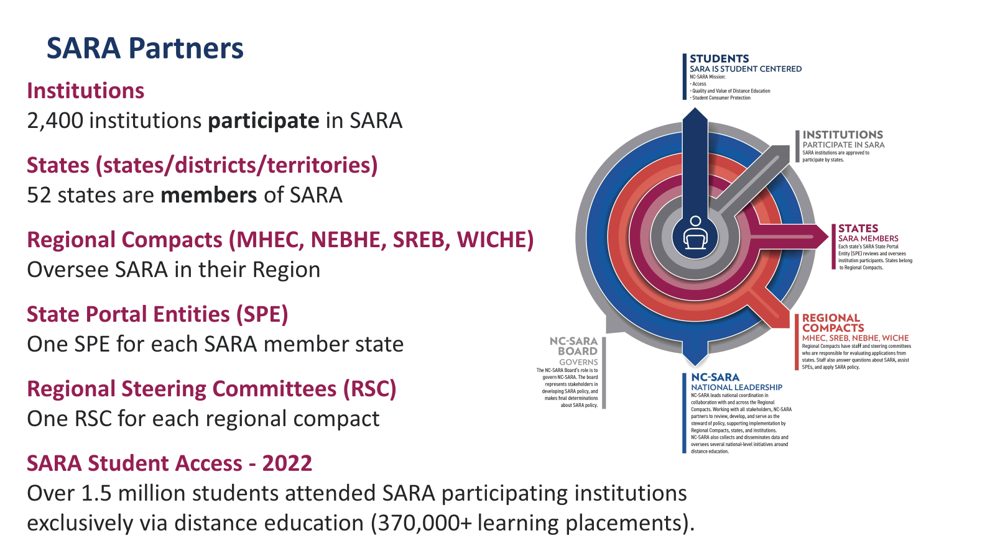
SARA Partners and Impact
Institutions
Over 2,400 institutions voluntarily participate in SARA
Institutions are reviewed for renewal annually by the SPE
States (states/districts/territories)
52 states are members of SARA
State are reviewed every two years for SARA Membership
Regional Compacts (MHEC, NEBHE, SREB, WICHE)
Oversee SARA in their region
State Portal Entities (SPE)
One SPE for each SARA member state
Regional Steering Committees (RSC)
One RSC for each regional compact
SARA Student Access
Over 1.66 million students attended SARA-participating institutions out-of-state exclusively via distance education (473,000+ out of state learning placements)
Notes:
MB

Slide 5

The Critical Role of the States
States approve their “home-state” institutions to participate in SARA
The SARA State Portal Entity (SPE) is the state agency responsible for SARA approvals and compliance
Notes:
MB

Slide 6
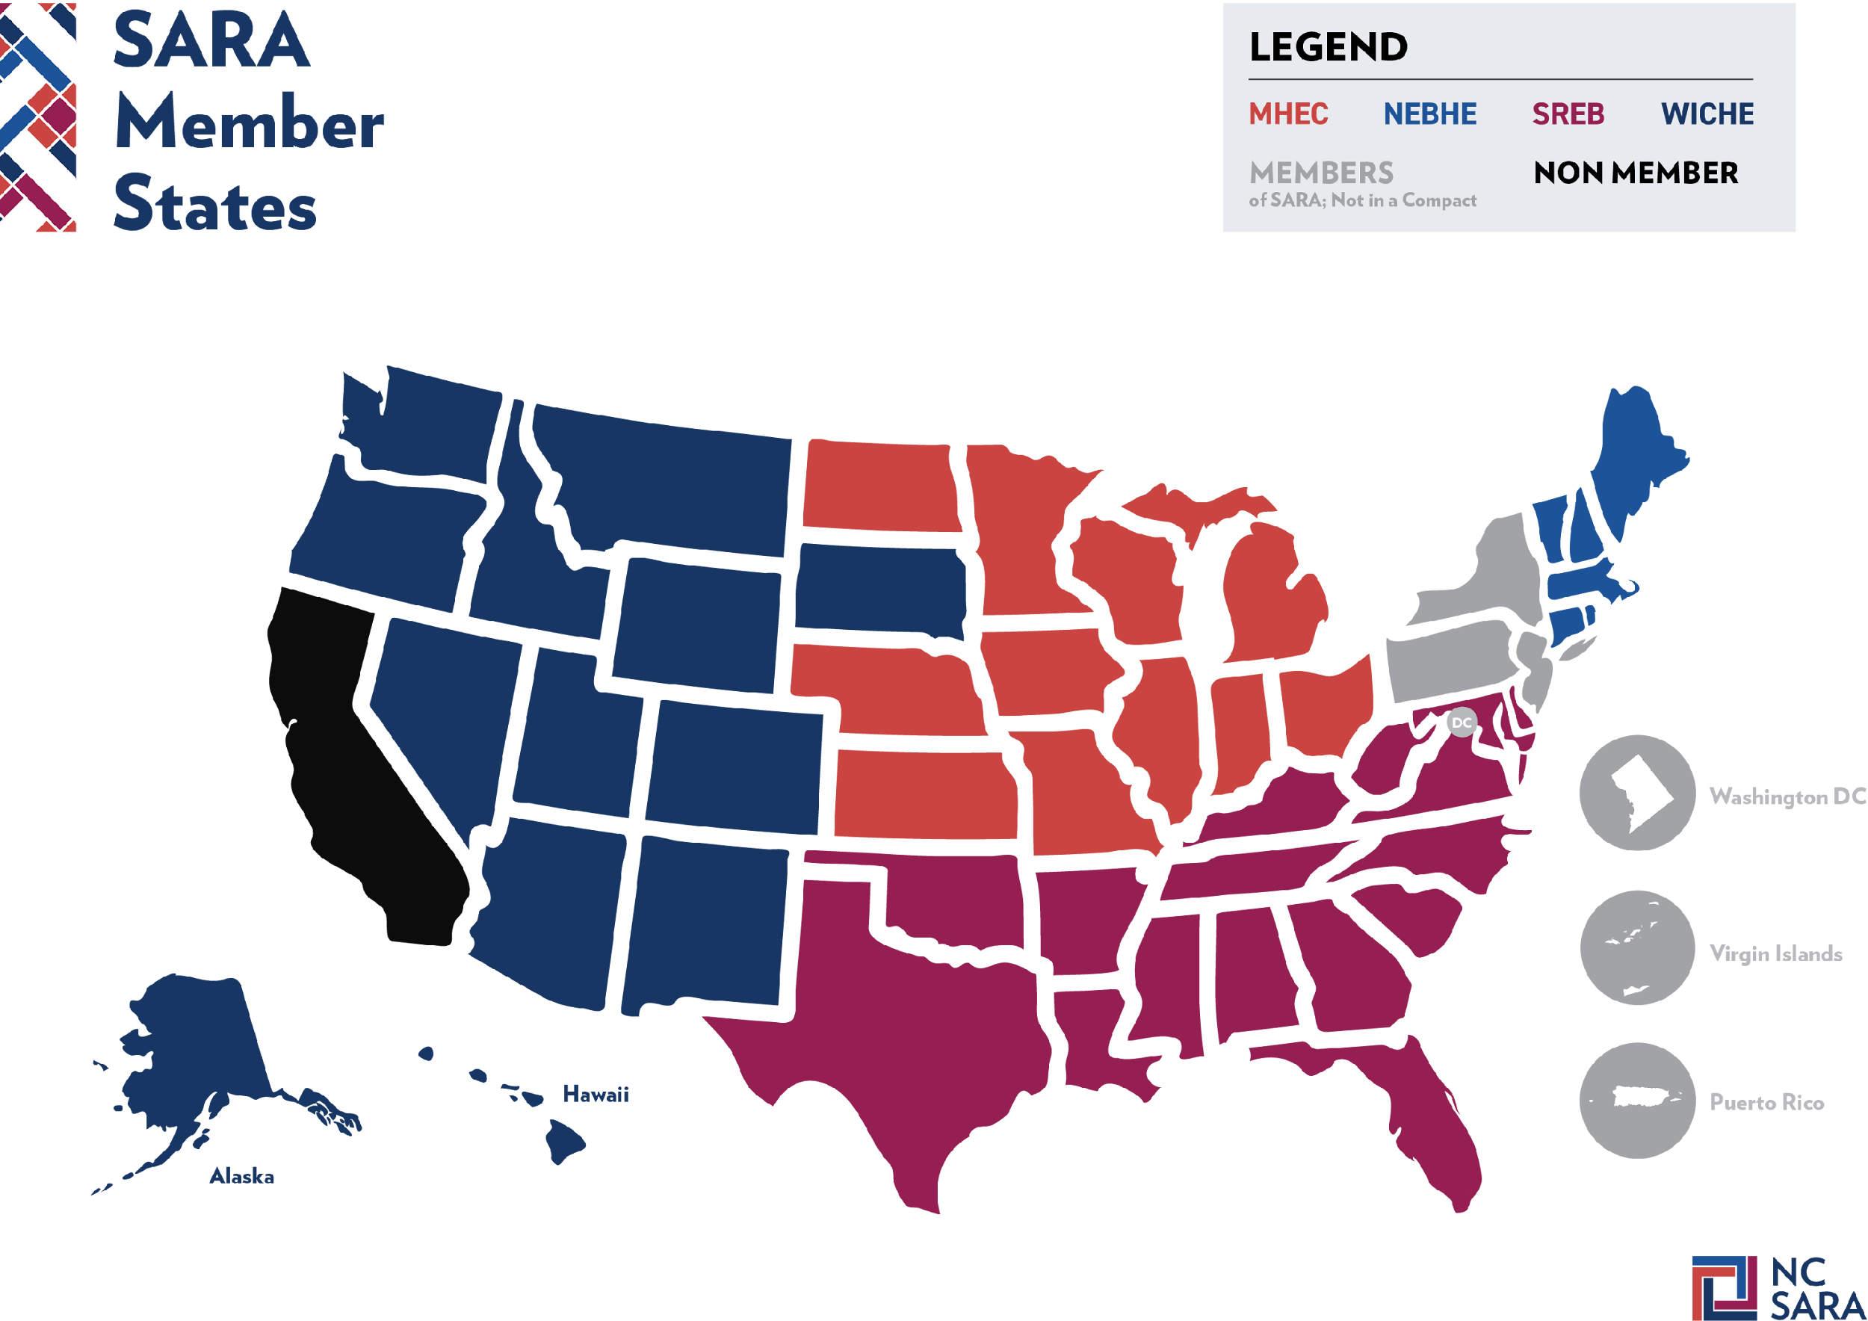
Notes:
MB

Slide 7
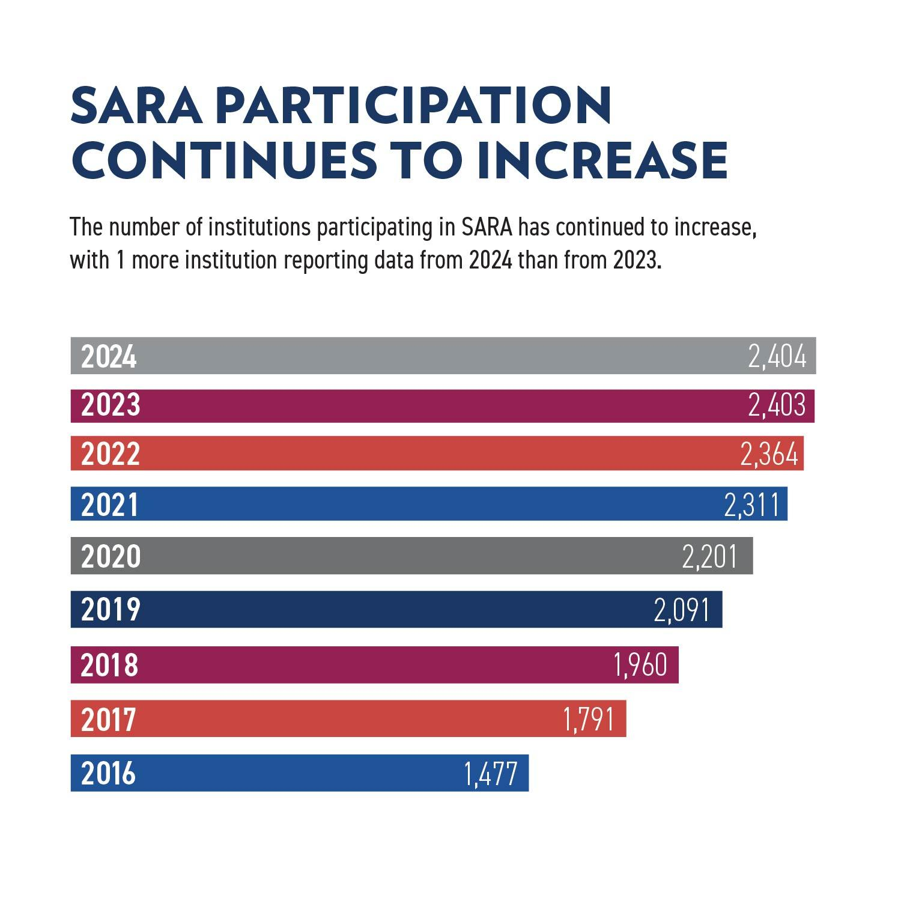
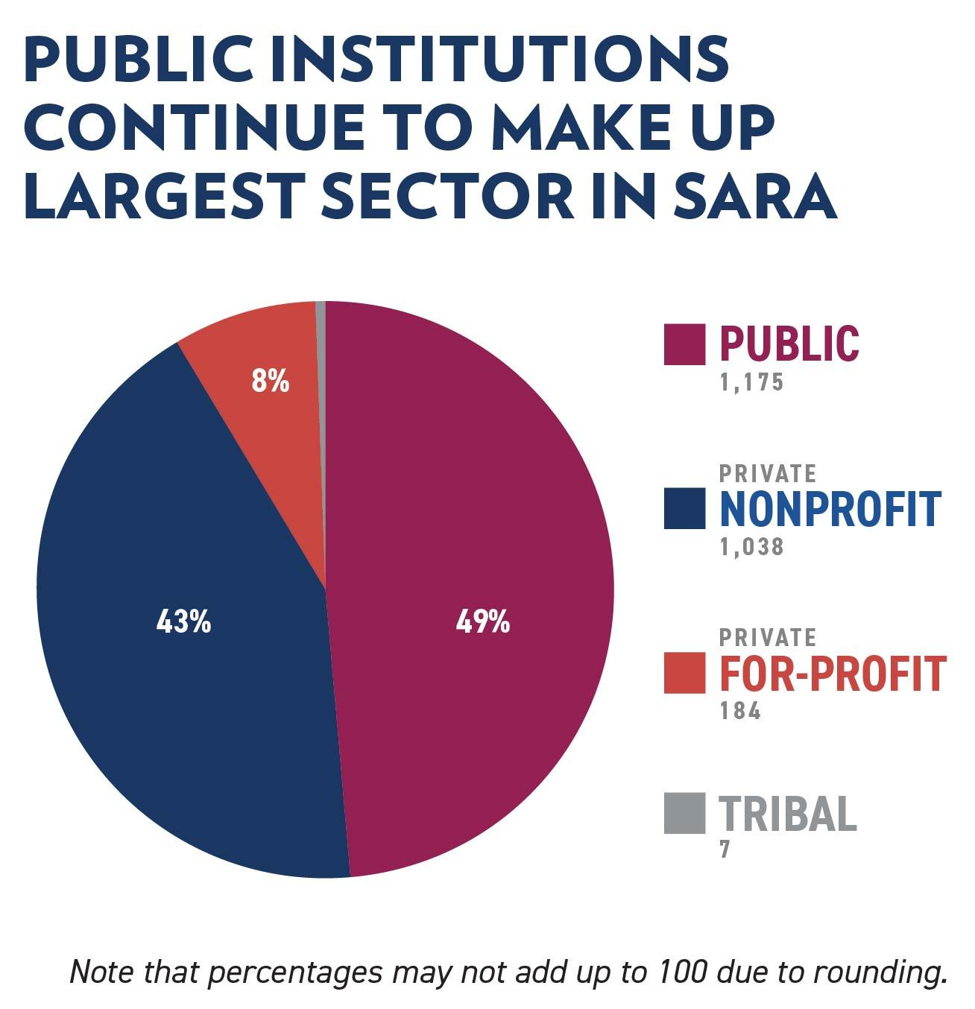
Notes:
MB

Slide 8
SARA Resources
Notes:
JA

Slide 9
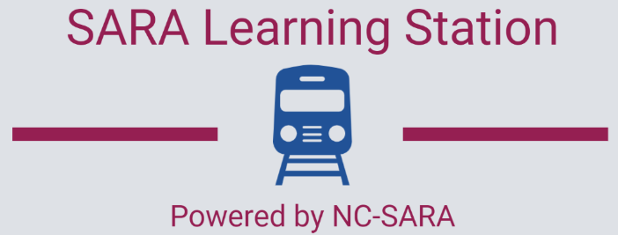
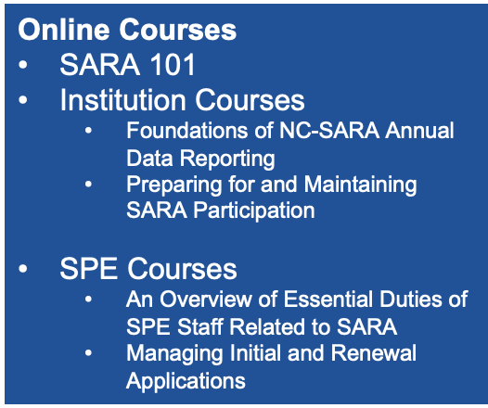
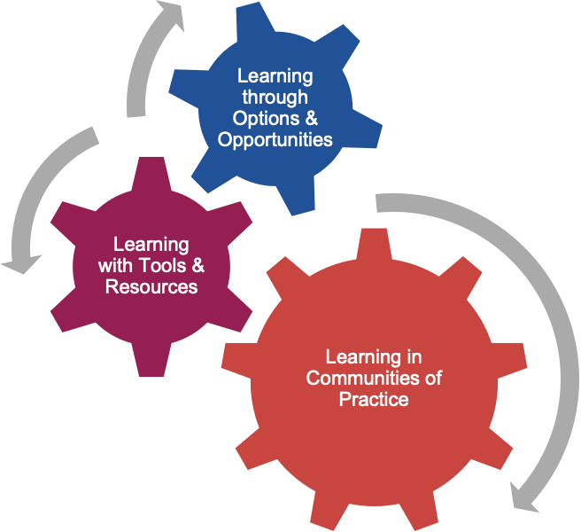
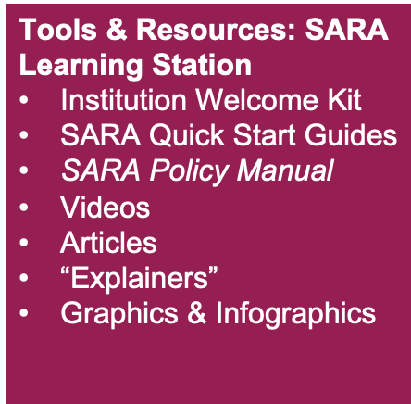
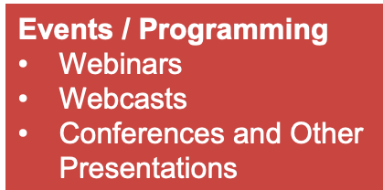
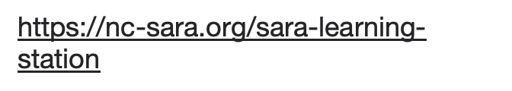
Notes:
JA

Slide 10
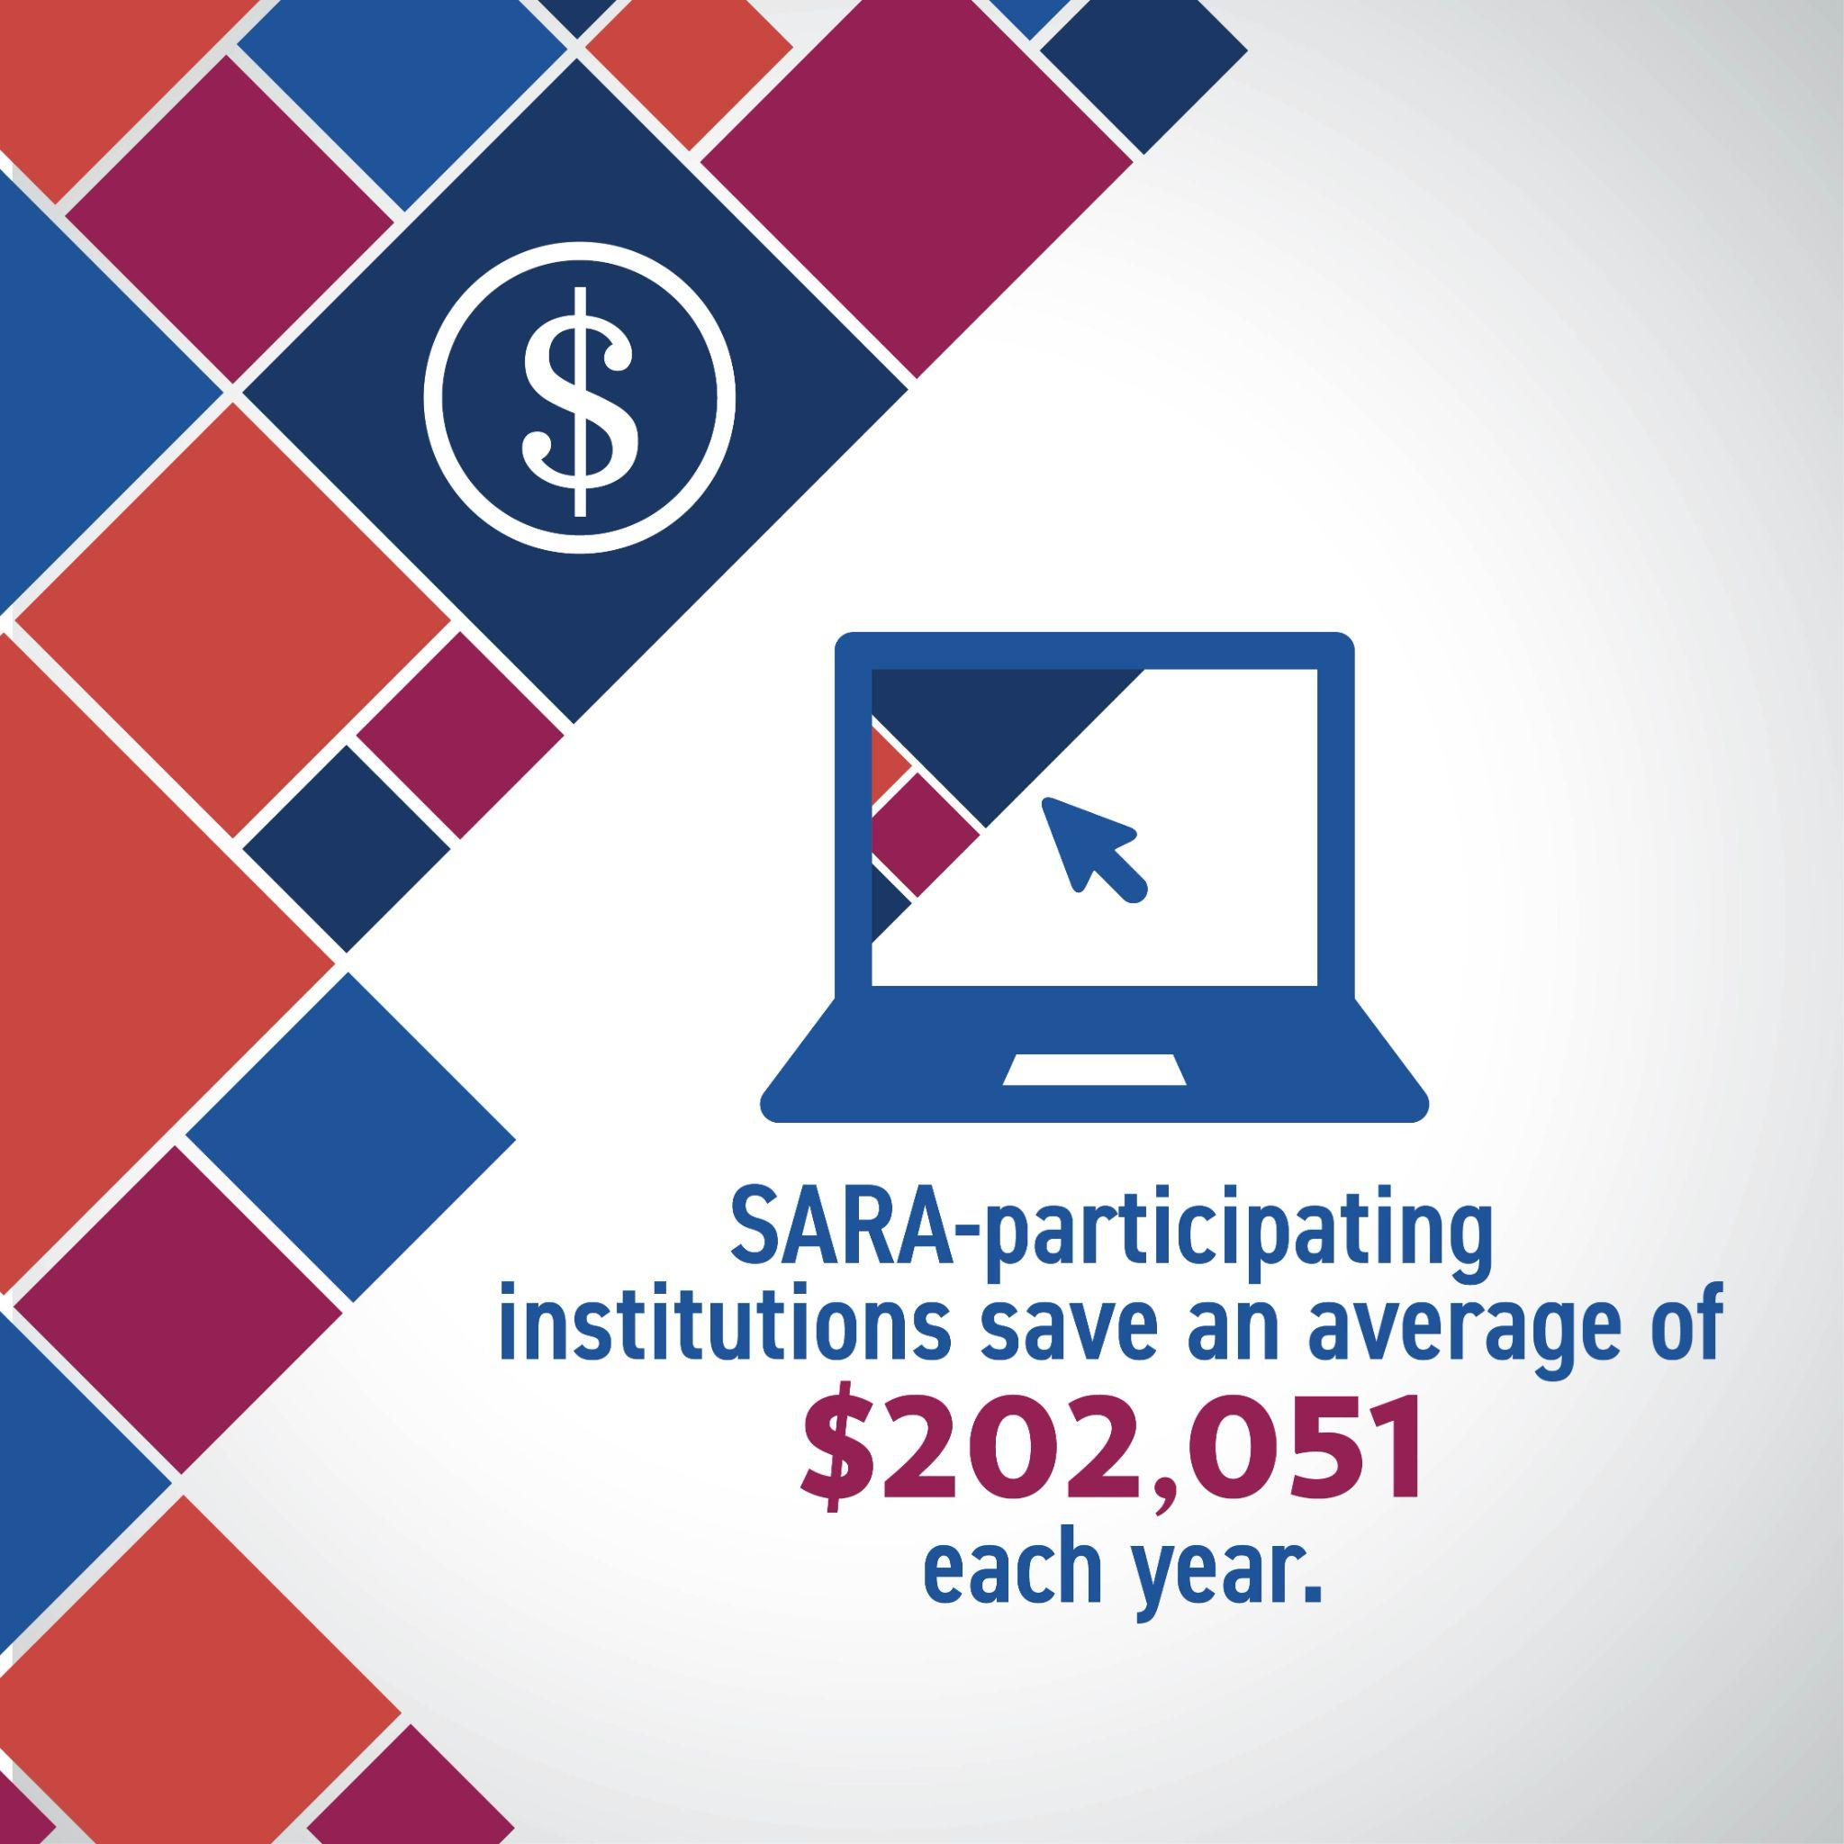
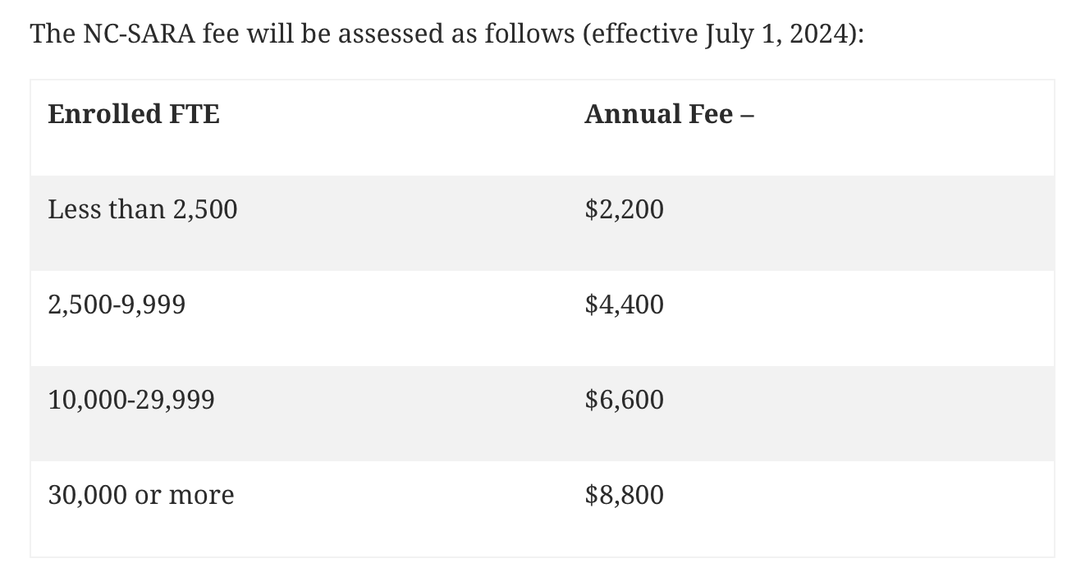
NC-SARA Participation Fees
Note – this is separate from and in addition to any fees state-specific fees charged
Notes:
JA

Slide 11
SARA Developments
Notes:
JA

Slide 12

Current Areas of Work
Converting to eForms - electronic processing
Electronic Enhancements to Institution Application
SARA Institution Application
new policies require updates (SARA Policy Modification Process)
new versions - 7/1/25, 1/1/26, 7/1/26
Institutions only complete renewal application ONCE annually
plan to update only once a year in July, starting 2026
Notes:
JA

Slide 13

Enhancing Institution Engagement
Quarterly Institution Newsletter (began January 2025)
Timely webinars
November - SARA Policy changes (mostly) effective 2026
June - Federal Financial Responsibility Composite Scores (FFRCS)
March - Professional Licensure
Updated learning resources
Institution Application “Quick Start Guide”
Notes:
JA

Slide 14
SARA Policies
Notes:
JA

Slide 15
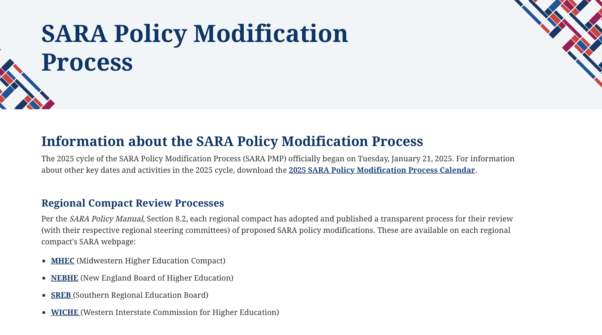
SARA Policy Modification Process (PMP)

Slide 16
Learn, View, Participate & Follow
Learn About the SARA Policy Modification Process
SARA Policy Modification Process Calendar
View the SARA Policy Modification Process in a flowchart format.
Learn about the history of the SARA Policy Modification Process and how the regional compacts review proposals.
View SARA Policy Modification Proposals
SARA Policy Portal
Participate & Follow the SARA Policy Modification Process
Public Comments
SARA Public Forum

Slide 17
PMP24-0619: Responsibilities for Resolving Complaints
January 1, 2026 Institution Application
Already reflected in SARA Student Complaints “Quick Start Guide”
eBlast to all institutions mid-March letting them know this is coming, given potential timeline for their next academic catalog. Continue reminding in new quarterly newsletter for institutions for remainder of 2025.
4.4 Responsibilities for resolving complaints (italicized language effective January 1, 2026)
Effective beginning January 1, 2026 - Institutions operating under SARA policies shall provide their and SARA’s complaint resolution policies and procedures to all students taking courses under SARA policies on the institution’s website and in the institution’s catalog or equivalent information provided either in print or electronically to students when they enroll.
Notes:
JA

Slide 18

SARA PMP 2025 - What’s on the Horizon
Effective July 1, 2026
PMP25-0746: Submitting Teach Out Plans to States - A SARA-participating institution that is required to submit an institutional teach-out plan or similar with an accrediting agency, authorizing entity, or the U.S. Department of Education shall simultaneously provide a copy to their SPE.
PMP25-0751: Provisional Status Disclosure - Institutions placed on SARA provisional status will be required to disclose this status on the institution’s website, including the reason.
Notes:
JA

Slide 19


Upcoming Webinar
2025 SARA Policy Modification Process Cycle Wrap-Up
Reviewing Impact and Considerations for
SARA-Participating Institutions
November 17, 2025
11:00 A.M. – 12:30 P.M. Mountain Time.
Registration required to attend
https://nc-sara.org/news-events/2025_sara_pmp_wrap-up/
Recording and slides posted on the page above soon after program date
Notes:
JA

Slide 20
State and Federal Developments
Notes:
MB

Slide 21
State Legislative Updates
California SB-790
On February 21, 2025, the bill was introduced by Senator Cabaldon
The bill went through several amendments through various committees
During the Suspense File hearing in the Assembly Appropriations Committee on August 29, 2025, this measure was held in committee under submission
Held under submission is an action taken by a committee when a measure is heard in committee and there is an indication that the author and the committee members want to work on or discuss the measure further, but there is no motion for the measure to progress out of committee.
Bill Text - SB-790 Postsecondary education: postsecondary education coordinating entity: interstate reciprocity agreements for distance education: out-of-state postsecondary educational institutions.
Washington HB-1279
Introduced by Representatives Pollet, Leavitt, Doglio, Reed, and Simmons
Passed the House on March 7, 2025; Passed the Senate on April 11, 2025
Governor signed on April 21, 2025
Note: the state will assess its SARA membership in 2026 and again in 2028, with the ability to take steps to leave SARA in 2028.
Bill Text - HB 1279 Washington State Legislature
WSAC has included information about the legislation on its website here: https://wsac.wa.gov/sara

Slide 22
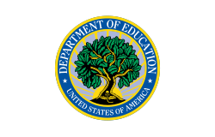
The US Department of Education
Created in 1979
More than 4,400 people worked for the department in 2024
In fiscal year 2024, the department had a $80 billion discretionary budget; 268 billion total budget
Its spending makes up just over 4 percent of the federal budget
Abolish the U.S. Department of Education? Not so fast…but we could see it dismantled:
A downsizing of staff (cutting the staff)
Focus on Core Work
Shifting enforcement authority to other agencies
Freezing grants (and moving monies directly to states)
What might this mean for national data collection, Financial Responsibility Composite Scores, FTE, institutional ownership?
Notes:
MB

Slide 23
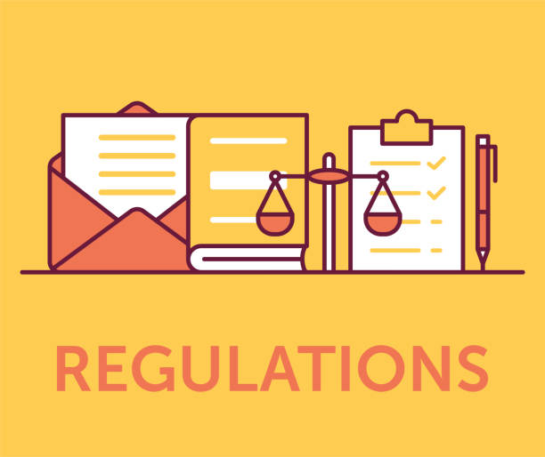
Federal Rules and Regulations
Professional Licensure federal regulations and State Authorization federal regulations remain in effect.
These regulations are not subject to any freeze and will remain legal obligations until there is a new rulemaking amending regulations or Congress making a change to the HEA.
Reversing Biden-era regulations cannot happen quickly and will require actions from courts, the legislature, or rulemaking committees.
Notes:
MB

Slide 24
SARA Stakeholders Stay Focused
Working Group – Institutional Closures
Teach out plan / teach out agreement
Financial arrangements
Records retention
SARA Narrative
White papers/blogs on a variety of topics
One pager on student consumer protections
“NC-SARA, SARA and SAN: The Power of Collaboration”
Myth Busting
The Value of SARA
Collect, Review, and Disseminate Information
Collect and share exclusively distance education enrollments trend data with SPEs
Continue to gather data and information from SARA states/institutions on issues related to ongoing concerns.
Notes:
MB

Slide 25
What To Do?
Continue your good work of providing educational opportunities to all students.
Remain compliant with all state and federal laws and regulations that pertain to distance education programs.
Stay Informed!
Notes:
MB

Slide 26

Questions and Discussion

Slide 27
Thank You!
Notes:
ALL

