Slide 1
Alabama SARA
2025 SARA Workshop
Montgomery, Alabama
November 7, 2025
Elisa Jaden, EdS
Regional SARA Director
Postsecondary Access and Student Success

Slide 2
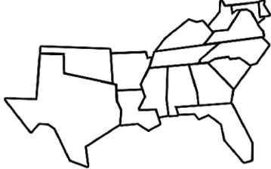
SREB’s History
  First Regional Interstate Compact
    began in 1948 with Southern Governors
    non-partisan, non-profit
  First program launched in 1949 with RCP
  Three other regional education compacts
Notes:
SREB was created by Southern governors and legislators who recognized the link between education and economic vitality
The first of the four regional education compacts:
MHEC
NEBHE
WICHE

Slide 3
SREB Operates as:
    Largest Compact
      The most states
      The most institutions
    16 original member states
    4 affiliates (solely for SARA)
      Pennsylvania
      District of Columbia
      Virgin Islands
      Puerto Rico
Notes:
Only compact to do both K-12 and Postsecondary Education
Workforce added in recent years
K to Gray!

Slide 4
SREB SARA Operates as:
SARA is a voluntary program for both states and institutions that participate.
SARA membership versus SARA Participation.
States gain SARA membership through their regional compact membership, while institutions can participate in SARA through membership in their state agencies that facilitate SARA, as long as the state is a member of one of the four regional education compacts.
States renew SARA membership every two years and institutions renew SARA participation annually.

Slide 5
S-SARA RSC Operates as:
The SREB SARA Regional Steering Committee (S-SARA RSC) consists of the SPEs from SREB’s 16 member states and its 4 affiliates, as well as 5 at-large members that represent various higher education sectors and SARA stakeholders:
Large Online 4-year
Two-year
Private and Vocational
Higher Education Policy Consultant
SREB’s RSC includes both the states and institutions’ voices in conversations and votes regarding SARA matters.

Slide 6
SREB Office of Postsecondary Education
Vice President of Postsecondary Education
Harriette Scott, EdD
Postsecondary Office of Access and Student Success Staff
Michael DeJesus III, PhD
Director, Postsecondary Access and Student Success
Elisa Jaden, EdS Jimikea Wilson
Regional SARA Director Program Coordinator
Program Specialist
Allison Buckley Kenneth Mason
Program Specialist Program Coordinator

Slide 7
Postsecondary Access & Student Success Programs
Regional Tuition Reciprocity Programs Education Technology and STEM
Academic Common Market (ACM) Open Educational Resources (OER)
Regional Contract Program (RCP) Education Technology Cooperative (ETC)
Higher Education Policy and Compliance Collaborative Online Course Sharing
State Authorization Reciprocity Agreement (SARA) HBCU-MSI Course-Sharing Consortium
www.SREB.org/PostsecondaryEd

Slide 8
SREB’s 6 Priorities

Slide 9
SREB’s Priority Work
AI in Education
Career Pathways and Credentials
Educator Workforce
Longitudinal Literacy
Crisis Recovery Support Network
Student Success in Postsecondary

Slide 10
Crisis Recovery Support Network
Counseling Support for Recovery
In collaboration with governors’ offices, state education agencies, local districts and postsecondary institutions
coordinated response to crisis recovery
year-long emotional and mental health support for students, teachers and communities impacted by tragedy
cadre of counselors across the South, building shared capacity to support crisis recovery in their home state or elsewhere

Slide 11
Why Crisis Recovery Support?
Offers an extended healing process to students, teachers and entire communities with at least a year of dedicated support for:
Natural Disaster Recovery
  Weather (hurricanes, tornados, floods)
  Health (Covid or other Pandemics)
Violence on Campus
  Shootings
  Suicides and Deaths (student, teacher, staff)
  Witnessing Violence (Incidents/accidents that result in a severe injury and death)

Slide 12
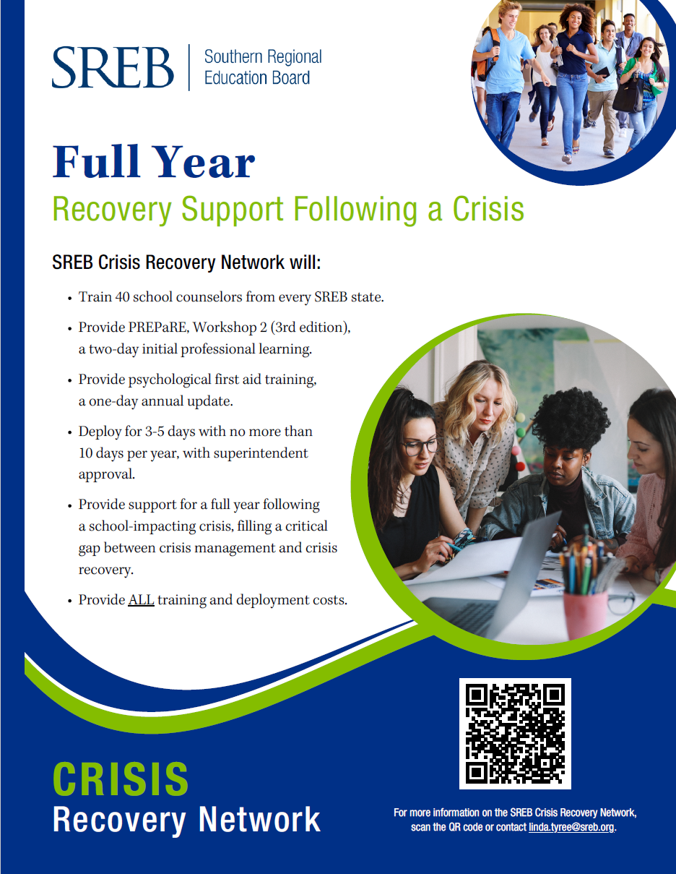
Crisis Recovery Support in Alabama
Informational (virtual) meeting hosted by AL DoE on October 30, 2025, at 10am CT.
AL CRN Training is scheduled for January 15-16, 2025, at Birmingham DoE Office, hosted by Sean Stevens, Instructional Services Coordinator.
There is currently no postsecondary program in place for SREB’s Crisis Recovery Network. Please let us know if you would like to collaborate.
For more information, please contact:
Linda Tyree
Program Director, Crisis Recovery Support Network
P: (404) 875-9211
E: linda.tyree@sreb.org

Slide 13
SREB and
Student Success

Slide 14
Why a Framework for Student Success?
Increase Access for All Students
Support Completion and Persistence
Align Education with Workforce Needs
Facilitate Seamless Transitions
Data-Driven Strategies
Strengthen Economic Outcomes
Holistic Student Support

Slide 15
Student Success in Postsecondary – A Framework https://www.sreb.org/publication/srebs-student-success-framework

Slide 16
The 4 Pillars Defined
Access | Postsecondary access refers to the capacity of all institutional stakeholders to prepare students to pursue and succeed in education beyond high school, encompassing awareness of various options, entry requirements and processes, and affordability.
Persistence | Postsecondary persistence emphasizes individual agency and goal- oriented progress towards personal goals in an aligned and transparent system by actively engaging with resources and supports.
Retention | Postsecondary retention is providing students with tools and services that enable them to complete their intended courses of study, including streamlined processes, robust support services, comprehensive learning environments, clear academic and career pathways, and proactive monitoring and support of each student’s progress.
Attainment | Attainment refers to the completion of postsecondary education and training, including certificates, degrees, and work-based experiences, to prepare individuals for fulfilling careers and foster a diverse, skilled workforce.

Slide 17
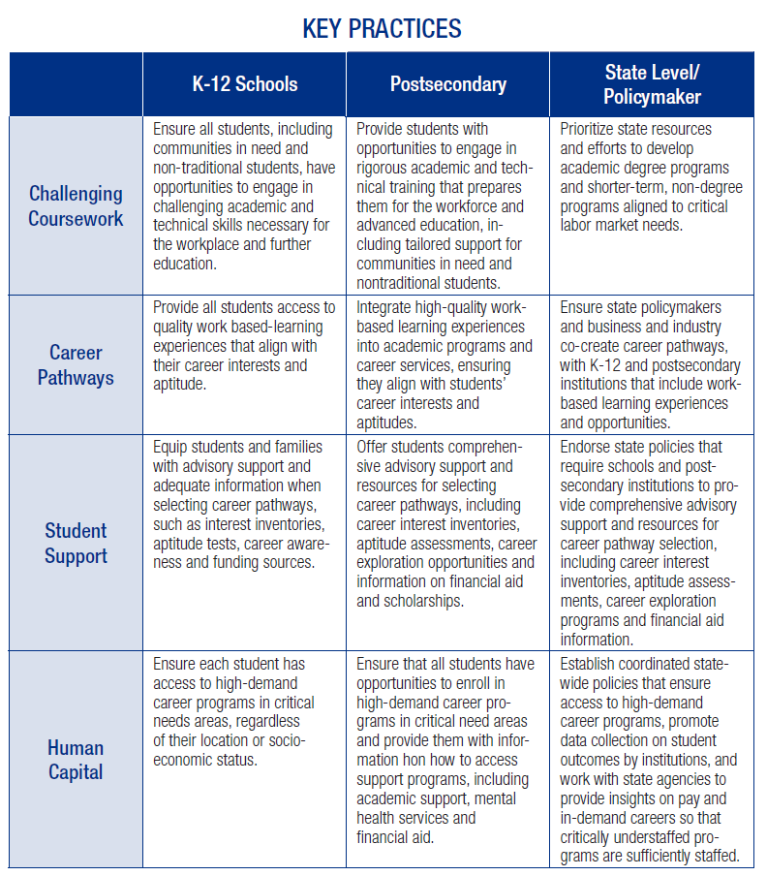
Access

Slide 18
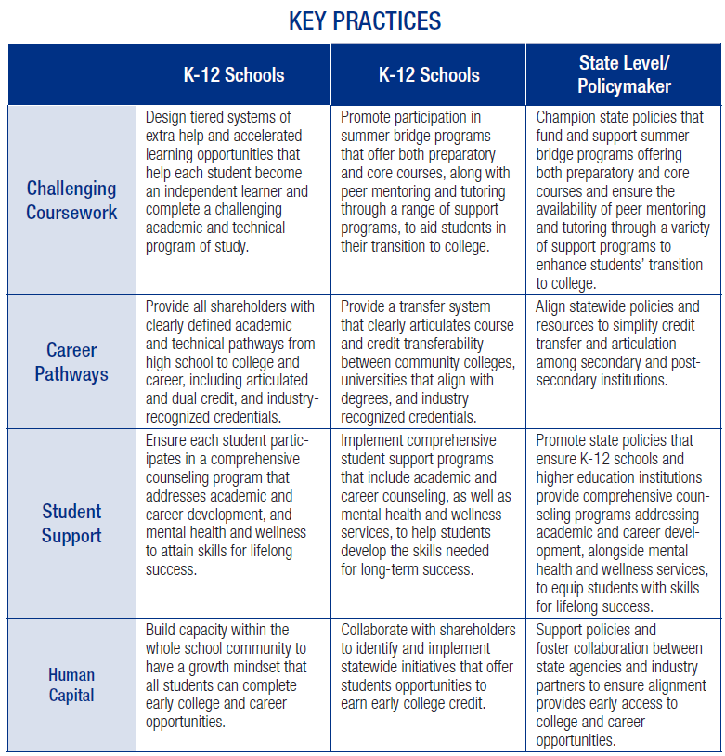
Persistence

Slide 19
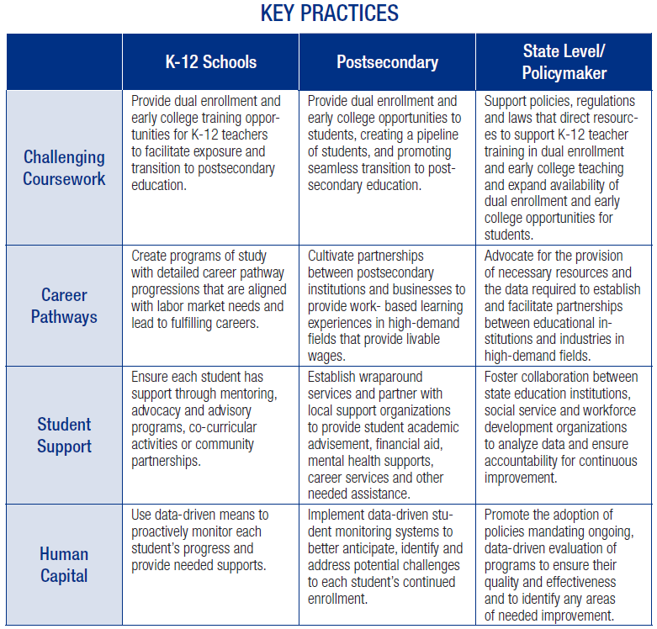
Retention

Slide 20
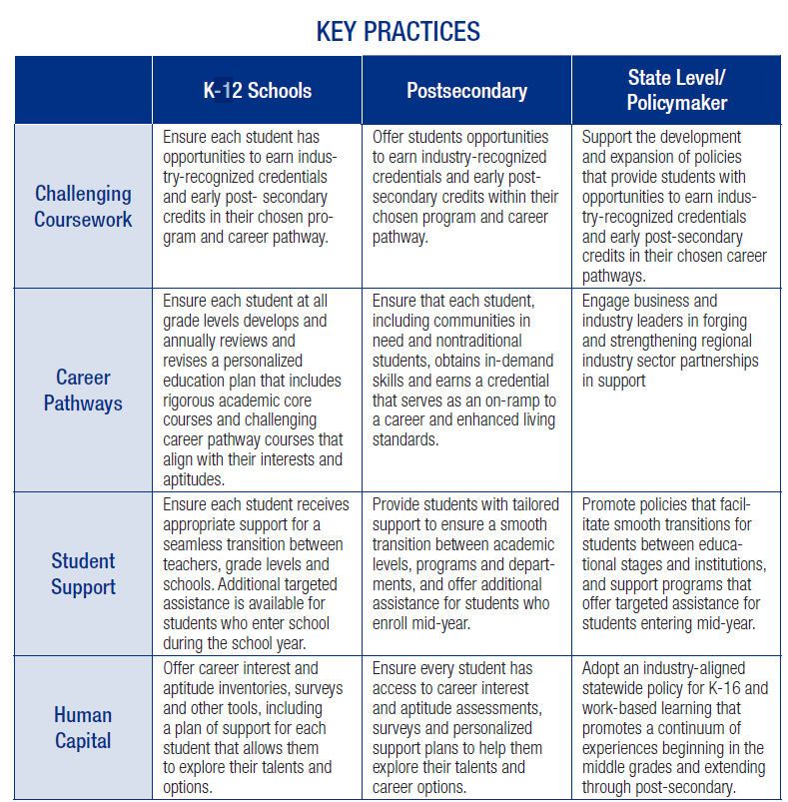
Attainment

Slide 21

Currently in Development (to implement the framework)
Needs Assessment for Framework Participants
Rubric to Assess Key Practices
Policy Toolkit for State and Policymakers

Slide 22
Professional Learning Communities

Slide 23
SREB Student Success Professional Learning Communities (PLCs) promote student achievement across three key areas:
  K-12 education systems
  Postsecondary institutions
  State systems and policymakers

Slide 24
SREB wants to collaborate with states to identify K12 School(s) or a District, Postsecondary Institutions – 2-year and 4-year (PWI, HBCU or MSI) institutions, and a State/System Office and/or policymaker to pilot assessment of the Student Success Framework using PLCs.
Real World Application
  Anne Arundel Community College and the Aspen Institute

Slide 25
Alabama & Student Success:
SREB Postsecondary Programming and Statistics

Slide 26
Academic Common Market
Alabama Participation for FY2024-25
  Alabama A&M University
  Alabama State University
  Athens State University
  Auburn University
  Auburn University – Montgomery
  Jacksonville State University
  Troy University
  University of Alabama
  University of Alabama at Birmingham
  University of Alabama in Huntsville
  University of North Alabama
  University of South Alabama
  University of West Alabama

Slide 27
Academic Common Market cont’d
Alabama Statistics for FY2024-25
97 AL residents certified to go out of state (exported)
138 out-of-state residents imported to attend AL colleges
Alabama is a net importer ☺
  Coming mostly from GA, then LA, TN, and MS
Top ACM Institution in Alabama:
  University of Alabama at Birmingham

Slide 28
Regional Contract Program
Alabama Participation for FY2024-25
  The state of Alabama does not fund residents to go out of state to study first professional degrees that are not offered in the state.
  However, Auburn University and Tuskegee University offer Veterinary Medicine to out of state residents from Kentucky, Tuskegee University also offers Veterinary medicine to South Carolina residents, and University of Alabama at Birmingham offers Optometry to residents of Georgia, Louisiana, Mississippi, and South Carolina
  ***Again, Alabama is an importer of students***

Slide 29
Regional Contract Program cont’d
Alabama Statistics for FY2024-25
Alabama earned $6,832,746 receiving Georgia, Kentucky, Louisiana, Mississippi, and South Carolina residents for Optometry at University of Alabama at Birmingham, and Veterinary Medicine at Auburn and Tuskegee Universities.
  $488,856 to UAB Optometry from GA, LA, MS and SC
  $5,331,000 to Auburn for Vet Med from KY
  $1,012,890 to Tuskegee for Vet Med from KY and SC

Slide 30
State Authorization Reciprocity Agreement
Alabama Participation
  Alabama has been a SARA member since August 2016.
  Alabama renews biennially through the SREB compact for continued SARA membership.
  Alabama has 45 SARA-participating IHLs. Per NC-SARA Data Dashboards (as of Fall 2024 – SARA only):
    Exclusively DE Enrollment – 82,116
      Incoming EDEE – 29,839, with OOSLP at 4,552
      Outgoing EDEE – 31,115, with OOSLP at 9,554

Slide 31
HBCU-MSI Course-Sharing Consortium
Alabama Participation
  Miles College, Stillman College, and Tuskegee University are members of SREB’s HBCU-MSI Course-Sharing Consortium.
  You do not have to be an HBCU or MSI to participate in course sharing.
  If your institution is interested in learning more about course sharing, please contact me directly.

Slide 32
For more information on:
SREB SARA
SREB’s 6 Priorities
SREB Programs and Services
Elisa Jaden
Regional SARA Director
PASS Program Specialist
Elisa. Jaden@sreb.org
(404) 879-5517

