Slide 1
NC-SARA Data Reporting & Research
Rachel Christeson, Ph.D.
Senior Director, Research & Planning
NC-SARA
November 7, 2025

Slide 2

Agenda:
2025 Data Reporting
  Changes made in 2025
  Participating Institutions
  Exclusively Distance Education Enrollment (EDEE)
  Out-of-State Learning Placements (OOSLP)
  Important Dates
Other Data Resources
  Cost Savings Study
  SARA Source

Slide 3
The Distance Education Landscape
18,823,145 Total Students
4,967,649 Exclusively Distance Education Enrollments (EDEE)
1,646,064
Out-of-State
EDEE
Source: IPEDS Fall Enrollment 2023; Degree-granting postsecondary institutions only.
Notes:
Rachel
For Fall 2023, based on IPEDS data, all postsecondary students – SARA counts are 1.612 million, because we don’t include CA, but do include some non-IPEDS participating institutions (primarily Penn Foster)
26% of students are exclusively online
9% are online students enrolled in another state
In addition, in 2022-23, 1.2 million students graduated with degrees in education or health professions – programs that generally require an experiential learning activity. In 2024, students at SARA participating institutions participated in 473,548 out of state learning placements.

Slide 4
2025 Data Reporting
Next Topic

Slide 5
What is the SARA Data?
Exclusively Distance Education Enrollment (EDEE)
  The number of students engaged exclusively in distance education during the fall term – 100% online enrollments, regardless of program.
  Consistent with IPEDS Fall EF reporting – but disaggregated by state
  Includes in-state and out-of-state
Out-of-State Learning Placements (OOSLP):
  Learning placements are on-ground, out-of-state experiential learning activities.
  OOSLP includes clinical rotations, student teaching, internships, and other similar activities.
  OOSLP are often a required part of obtaining a degree and/or license to practice a particular profession.
  Reporting includes on-ground students as well as distance education students.

Slide 6
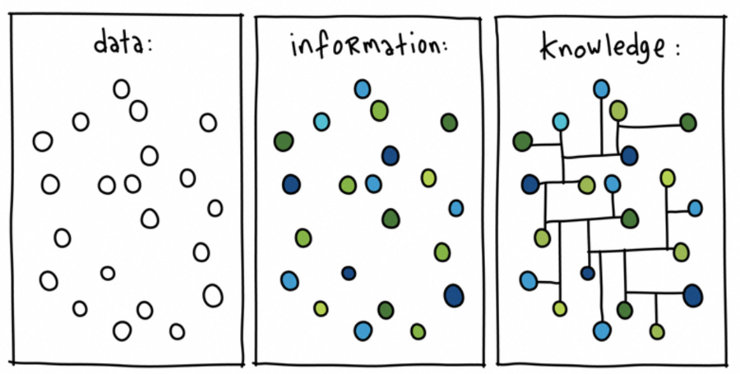
How You Might Use the SARA Data
  The data describe the distance education landscape in your state or region
  They hold historical trends and may provide insights that could inform key decisions about distance education offerings
  These data may be used as your institution plans for new distance education programs to meet student needs and institutional goals
  These data may be used by your state to ensure institutional compliance

Slide 7
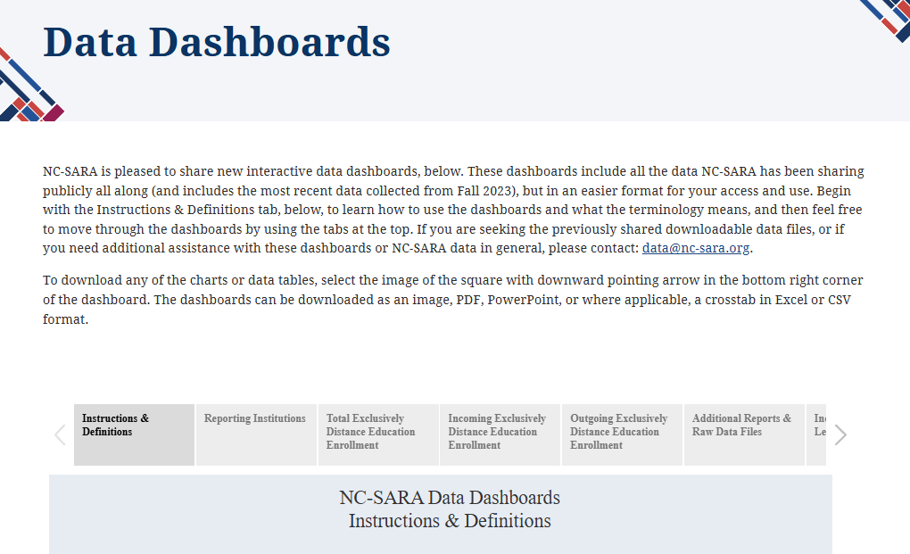
NC-SARA’s Data Dashboards
Explore the interactive data dashboards: https://nc-sara.org/data-dashboards

Slide 8
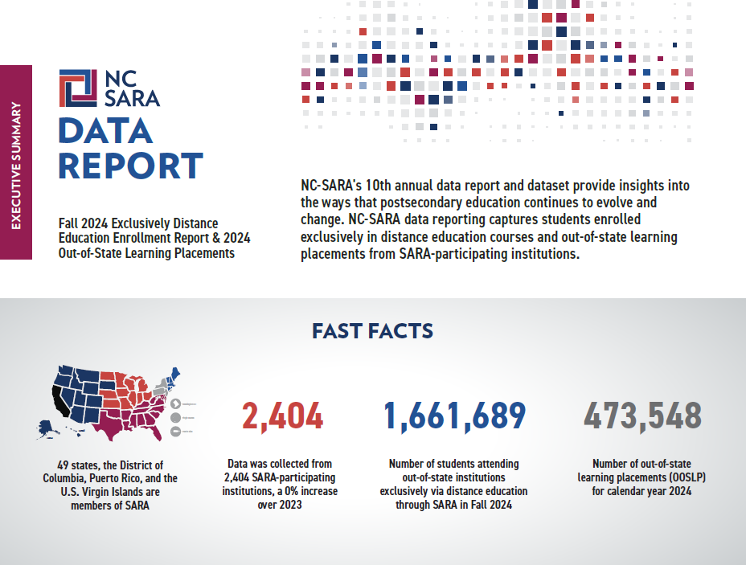

Slide 9

Methodology
SARA Data Reporting Window is May 15 – June 15 each year
2,429 Institutions were sent email requests to report
  25 exemptions were extended
    23 non-renewals or institutional closures
    1 joined near the end of 2024
    1 closure
  0 institutions did not report
Notes:
We did face an issue this year with many system schools not receiving our initial emails due to spam filters / internal firewalls, but we did our best to ensure everyone received communications.

Slide 10
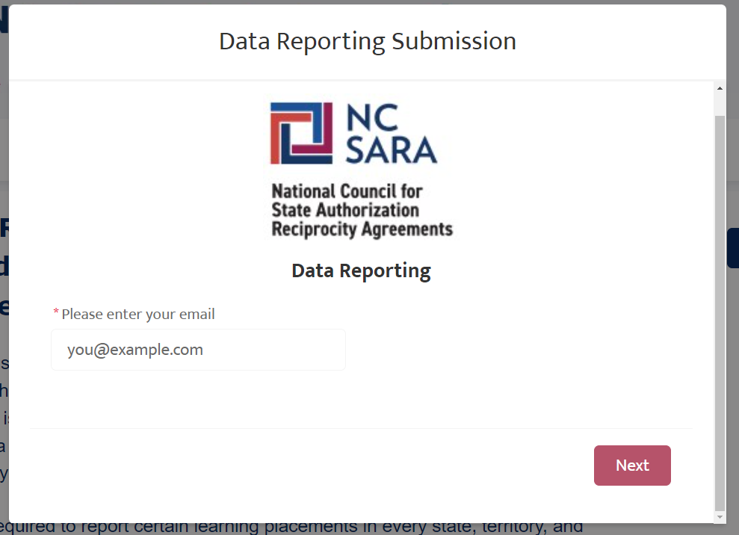
Changes made in 2025 Data Collection
Contact Verification
  Only users assigned as an institutional contact in Salesforce were able to upload data.
  Users not in Salesforce needed to be verified by a current Salesforce contact for their institution (then entered by NC-SARA staff).
  Data reporting portal was one public link, rather than individual institution links.
  Contacts for multiple institutions were able to select the institution to submit for.
Notes:
Led to a significant increase in NC-SARA help requests and a delay for some schools, but overall was a more secure system.

Slide 11
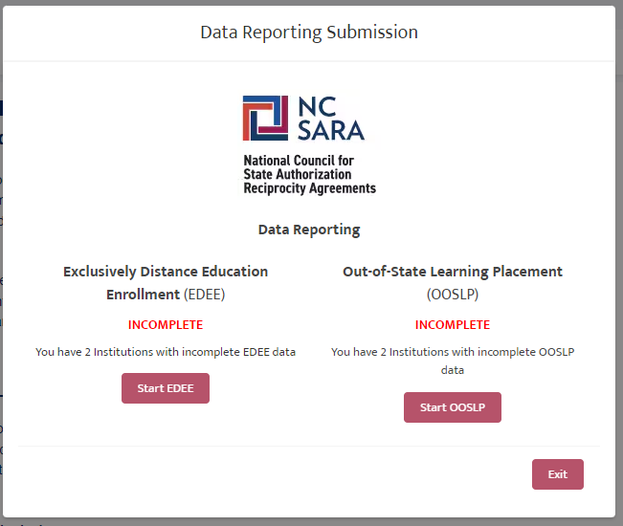
Changes made in 2025 Data Collection
File Upload vs. Manual Entry
  Users were provided with two templates to compile their EDEE and OOSLP data.
  Data was upload in a .csv file, rather than manually entered in the web form.
  Institutions were given the chance to confirm data and resubmit a file in case of errors.
  Confirmation emails included counts and submitter name.
  Users could easily see when they had a submission outstanding.
Notes:
May not have been a huge help for small schools (in fact may have been more difficult), but we heard from many that the process worked well.

Slide 12
Changes made in 2025 Data Collection
Feedback received:
  Institutions support the verification of contacts.
  Many users found the new process easy, though for smaller schools the templates were more cumbersome.
  EDEE file would be better long than wide (one row per state vs one row total).
  Address blocked emails before the data reporting window.
  Provide annual calendar of important institution dates.
Notes:
RC
We did face an issue this year with many system schools not receiving our initial emails due to spam filters / internal firewalls, but we did our best to ensure everyone received communications.
No major changes planned for next year’s collection, though will be starting to discuss additional data elements for future years – 2028 or 2029.

Slide 13
Participating Institutions
Next Topic

Slide 14
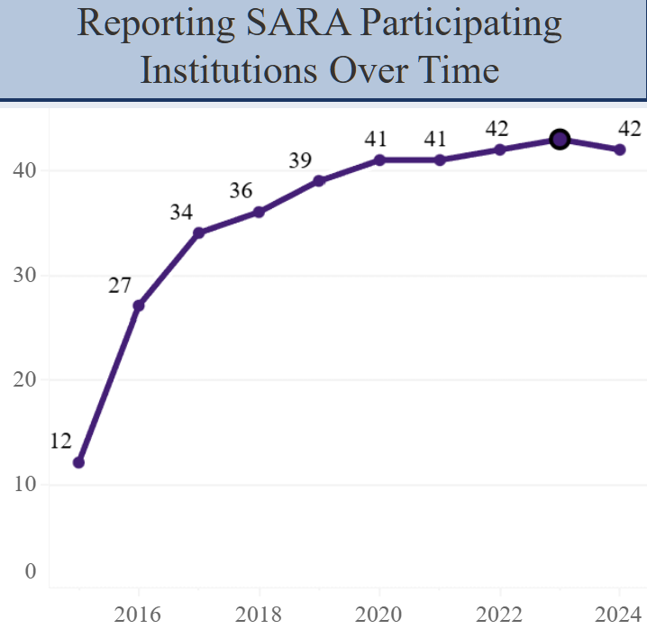
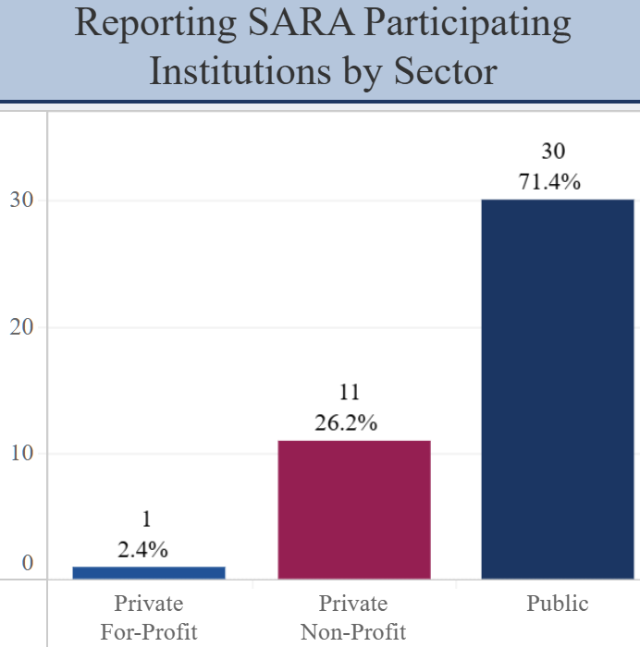
Total Number of Reporting Alabama Institutions
42 total number of participating institutions in Alabama

Slide 15
Fall 2024 Exclusively Distance Education Enrollment (EDEE)
Next Topic

Slide 16
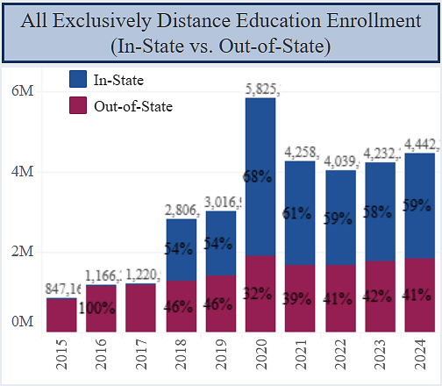
Total Reported In-State and Out-of-State EDEE 2015-2024

Slide 17
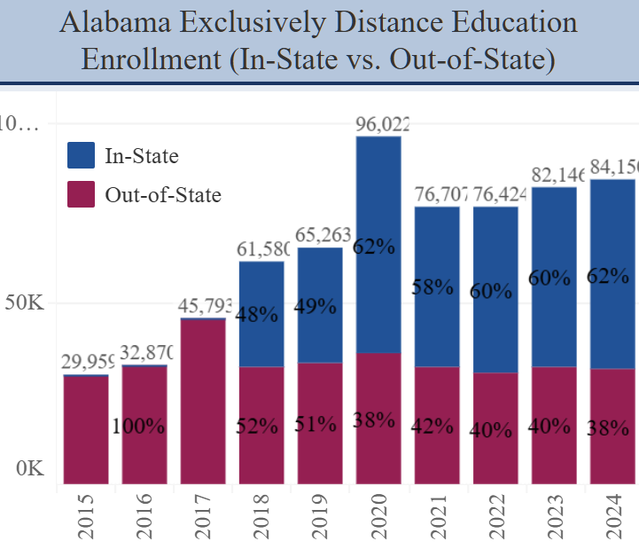
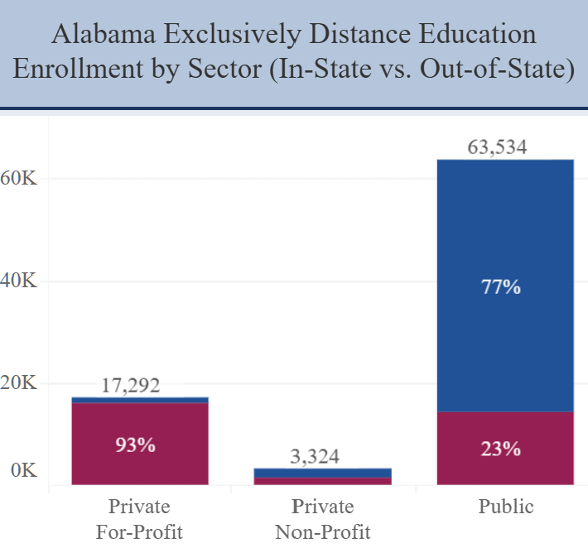
Alabama Total EDEE & Sector Trends
84,150 EDEE in Alabama
52,277 In-State
31,873 Out-of-State

Slide 18
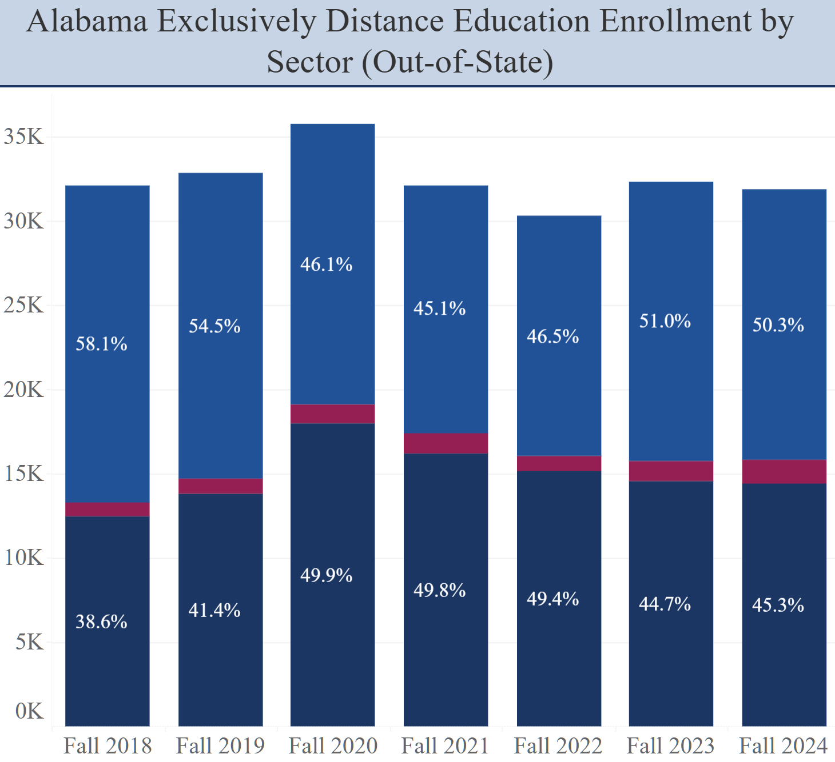
Out-of-State SARA EDEE by Sector

Slide 19
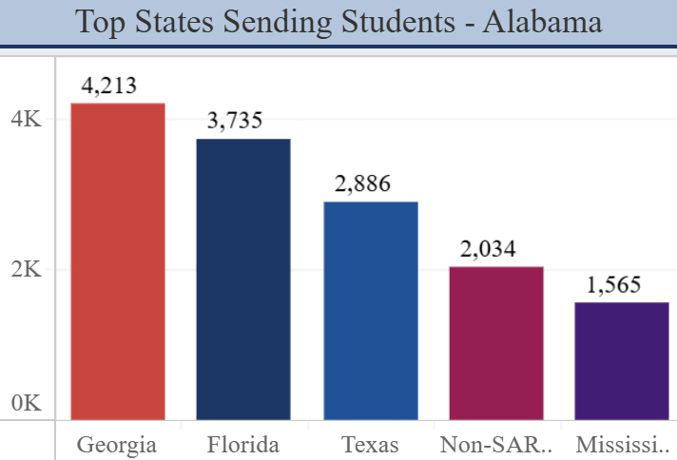
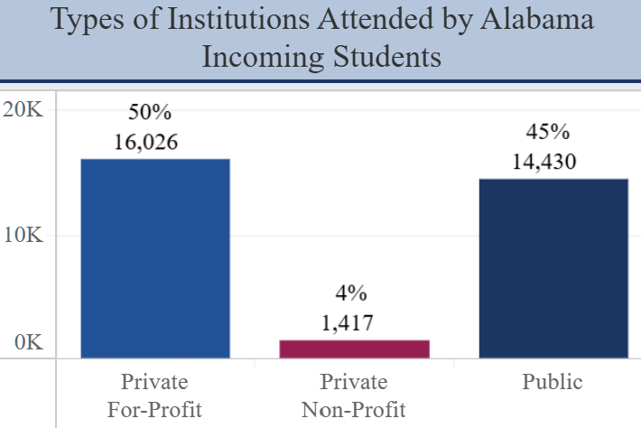
Who is attending Alabama institutions?
In Fall 2024, 31,873 out-of-state students attended an Alabama institution exclusively via distance education.
45% attended a public institution, 4% attended a private non-profit, and 50% attended a private for-profit.
Notes:
Al top institutions: Columbia Southern, Troy, South Alabama, Uni of Alabama, Alabama at Birmingham

Slide 20
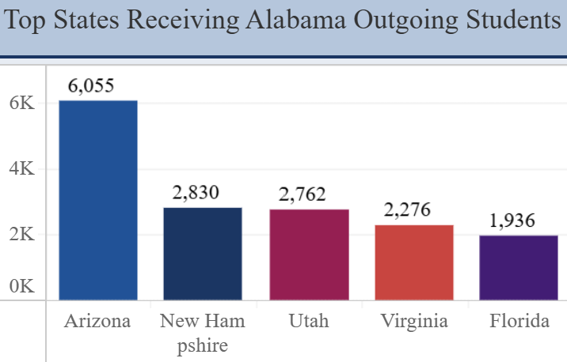
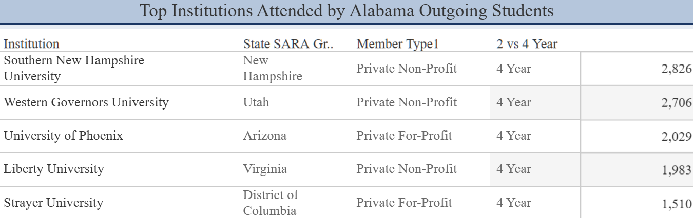
Where are Alabama residents enrolling?
In Fall 2024, 31,115 Alabama residents enrolled at an out-of-state institution exclusively via distance education.
44% attended a private non-profit, 34% attended a private for-profit, and 22% attended a public institution.

Slide 21
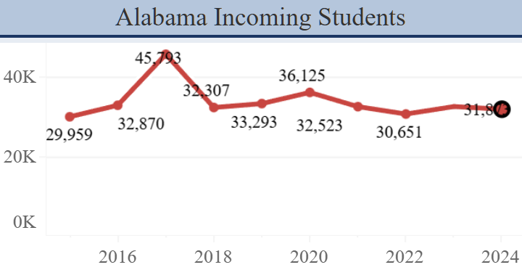
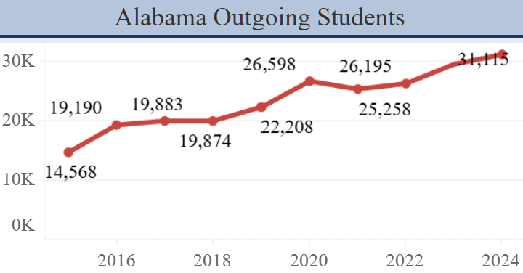
Out-of-State Student Trends in Alabama

Slide 22
2024 Out-of-State Learning Placements
Next Topic

Slide 23



Out-of-State Learning Placements (OOSLP)
What are OOSLP?
Learning placements are on-ground, out-of-state experiential learning activities
OOSLP include clinical rotations, student teaching, internships, and other similar activities
OOSLP are often a required part of obtaining a degree and/or license to practice a particular profession
Note that reporting includes on-ground students as well as distance education students

Slide 24
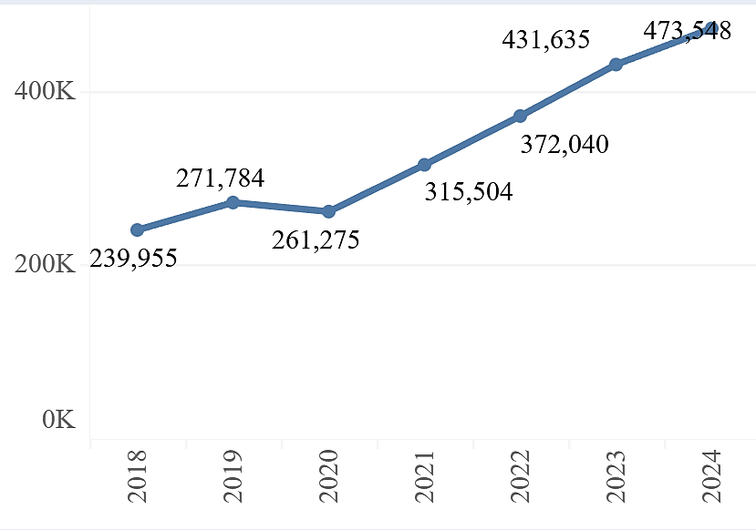
Total Reported Out-of-State Learning Placements 2019-2024

Slide 25
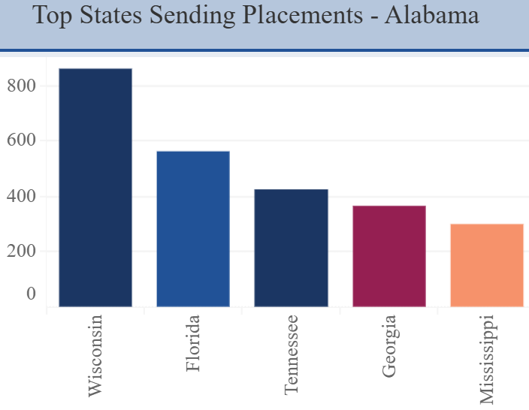
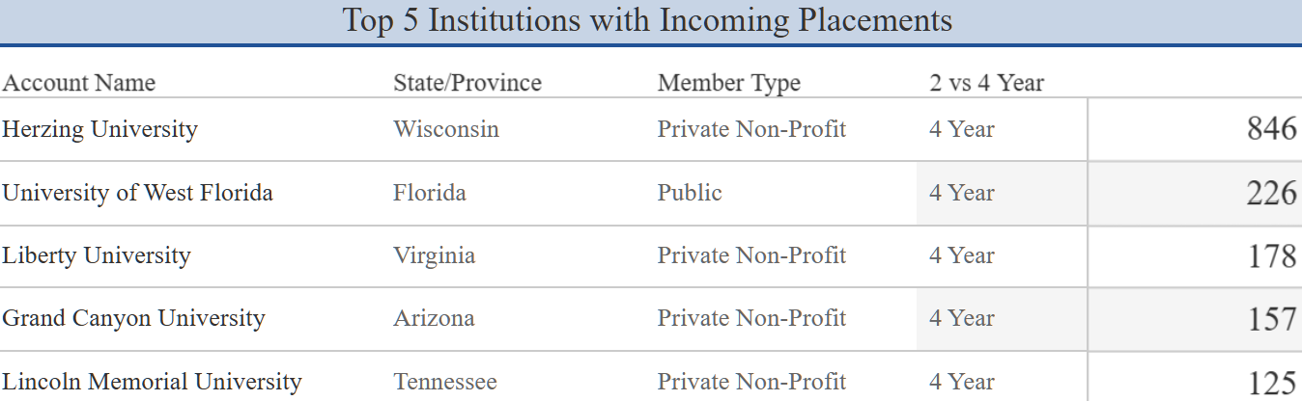
Who is placing students in Alabama?
In 2024, 4,552 students from out-of-state institutions did a learning placement in Alabama.
66% were in Health Professions, followed by Education (8%), and Business (4%).

Slide 26
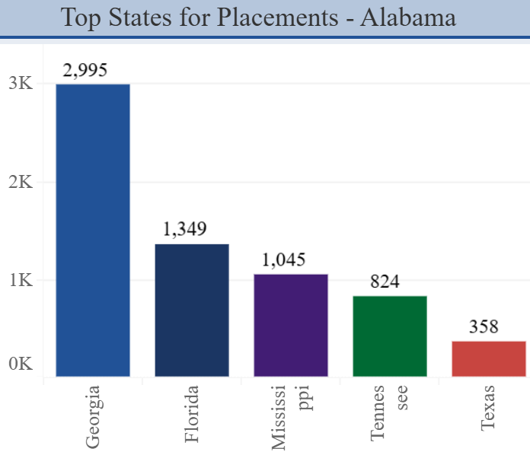
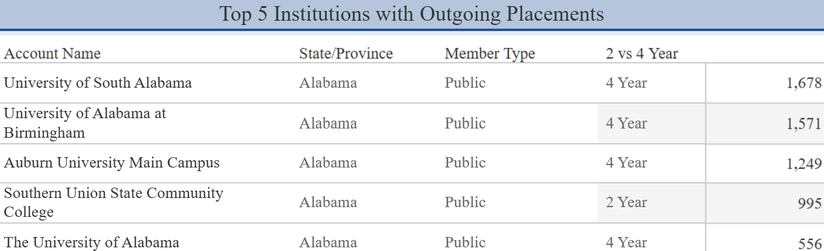
Where are Alabama institutions placing students?
In 2024, Alabama institutions had 9,554 students participate in learning placements out-of-state.
70% were in Health Professions, followed by Business (7%), and Education (4%).

Slide 27
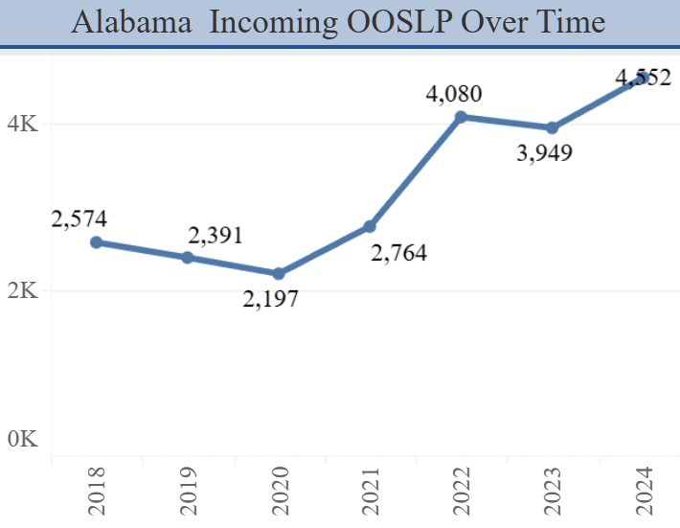
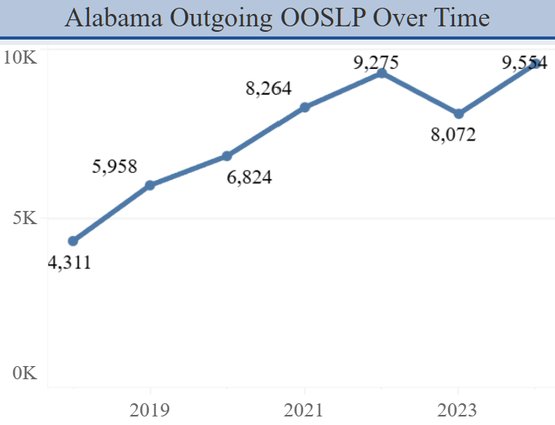
Out-of-State Learning Placement Trends in Alabama

Slide 28
Important Annual Data Reporting Dates
2025 Annual Data Handbook Available: January 2026
2025 Annual Data Collection Webinar: February / March 2026
2025 Annual Data Collection Window: May 15 – June 15, 2026

Slide 29
Institution Directions for Data Reporting: Your One-Stop Shop
How-To Guide:
Reporting Handbook
How-To Resources:
Webinar Recordings
Instruction Videos
Tools:
Templates
Quick Start Guide
Data Reporting Fact Sheet
Overview & Use of Data:
Online Foundations Course

Slide 30
Data Reporting Best Practices
Mark your calendars now!
Determine who at your institution will be responsible for data reporting and ensure contacts are up to date with your SPE.
Review the Data Reporting Handbook
Build relationships on campus –
  What programs have learning placements you’ll need to report?
  How are those placements being tracked?
Notes:
Consider vacations, commencement, etc.

Slide 31
Other Data Resources
Next Topic

Slide 32
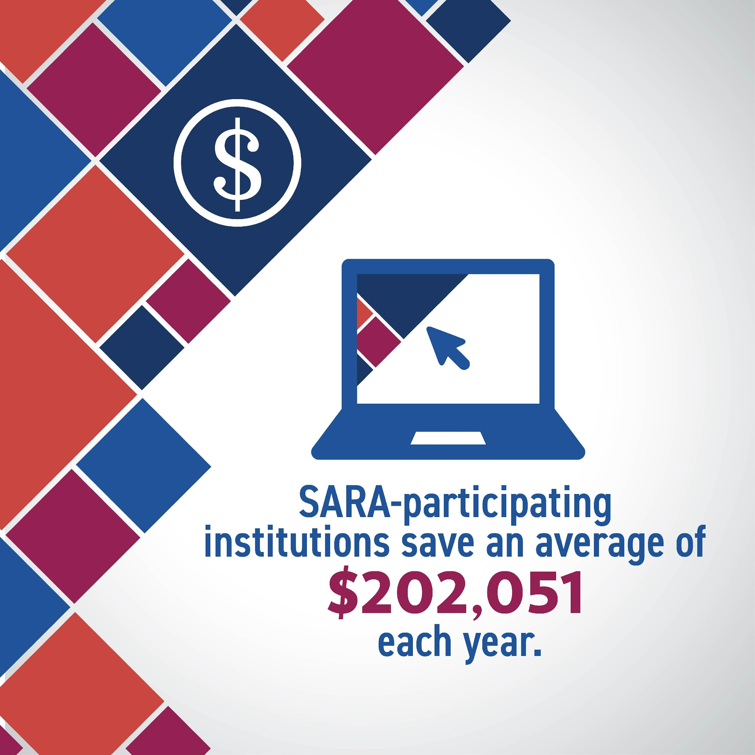
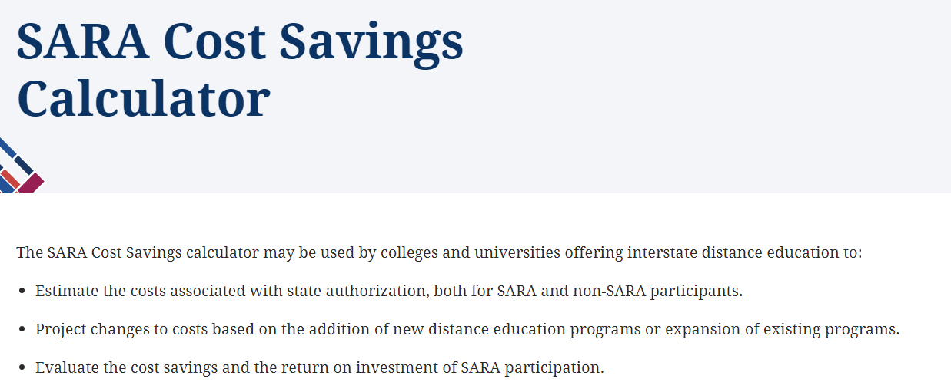
SARA Institution Cost Savings
2025 SARA Cost Savings Report:
All participating institutions surveyed; 537 complete responses received.
Results show that on average, initial authorization would cost institutions $268,829 outside of SARA, and $156,950 annually for renewal.
Overall, the average institution would spend more than 60 times as much for initial authorization and 35 times as much annually on renewal if it did not participate in SARA.
https://nc-sara.org/sara-cost-savings-calculator

Slide 33
SARA Institution Cost Savings - 2025
Initial
 | Estimated Costs | State & NC SARA Costs | SARA Affiliation Fee | Estimated Savings
MHEC | $220,678,561 | $3,456,550 |  | $217,172,011
NEBHE | $223,193,169 | $3,312,450 | $50,000 | $219,870,719
SREB | $417,744,312 | $6,206,550 | $160,000 | $411,387,762
WICHE | $106,541,971 | $1,531,650 |  | $105,010,321
 | $968,158,013 | $14,507,200 | $260,000 | $953,390,813
Renewal
 | Estimated Costs | State & NC SARA Costs | SARA Affiliation Fee | Estimated Savings
MHEC | $115,612,435 | $3,318,550 |  | $112,243,885
NEBHE | $114,884,660 | $3,287,450 | $50,000 | $111,587,210
SREB | $218,048,708 | $6,206,550 | $160,000 | $211,692,158
WICHE | $54,357,251 | $1,531,650 |  | $52,825,601
 | $502,903,054 | $14,344,200 | $260,000 | $488,298,854
Notes:
Al estimated savings:
Initial Authorization - $20,607,605
Renewal - $10,309,869

Slide 34
Differences between the 2024 and 2021 Cost Saving Estimates
The 2024 multipliers are larger than the 2021 multipliers
Major reasons for changes in cost estimates include:
  More institutions responded to the 2024 survey (537 vs. 171)
  More states served in the 2024 survey
  More large institutions that enroll 30,000 or more students responded to the survey
  More programs offered by the responding institutions, especially by the institutions with large enrollment totals
  Several states have revised their fee structure since 2021
  Online education has become more popular since the COVID-19 pandemic
Notes:
RC

Slide 35

SARA Source Redesign
  New tool is based on IPEDS Completions Files
    Includes counts of programs, by degree level and program type / area, that are offered 100% online and a student has completed.
  Includes institutional characteristics (sector, level, etc.), web address, net price calculator, and other fields in Salesforce or IPEDS
  Refreshed monthly to include new institutions
  Updated annually by NC-SARA staff (September)

Slide 36
SARA Source Redesign
Old Version:
  Student Audience
  Contained 1,400 programs from 60 institutions
  Data verified by NC-SARA staff
  Current program offerings
  Updated as data provided from institutions
  Site maintained by external contractor
New Version:
  SPE Audience
  Contains 20,000+ programs with graduates from all SARA-participating institutions
  Publicly available data
  Offerings with graduates one year prior
  Updated annually (fall IPEDS release)
  Site maintained by NC-SARA staff

Slide 37
Questions about NC-SARA Data?
Notes:
Jared

Slide 38
Thank You!

