Slide 1


Professional Licensure Disclosure
2025 Alabama SARA Workshop
November 7, 2025
Notes:
---

Slide 2
Introduction
Notes:
Introduce myself and Breanna.
Ron Leonard and I presented on professional licensure disclosures at the Instructional Officers Association Conference this past May, and this presentation will be similar. This presentation provides an overview of professional licensure requirements in higher education, focusing on federal and state regulations, disclosure requitements, and institutional responsibilities. The goal is to help you understand professional licensure disclosure requirements and implement best practices.

Slide 3

AGENDA
Key Terms and Concepts
  Provide definitions of professional licensure and certification at both the federal level and within the state of Alabama.
Regulatory Overview
  Review of federal and state regulations including Title IV and SARA policies governing educational programs.
Resources
  Provide resources for professional licensure compliance support.
Examples of Disclosures
  Institutional examples of general and direct disclosure requirements.
Notes:
The agenda includes defining key terms such as licensure and certification, reviewing federal and state regulations that govern educational programs, including Title IV requirements and SARA policies, providing examples of how institutions are meeting disclosure requirements. We will provide a list of resources and tools that institutions can use to stay informed and compliant.

Slide 4
KEY TERMS and Regulations

Slide 5

LICENSURE VS Certification
Professional Licensure
  The term “licensure” generally refers to an official process, administered by a state-level authority, that is required by law in order for an individual to practice a regulated profession.
Certification
  The term “certification” generally refers to a function administered by a nongovernmental organization, which is intended to further recognize professional competence based on having met the quality standards of the organization. The prevalence and relevance of certification varies by profession.
  Source: Professional Licensure | U.S. Department of Education

Slide 6

ACHE Operating definitions
ACHE Operating Definitions
  (86) Professional Licensure Program: As defined in federal regulations, an instructional program that is designed to meet educational requirements for a specific professional license or certification that is required for employment in an occupation or is advertised as meeting such requirements.
  (90) Program that Leads to Professional Educator Certification: A type of professional licensure program at the baccalaureate, master’s, or education specialist level that receives authorization from the Alabama State Board of Education to lead to professional educator certification and is considered an “approved program,” as defined under Alabama Administrative Code §290-3-3-.01.
  Source: Alabama Legislative Services Agency Administrative Code 300-2-1-.01
Notes:
Final Approval of Repeal and New Rule §300-2-1-.01 within Administrative Procedures for Academic Program Review. The proposed new rule was given preliminary approval by the Commission at its meeting on March 14, 2025, and final approval at the June 13, 2025 Commission meeting. Published June 30, 2025; effective August 14, 2025. Dr. McGill was the author.

Slide 7

Key Regulatory Frameworks
Federal Regulation Requirements
  Federal regulations mandate disclosures for programs leading to professional licensure, ensuring transparency and compliance.
Program Participation Agreement
  Certification procedures under 34 CFR 668.14(b)(32) guide institutions in maintaining eligibility for federal programs.
State-Level Education Regulations
  State rules, like Alabama's nursing education standards, set specific requirements for distance education programs.
Interstate Distance Education Framework
  SARA facilitates interstate distance education but does not substitute state professional licensure mandates.
Notes:
Higher education institutions must navigate a complex landscape of federal and state regulations to ensure compliance. Key federal regulations include 34 CFR 668.43(a)(5)(v) and 668.43(c), which mandate disclosures about educational programs leading to professional licensure. Additionally, 34 CFR 668.14(b)(32) outlines certification procedures as part of the Program Participation Agreement (PPA). State-level regulations, such as the Alabama Board of Nursing Rule 610-X-3-.08, impose specific requirements for distance education programs. The State Authorization Reciprocity Agreements (SARA) provide a framework for interstate distance education, but do not override state licensure requirements. Understanding and adhering to these regulations is critical for institutional integrity and student protection.

Slide 8

Federal Regulations 668.43(a)(5)(v) and 668.43(c) (Effective July 1, 2020)
For consumer protection, 34 CFR 668.43 as amended requires Title IV institutions to identify which of their academic programs (whether online, hybrid, or face-to-face) are designed to fulfill the educational requirements for a professional license or certification that is a gateway for entry into a specific occupational field. For each academic program that falls within this category, institutions must develop two kinds of disclosures related to professional licensure or certification:
General Disclosure (34 CFR 668.43 (a)(5)(v)
Direct Disclosure (34 CFR 668.43 (c)(1) et seq.

Slide 9
Federal Regulations 668.43(a)(5)(v) and 668.43(c) (Effective July 1, 2020)
General Disclosures
General disclosures entail posting information in a public place, such as on your website or in your catalog, and must include state-by-state determinations of whether the program fulfills educational requirements for licensure or certification in that state. ACHE has developed a template that institutions may adopt to comply with this federal requirement: public disclosure template

Slide 10
Federal Regulations 668.43(a)(5)(v) and 668.43(c) (Effective July 1, 2020)
Direct Disclosures:
Direct disclosures are targeted communications to individual students who are enrolled in or who are considering enrolling in a program that is designed to lead to licensure. These disclosures must indicate whether the student’s chosen program fulfills the education requirements for licensure or certification within that student’s state of residence.

Slide 11
Federal Regulations 668.43(a)(5)(v) and 668.43(c) (Effective July 1, 2020)
Direct Disclosures:
Prospective Students – if curriculum does not meet state requirements or no determination made where student is located prior to enrollment in the program (prior to a financial commitment is official guidance from the Department of Education) provide a disclosure to that effect.
Enrolled students - if the institution makes a determination that the curriculum does not meet state educational requirements where the student is located - 14 calendar days of that determination to notify the students where they are located provide the disclosure to that effect.
Disclosures of this section must be made directly to the student in writing, which may include through email or other electronic communication.
Source: Professional Licensure

Slide 12
Federal Regulations: Certification Procedures (Title IV) – 34 CFR 668.14(b)(32) (Effective July 1, 2024)
General Disclosures
As part of the Program Participation Agreement (PPA), the institution must certify that it satisfies applicable state educational requirements:
Where the institution is located.
Where the student enrolled in distance education is located at the initial time of enrollment or where the student attests they intend to seek employment.
Source: Programs Leading to a License or Certification | State Authorization Network

Slide 13
Program Participation Agreement (PPA)
The Program Participation Agreement (PPA) is the agreement between the institution and the Department that specifies the conditions of the institution’s participation upon compliance with the provisions of the agreement. Consequences for failure to comply could include an impact on future participation in Title IV programs, fines, and repayment of misspent funds.
New regulation addressing programs leading to a license or certification is among the new provisions of the PPA (July 1, 2024).
Source: eCFR :: 34 CFR 668.14 -- Program participation agreement.
Notes:
The new rule is not retroactive as it applies to students enrolled on or after July 1, 2024. This is important as it means that there are no new barriers for the student currently enrolled to continue their program.
The rule is narrowly focused on a very specific point in time – “the time of initial enrollment.” The institution’s obligation to satisfy state educational requirements is tied to the time of initial enrollment.
The responsibility of the institution to know the location at the time of initial enrollment should correspond to the structure of the institution’s process for determination of location as has been required by 34 CFR 600.9 (c)(2) since July 1, 2020.
In the preamble of the final rules, the Department indicated that they recognize that laws change, and students move. Therefore, although the institution satisfied state educational requirements at the time of initial enrollment, if there is a change of law or change of location, the institution may continue to serve the student. The institution must provide the required notifications as indicated below.
The attestation option provided in the regulation directs that a student may be served even if the institution cannot satisfy state educational requirements where they are located IF the student attests that they intend to seek employment in another state and the institution can satisfy state educational requirements in that state. PROCEED WITH CAUTION!

Slide 14
SARA Policy
5.2 Programs leading to professional licensure Effective beginning July 1, 2025:
SARA has no effect on state professional licensing requirements. Any institution approved to participate in SARA that offers courses or programs designed to lead to professional licensure or certification or advertised as leading to licensure must satisfy all federal requirements for disclosures regarding such professional licensure programs. For SARA purposes, these requirements will also apply to non-Title IV institutions and programs.

Slide 15
Resources
Notes:
Support Tools and Guides

Slide 16
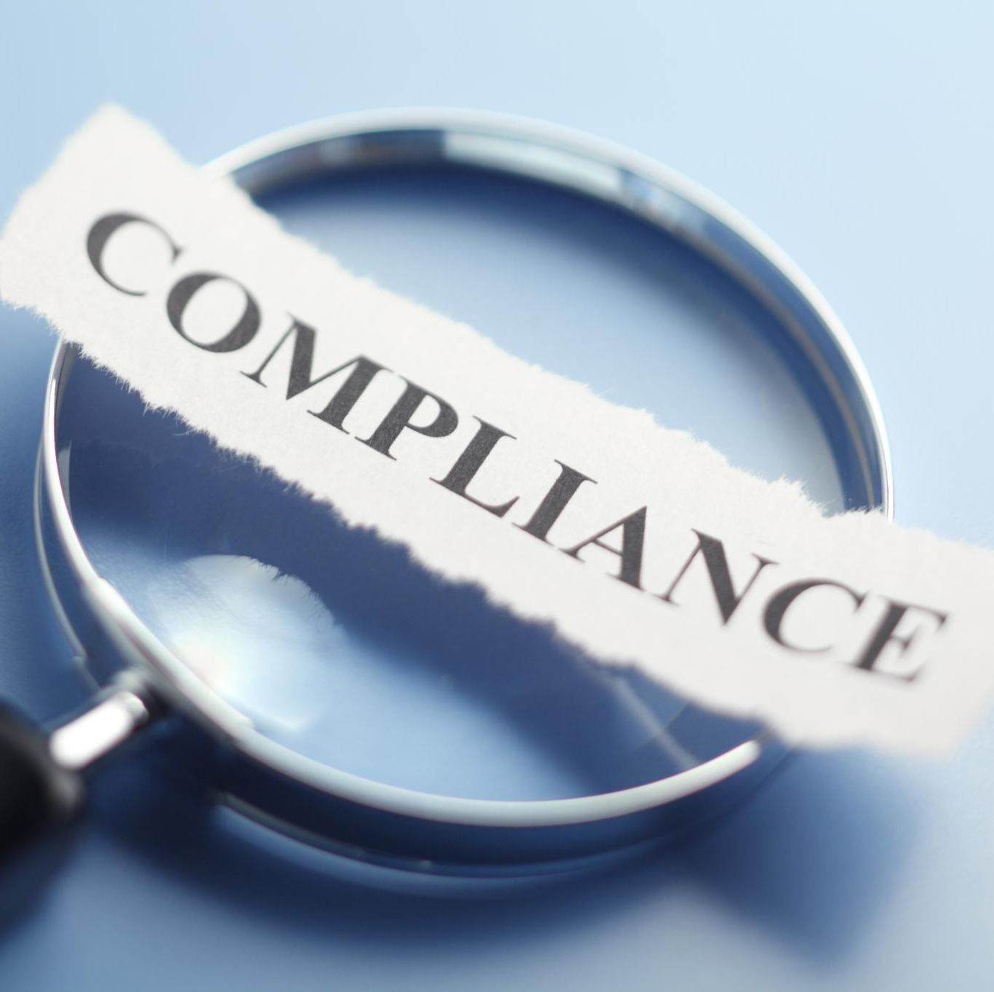
Support Tools and Guides
Official Guidance and Licensing Boards
  The U.S. Department of Education provides official guidance and maintains lists of state licensing boards for regulatory compliance.
Interstate Authorization Tools
  NC-SARA offers tools to help institutions understand and comply with interstate authorization requirements effectively.
Compliance Articles and Webinars
  WCET and SAN publish articles and webinars addressing emerging compliance challenges in higher education.
Best Practices for Licensure Disclosures
  The NASASPS Best Practices Guide provides effective strategies for transparent licensure disclosures.
Notes:
A variety of resources are available to support higher education compliance efforts. The U.S. Department of Education provides official guidance and lists of state licensing boards. NC-SARA offers tools for understanding interstate authorization requirements. WCET and the State Authorization Network (SAN) publish articles and webinars on emerging compliance issues. The NASASPS Best Practices Guide outlines effective strategies for licensure disclosures. These resources help institutions stay informed about regulatory changes, develop internal policies, and train staff on compliance responsibilities. Leveraging these tools is essential for maintaining transparency and avoiding penalties.

Slide 17
SARA Professional licensure directory
NC-SARA maintains the Professional Licensure Directory, which provides contact information for five programs that lead to a professional license. These programs have the most enrollments per the data provided by SARA participating institutions.
    Counseling
    Nursing
    Psychology
    Social work
    Teacher Education
This resource does not house regulations or requirements; it is exclusively general contact information. Students may find this contact information helpful in their research on state licensure requirements in their locations. NC-SARA updates the contact information twice annually.

Slide 18
Resources on sara website
Professional and Occupational Licensure Disclosures Best Practices Guide: NASASPS Best Practice Guide.docx.pdf - Google Drive
SARA Quick Start Guide: SARAQuickStart_ProfessionalLicensureDisclosures.revised.11.20.24.pdf
Federal and State Requirements for Professional Licensure: A Workshop for Higher Education Institutions & States (webinar & slides):Federal and State Requirements for Professional Licensure: A Workshop for Higher Education Institutions & States | NC-SARA

Slide 19
US Department of Education
Resources
List of State Licensing Boards:
Professional Licensure | U.S. Department of Education
Certification Procedures - Questions and Answers:
Certification Procedures - Questions and Answers | U.S. Department of Education
Source: Ready or Not, Here It Comes! New Regulations When Offering Programs Leading to a License Effective July 1! - WCET

Slide 20
Other resources
Thompson Coburn LLP
Newsroom | U.S. Department of Education
Alabama Board of Nursing FAQs
NCSBN 2023 Education Survey
Board meeting minutes and policy manuals
Legal research tools
  Lexis+, West Law
Software

Slide 21
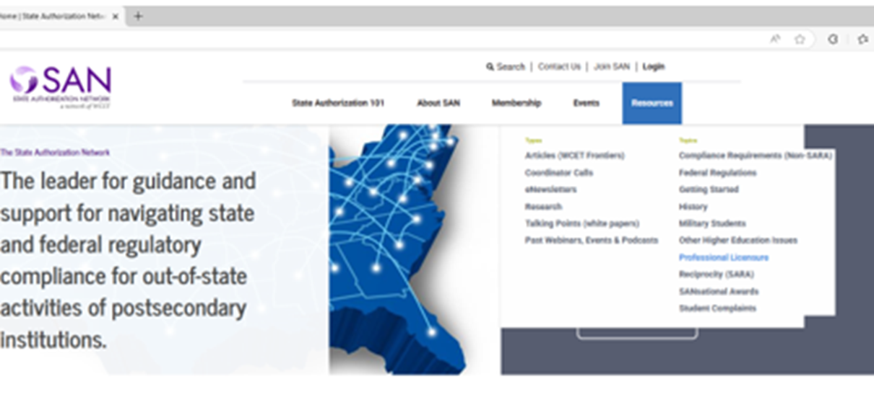
State authorization network (SAN)
Notes:
On the resulting page, scroll to the bottom of the page to “Latest Resources”
Note: Some resources are only available to SAN members.

Slide 22

Institutional Support
Primary Compliance Contact
Coordination and Liaison
Accountability
Notes:
For further assistance with compliance matters, institutions should designate a primary contact person responsible for regulatory adherence. This individual should be knowledgeable about federal and state requirements, coordinate with academic and administrative departments, and serve as a liaison with external agencies. Contact details should include the compliance officer’s name, email address, and phone number. Providing clear and accessible contact information ensures that students and staff can reach out with questions or concerns, fostering a culture of accountability and support within the institution.

Slide 23
Individualized/Direct Disclosure Checklist
Primary Compliance Contact
Your institution has designated a primary contact to oversee regulatory adherence and coordination.
  The contact has administration’s backing for enforcing the requirement.
  The contact has worked with faculty and staff to determine which programs do and do not lead to licensure in all states.
  The contact has informed all applicable faculty and staff of the requirement, its importance, and, if necessary, created a “elevator speech” for them to use when communicating to students.
Coordination and Liaison
Coordinates with academic and administrative departments and liaises with external agencies.
The contact keeps up with any changes to the regulation and updates faculty and staff of changes as needed
Accountability and Support
Faculty and staff have a hard copy of the communication via email to students.
The institution has a trigger in its Learning Management System (Canvas, etc.) for preventing students from enrolling if one’s program does not meet the student’s home state’s requirements
OR It provides an attestation to the student for completion and submission prior to enrollment.

Slide 24
EXAMPLES of Disclosures
Notes:
Faulkner University – Breanna

Slide 25

Takeaways
Determine who is responsible for compliance
Involve faculty; they have the expertise
Determine which programs do and do not lead to licensure in all states.
Review program and course descriptions
Have a single landing page for all disclosures
Those communicating with prospective and enrolled students should have an “elevator speech” to use.
Staff need to be trained on what not to say
Notes:
Case studies from institutions such as Jefferson State Community College, Auburn University, and Faulkner University provide valuable insights into effective compliance practices. These examples showcase how institutions implement public and direct disclosures, align academic programs with licensure requirements, and communicate with students about regulatory obligations. By examining these real-world applications, institutions can learn strategies for improving their own compliance processes. Each case highlights the importance of collaboration between academic departments, compliance officers, and IT systems to ensure accurate and timely disclosures.

